Slide 1
Capacity to Consent to Sexual Activity
David Godfrey
Senior Attorney
ABA Commission on Law and Aging

Slide 2
Disclaimer
This is not legal advice and should not be relied on.
The law varies from state to state, consult attorneys in your state
The opinions expressed are mine, and may not reflect the opinion or policy of the American Bar Association.

Slide 3
What Is Capacity
“the ability to do something : a mental, emotional, or physical ability”

Slide 4
Tell me More!
The ability to understand,
Including risks and benefits,
Make a choice,
Communicate the choice.

Slide 5
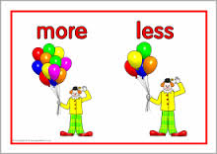
More than, Less than
More Than
Less Than
Being able to say yes
Not saying no
Being able to justify the choice
Being able to explain in detail

Slide 6
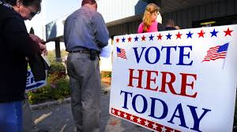
What Capacity is Not
A requirement to act in one’s best interest
A requirement to make the choice that other’s think you should make
A requirement to be able to justify the choice you are making

Slide 7
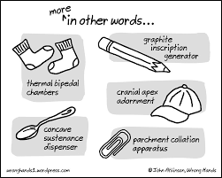
Volition – Center for Practical Bioethics
A resident’s clear, unequivocal, unforced willing participation in an intimate relationship or sexual activity.
Freedom from coercion is a trait of volition.

Slide 8
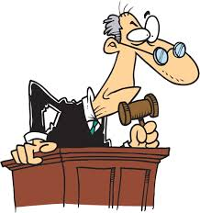
Sexual Contact without Consent is a Crime
All states recognize spousal or marital rape as a crime
Minors are deemed “incapable of consent” without regard to individual abilities – until the age of consent
Sexual contact with a person who is unconscious is a crime

Slide 9
Red Flags
Sexual contact with staff or care providers – automatic NO
Any significant imbalance within the relationship - not an automatic No but a caution.

Slide 10
No universally Accepted Criteria
For most adults capacity can be safely assumed
For persons with advanced dementia, significant developmental concerns or serious mental illness capacity should not be assumed

Slide 11
1: Knowledge of Relevant information – including risks and benefits
Potential risks
The right to say no
The ability to end a relationship

Slide 12
2: Understanding or Rational Reasoning that reveals a decision is consistent with the individuals values
Past behavior
Values
Beliefs
If inconsistent – can the person describe reasoning for the change

Slide 13
3: Voluntariness
Not coercion,
Unfair persuasion, or
Inducement
Differences in capacity, raises a risk

Slide 14
Privacy
Privacy is essential
Information
Space
Guardians –need to be involved – if the guardianship order includes personal decisions – NGA standards – Guardian shall assure consensual – ensure safety and health
Other fiduciaries – ?

Slide 15
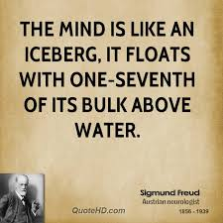
When in doubt
Ask for a professional assessment by a psychologist or psychiatrist

