Slide 1
Consumer Voice Conference
Bringing Geriatric-led Care to
Long-Term Care
Deanna Larson, CEO Avera eCARE
Notes:
Title slide for eCARE Overview

Slide 2
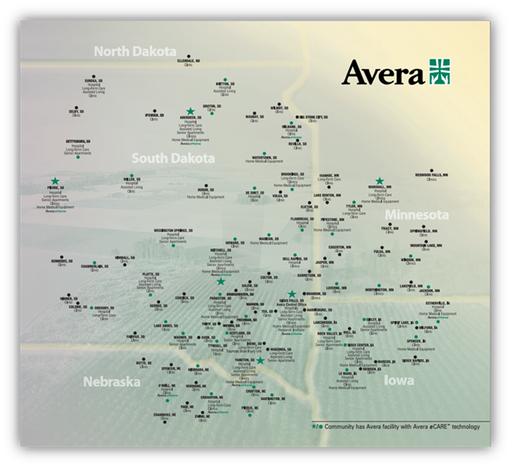
BACKGROUND
Avera Health
Avera is a health ministry rooted in the Gospel. Our mission is to make a positive impact in the lives and health of persons and communities by providing quality services guided by Christian Values.
Notes:
Mission
Our mission and summary of our history.

Slide 3
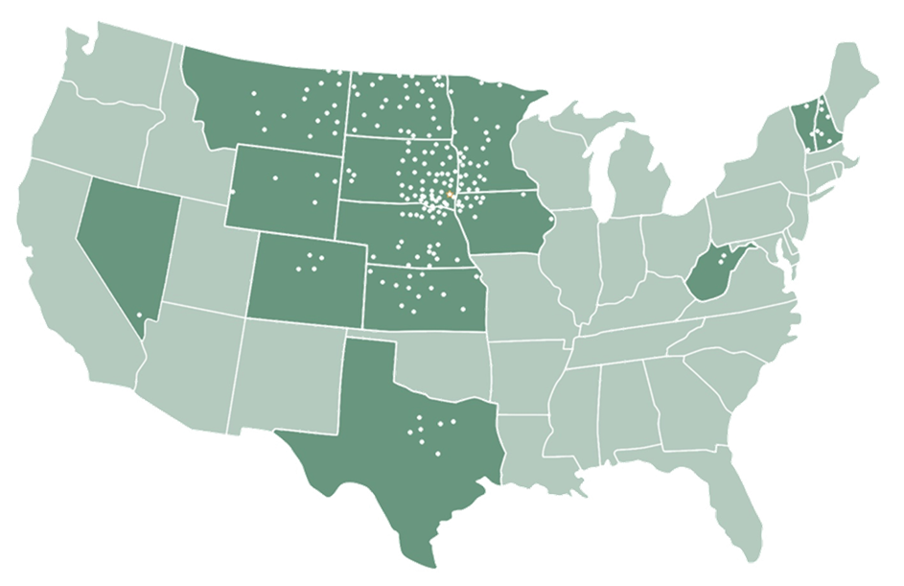
ABOUT US
Avera eCARE
350+ Sites
14 States
Serving 13% of Critical Access Hospitals (170/1332) in the United States

Slide 4
ABOUT US
Avera eCARE
Acute & Post Acute
Ambulatory
150
Sites
36 Sites
101
Sites
55
Sites
4 Sites
1 Site
1 Site
190 Sites
13
Sites
8469 Enrollees
Emergency
Senior Care
Hospitalist
AveraNow
ICU Care
Consult
Pharmacy
Correctional Health
Behavioral Health
School Health
Specialty Clinic
Oct. 2009
Aug. 2004
Nov. 2008
Jan. 2012
Apr. 2012
2017
2017
Nov. 1993
Mar. 2015
Jul. 2015
2017

Slide 5
OUR JOURNEY
Vision for Telemedicine
Telemedicine is Healthcare –
Needs to be integrated, not separated
Workforce Sustainability -
Recruitment & retention
Quality Access to Care –
Extend expertise & resources
Research
Investment – Educate and inform on telemedicine

Slide 6
OUR JOURNEY
eCARE’s Impact
Saving
Lives
Reducing
Costs
Improving
Workforce
Impacting
Communities
Notes:
Share the major milestone’s with the development of eCARE and how Avera grew a virtual hospital.

Slide 7
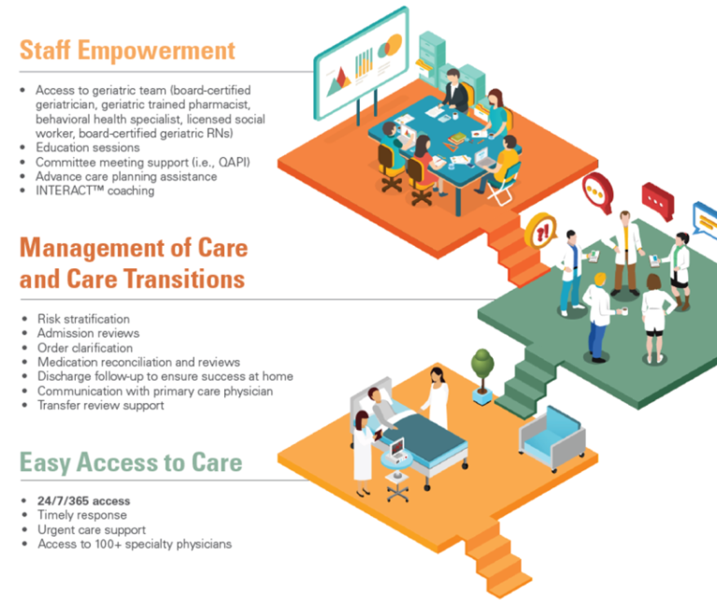
AVERA eCARE
Model of Senior Care
Notes:
Show the model of care and describe how eCARE works

Slide 8
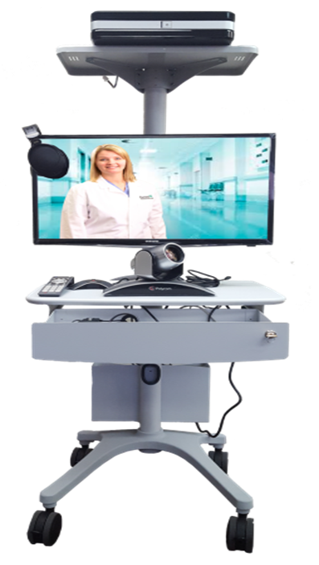
AVERA eCARE
Senior Care Equipment
Notes:
Show the model of care and describe how eCARE works

Slide 9
AVERA eCARE
Changing Expectations for LTC
Increasing Aging Population
Improving quality & decreasing costs
Staffing shortages
Sicker residents & higher acuity
Reimbursement
Specialized geriatric care needed
Pressure to reduce ED transfers
Multiple preferred partners

Slide 10
INDUSTRY CHALLENGES
Senior Population
15%
50%
Older adults constitute 15% of the population
Older adults constitute ~50% of health care costs
Notes:
U.S. Department of Health and Human Services. (2014). A Profile of Older Americans. https://aoa.acl.gov/aging_statistics/profile/2014/docs/2014-profile.pdf. Washington, DC.

Slide 11
INDUSTRY CHALLENGES
Hospitalizations
5 Million Hospitalizations Annually
46% Avoidable
Each hospitalization costs an average of $11,255 or
$15 Billion annually
Notes:
Acello, Barbara. Ending Hospital Readmissions: A Blueprint for SNFs. HCPro. March 2011.

Slide 12
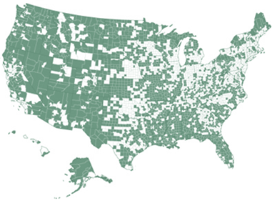
INDUSTRY CHALLENGES
Physicians
By 2020, the U.S. will be lacking:
45,000 primary care physicians
46,100 surgeons and medical specialists
20%
…of Americans older than 65 see 14 or more physicians and average 40 physician visits per year
One Geriatrician for every 2,200 elders
Geriatric-Led Care Results:
133 Fewer ER visits per 1,000
10% Reduction in cost of care per year
Notes:
The American Geriatrics Society. The Demand for Geriatric Care and the Evident Shortage of Geriatrics Healthcare Providers. http://www.americangeriatrics.org/files/documents/Adv_Resources/demand_for_geriatric_care.pdf. March 2013.¹
Marquez, Len. Physician Shortages to Worsen Without Increases in Residency Training. AAMC. https://www.aamc.org/download/150584/data/physician_shortages_factsheet.pdf. ²

Slide 13
INDUSTRY CHALLENGES
Census Mix
Medicaid
(55-57%)
Private Insurance
(27-29%)
Medicare
(12-14%)
Notes:
?Reference

Slide 14
LONG-TERM CARE
Impact of eCARE – Senior Care
Nursing Staff/Facility Impact
Physician Impact
Resident Impact
Increased access to urgent care services
Timeliness of care
Reduced re-hospitalizations
Reduced unnecessary ER visits
Nursing staff recruitment, satisfaction, and decreased turnover
Resident and family satisfaction
Decrease transportation costs
Decrease pharmacy costs
Maintain census
Higher acuity patients
Preferred partnerships (Medicare Advantage, ACO, Bundles, Post Acute Discharges)
Decrease in paperwork, phone calls, and faxing
Communicate with PCP when intervention occurs

Slide 15
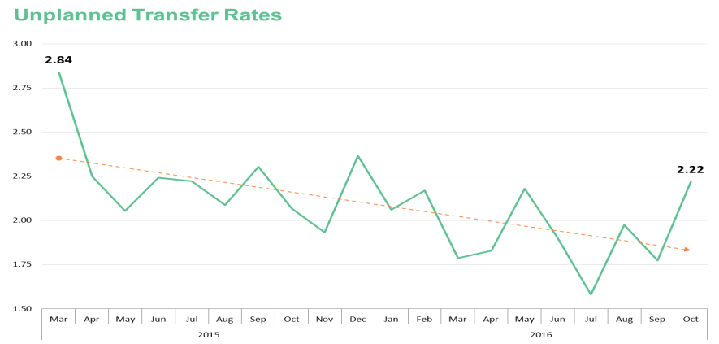
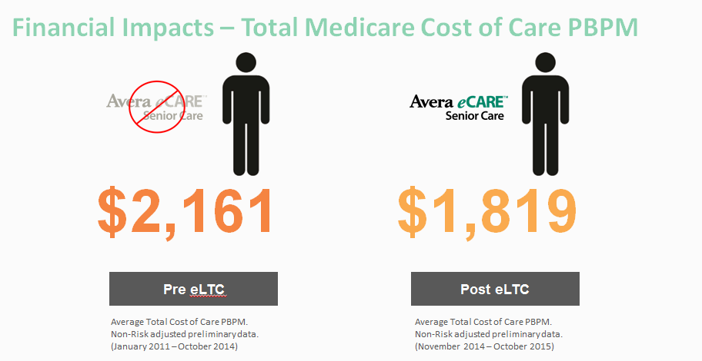
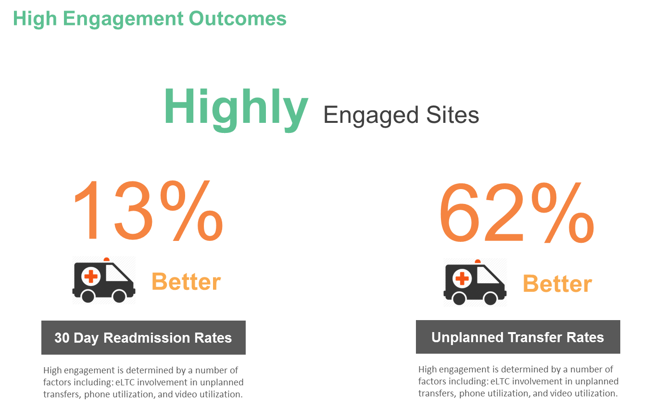
Using CMMI HCIA Innovation to Transform Long-Term Care
Definition: Represents the monthly rate of unplanned transfers to the ED/Hospital per 1000 resident days.
Analysis: Positive trends in unplanned transfers since March 2015.
The project described was supported by Grant Number 1C1CMS331325-01-00 from the Department of Health and Human Services, Centers for Medicare & Medicaid Services. The contents of this publication are solely the responsibility of the authors and do not necessarily represent the official views of the U.S. Department of Health and Human Services or any of its agencies. The research presented here was conducted by the awardee. Findings might or might not be consistent with or confirmed by the independent evaluation contractor.

Slide 16
eCARE SENIOR CARE
Resident Impact
7,100 Residents Impacted
$342
Estimated Medicare Cost Savings PBPM

Slide 17
eCARE SENIOR CARE
Solutions to Improving Care in SNF
Payment Structure
Aging Population
Physician-Focused Payment Model Technician Advisory Committee (PTAC)
By 2050, 1/5 of the total US population will be elderly* - extends access & coverage to services
Innovation
Access to Geriatricians
Centers for Medicare & Medicaid Innovation awarded eLTC $8.8M
Lack of access attributes to only
One Geriatrician for every 2,200 elders
*Congressional Budget Office
https://www.cbo.gov/publication/44363

Slide 18
DISCLAIMER
Funding Opportunity
Notice/Acknowledgement
The project described was supported by Grant Number 1C1CMS331325-01-00 from the Department of Health and Human Services, Centers for Medicare & Medicaid Services. The contents of this publication are solely the responsibility of the authors and do not necessarily represent the official views of the U.S. Department of Health and Human Services or any of its agencies. The research presented here was conducted by the awardee. Findings might or might not be consistent with or confirmed by the independent evaluation contractor.
Notes:
Josh

Slide 19
Thank You!
Deanna Larson
Avera eCARE Chief Executive Officer
Deanna.Larson@avera.org
For more information, please visit: www.averaecare.org

