Slide 1
Nursing Homes and Long-Term Care Reform
Elizabeth Blair
Center for Elder Care and Advanced Illness
Altarum Institute
Elizabeth.blair@Altarum.org

Slide 2
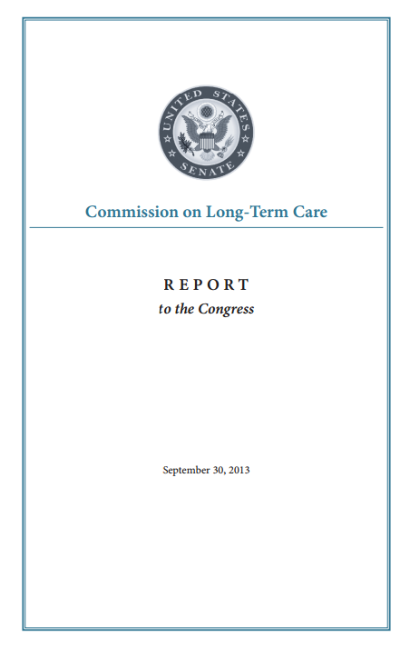

Slide 3
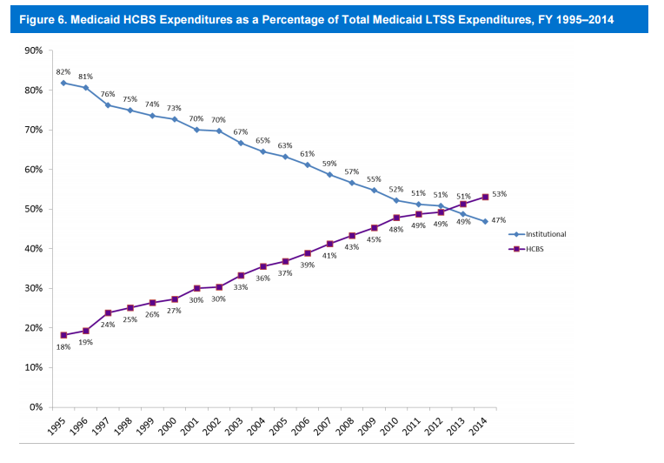

Slide 4
Older Adults Using LTSS
Notes:
If you’re just looking at older people and people with physical disabilities, we are at about 40% spending on hcbs, with 50% of older adults with disabilities receiving institutional care
Recent Kaiser survey of Medicaid programs across states found that Nineteen (19) states in FY 2016 and 18 states in FY 2017 report they include or will include specific rebalancing incentives (performance targets and/or financial incentives) in managed care contracts to encourage MCOs that cover LTSS to expand access to HCBS
41.6% of nursing home residents are over the age of 85 , and people over the age of 85 are the fastest growing demographic
From KFF:
In 2015, all states reported using cost controls in § 1915 (c) waivers, such as restrictive financial and functional eligibility standards, enrollment limits, or waiting lists. About 25 percent of § 1915 (c) waiver programs used financial eligibility standards that were more restrictive than those used to determine eligibility for Medicaid coverage for institutional care. However, six § 1915 (c) waivers used more restrictive functional eligibility criteria than those used for institutional care. More than one half of states offering personal care state plan services (59%, or 20 states) had some form of cost controls in place, with the majority utilizing service unit limitations. Over half of states (59%, or 30 states) had some form of expenditure or service restriction in place in their home health state plan programs.
In 2015, more than 640,000 people were on 133 § 1915 (c) waiver waiting lists, and the average waiting time exceeded two years. The growth in the number of people on waiting lists grew by 10 percent from 2014 to 2015, outpacing the growth rate of 8.5 percent in the previous period.

Slide 5
Current Directions
CMS Regulations strongly emphasize person-centeredness
Potential convergence on LTSS Financing
Notes:
“to focus on the resident as the locus of control and support the resident in making their own choices and having control over their daily lives”
that the resident has the right to participate in the care planning process, including the right to identify individuals or roles to be included in the planning process, the right to request meetings and the right to request revisions to the person-centered plan of care.

Slide 6
Not Just Aging in Place, But Aging with Options
Affordable housing is scarce
Most housing isn’t suitable for people with disabilities
Harvard Joint Center for Housing Studies reports that only 57% of homes have more than one feature of universal design
Only 1 percent of houses today have the five features necessary for universal design.
Notes:
Challenge of culture change is respond to OBRA 87 and Olmstead
Bipartisan Policy Center’s report on Housing referred to this as a shift from aging in place to aging with options
--means we’re going to see a wider variety of settings including congregate housing plus services
Look at NH final reg
Examine and analyzed, care plans should reflect what they want
Nursing home services into different forms of housing
Movement towards congregate settings that aren’t nursing homes—hoursing plus services
most housing stock isn’t suitable for people with disabilities
Person-Centered Care: Person-centered care means to focus on the resident as the locus of control and support the resident in making their own choices; having control over their daily lives

Slide 7
Conclusions
Nursing homes should not be left behind
Culture change can help nursing homes meet the challenges of OBRA ’87 and Olmstead
We would benefit from a demonstration to help understand how culture change could be implemented and evaluated

