Slide 1
Lift Up Your Voice! for Quality Care and Better Health
Consumer Voice Conference | November 7, 2017 | Arlington, Virginia
Rosa Palacios, Consumer Engagement Advisor
Carol Regan, Senior Advisor

Slide 2
Workshop Objectives
Participants will gain an understanding of the work of the Center for Consumer Engagement in Health Innovation, including the Lift Up Your Voice! Advocacy Training.
Participants will be offered specific strategies and tools for getting engaged.
Participants will develop a powerful statement that conveys their individual story.

Slide 3
About the Center
State and Local Advocacy
Leadership in Action
Research and Evaluation
Support Services to Delivery Systems and Health Plans
Federal Advocacy
Focus on Vulnerable Populations

Slide 4
Lift Up Your Voice! Advocacy Training Program
Educate
The Health Care System
What is Advocacy?
Who are the Decision makers and What Motivates Them?
Empower
The Power of Your Personal Story
Building Your Influence
Engage
Skill-building

Slide 5
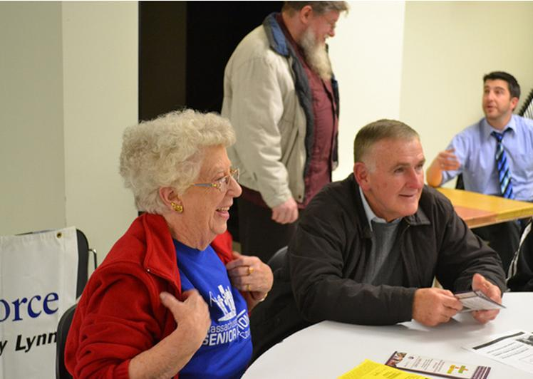
Lift Up Your Voice! Advocacy Training Program

Slide 6
Shining the Light Activity

Slide 7
Along my health care journey….

Slide 8
Story Telling- The Power of Your Story

Slide 9
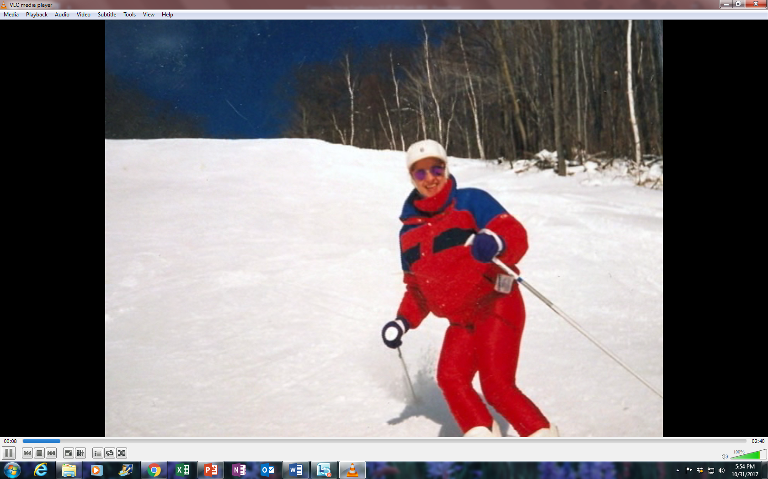
Ginny’s Story

Slide 10
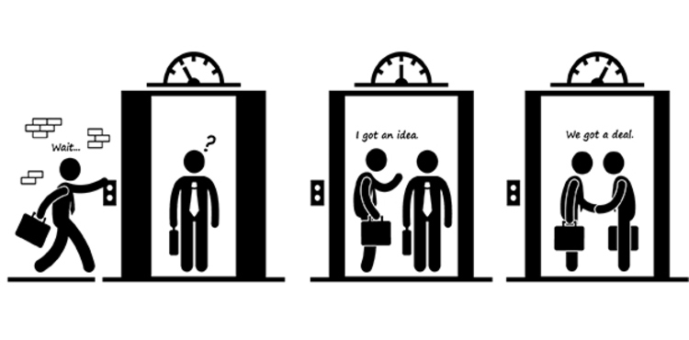
The 27-9-3- How to…
Notes:
An “elevator pitch” is a message brief enough that it could be delivered in the time it takes to ride an elevator with someone.
The 27-9-3 “Elevator Pitch” is a user-friendly process for creating messages that will engage key stakeholders and decision-makers.

Slide 11
The Five Questions
But before you craft a message, first answer 5 key questions...
Who is the audience?
What might appeal to their self-interest?
What do you want them to think or understand?
How do you want them to feel?
What do you want them to do?
Notes:
The process start with five questions:
Who is the audience for your particular message?
2) What might appeal to their direct self-interest?
What’s in it for them?
Why should they care?
3) What do you want your audience to think or understand about your issue?
4) How do you want them to feel about what you have said?
5) What do you want them to do after they hear your message?
Now you’re ready to craft your message using the 27-9-3 Rule.

Slide 12
27-9-3 Example
Cardiac arrest kills 250,000 people yearly.
In 2001, one of these people was my husband Joel.
If an AED had been available, it could have saved his life. (27 words)
Notes:
Created by some Vermont lawmakers several years ago, the 27-9-3 rule requires you to make your persuasive point in no more than 27 words within a time frame no longer than 9 seconds with no more than 3 points discussed.

Slide 13
Another Example
My son Jake is a cardiac miracle. But medical debt from co-pays, deductibles, and out of pocket costs strained our finances, our marriage, and our children’s lives (27 words)

Slide 14
Let’s Practice!

Slide 15
Telling Your Story!
Notes:
Practice saying it out loud to someone and invite their feedback.
Your statement may sound very different than it reads and most messages will be spoken, so you want to make sure your message actually sounds like something you would say out loud to another human being in person or leave on a voicemail!
Revise based on feedback.

Slide 16
THANK YOU!
Rosa Palacios
rpalacios@communitycatalyst.org
Carol Regan
cregan@communitycatalyst.org
Visit us on the Web! healthinnovation.org Follow us on Twitter! @CCEHI

