Slide 1
Division of Nursing Homes
LTC Survey Process/Phase II
Consumer Voice
November 7, 2017

Slide 2
Agenda
New Survey Process
Phase II Interpretive Guidelines
Emergency Preparedness
Enforcement / Q & A

Slide 3
Long Term Care Survey Process (LTCSP)
Begins November 28, 2017 (includes Phase 1 and 2 requirements)
Lessons learned from the Traditional and Quality Indicator Survey (QIS) processes
  Best practices and opportunities for improvement
  Identified slightly different quality of care/quality of life issues
  Flexibility vs. prescriptiveness
  Computer-aided vs. paper-based
Integrate finalized Requirements for Participation
Notes:
These are technical reasons for why we are implementing a new survey process. But the higher level objective is to improve the process of ensuring residents’ needs are met, that they are kept safe, and about to attain or maintain their highest practicable well-being. We want to identify any issues that have led to harm or could lead to harm, and if we don’t see any issues, have a high level of confidence that residents are truly safe when we walk out the door.

Slide 4
Survey Process Overview
Entrance Process
Sample Selection (size based on census)
    70% offsite
    30% selected onsite by team
    Screens → Initial Pool → Final Sample
Facility Tasks and Closed Record Reviews
Investigations
  All concerns for sample residents requiring further investigation

Slide 5
Entrance Conference
  Census and list of all residents, with identification of new admissions
  Documents
    Previous process (e.g., floor plan, CMS 671/672, etc.)
    Policies and Procedures
    New requirements (QAPI plan, Facility Assessment)
  Meal and medication administration times
  Access to Electronic Health Records
  Updated facility matrix

Slide 6
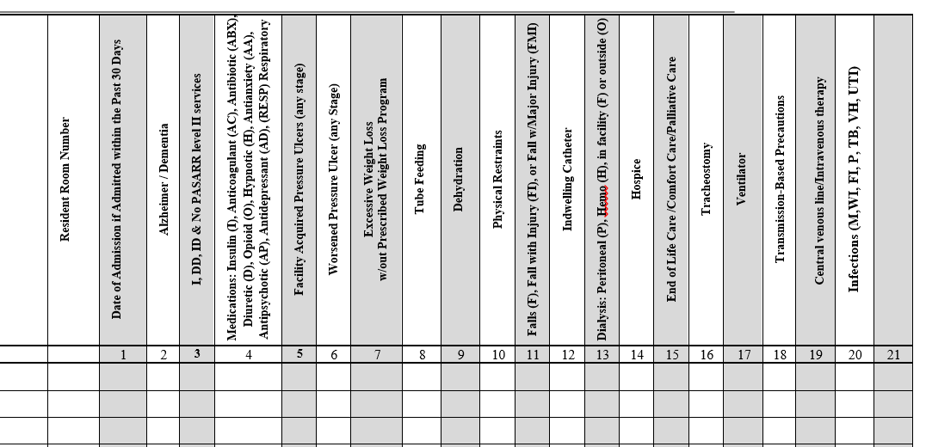
Facility Matrix

Slide 7
Sample Selection
Surveyors screen all residents in their assigned area.
Prioritize vulnerable residents, new admissions, complaints/facility reported incidents (FRIs), and other issues identified throughout the day.
Initial Pool: Conduct interviews, observations, and limited record review
  ~8 residents/surveyor
  Offsite, preselected residents
  Residents identified onsite as a result of screens (prioritized by new admissions, vulnerable residents)
  Facility Matrix used to identify other specific concerns(e.g., dialysis, hospice, smoking, ventilator, infection, etc.)
Final Sample:
  Based on facility census (~20%)
  End of day 1/start of day 2

Slide 8
Complaints & Facility Reported Incidents (FRI)
Policy:
  States may add up to five residents associated with a complaint or FRI
  If more than five residents are added to the sample, team size or survey time is extended
  Continuous monitoring and dialogue

Slide 9
Mandatory Facility Tasks
  Sufficient/Competent Staffing
  Infection Control
  Beneficiary Notices
  Dining Observation
  Medication Storage
  Medication Administration
  Kitchen Observation
  QAA/QAPI

Slide 10
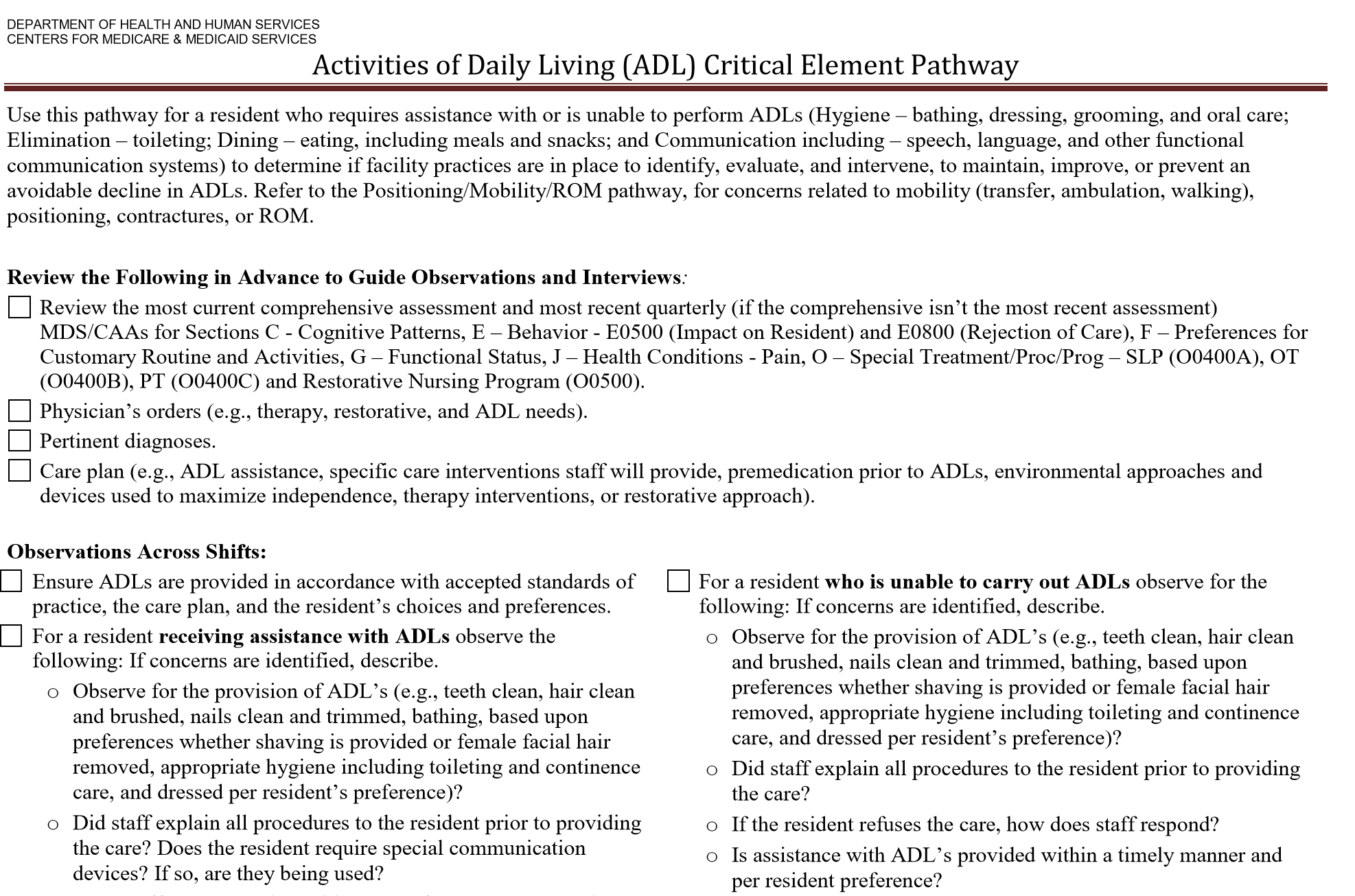
Areas where further investigation is needed
Notes:
Resident, Resident Representative, or Family Interview:
PT, OT, SLP, or Restorative Manager Interview:
Nurse or DON interviews: Nurse Aide
Record Review

Slide 11
Number of Surveyors & Time Onsite
Census | Sample Size | % of Census | # of Surveyors
< 48 | < 12 | > 25% | 2
49 - 95 | 13 - 19 | 20% – 27% | 3
96 - 174 | 20 - 34 | 20% | 4
≥ 175 | 35 | < 20% | 5
Survey time onsite is expected to be similar to current time spent onsite
Expect some lengthening while surveyors learn the new process
Number of surveyors and time onsite also impacted by other factors such as State licensure, facility history, or complaints
Continuous monitoring and dialogue
Notes:
One of the requests from SETI was to put forth an estimate of the number of surveyors needed and time onsite. This provides some estimates

Slide 12
Interpretive Guidelines (IG)
Revised format with consistent sections (e.g., Key elements of Non-compliance)
Revisions for phase 1 & 2 tags, and some existing tags where improvements were needed

Slide 13
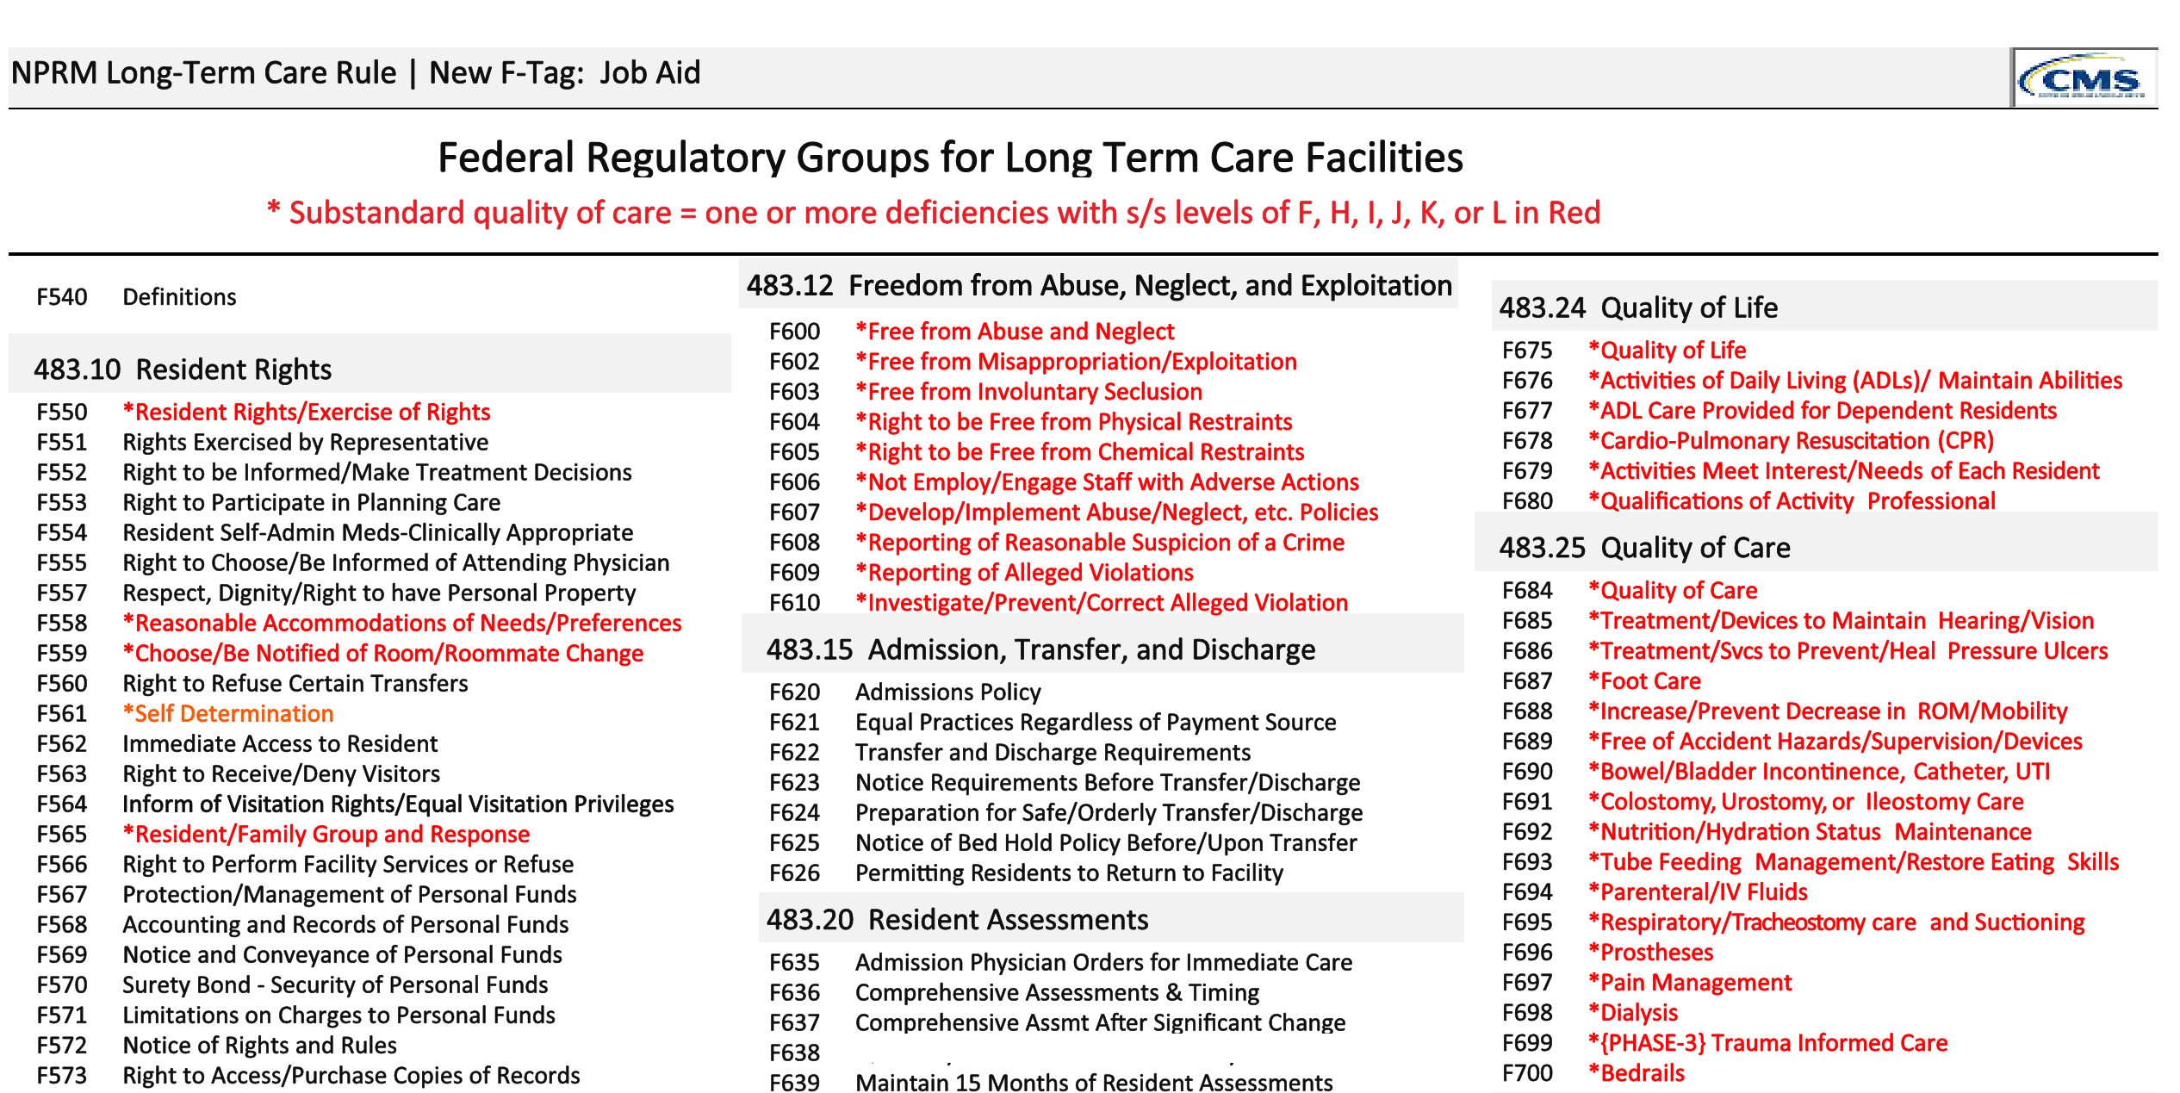
F-Tags

Slide 14
Facility Assessment
Intent: Facilities must know themselves, their residents, and their staff in order to determine needed resources and capabilities
http://qioprogram.org/facility-assessment-tool

Slide 15
Training
On-demand Training:
State management: Overview of new process and implementation
Subject Matter Expert Videos: Phase II Highlights
Provider Training – Overview of Survey process
Notes:
Surveyors will be instructed on the new software and able to practice on their own.
Training does not end when the class is over. It is on-going!

Slide 16
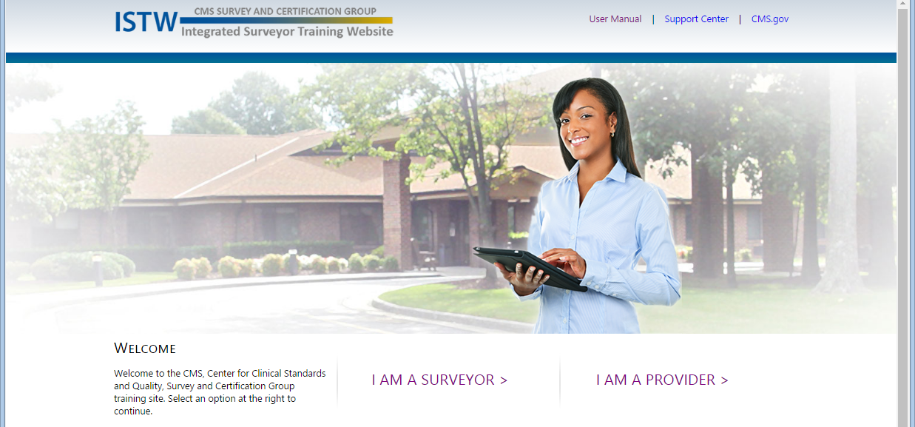
Integrated Surveyor Training Website

Slide 17
Provider Training
Training available through ISTW
Specific provider training
Survey documents
  Entrance worksheet
  Facility Matrix
  Procedure guide
Frequently Asked Questions

Slide 18
Resident and Family Information
Survey Process
Interviews/Observations
Record Reviews
Resident Council Interview
Information about New Regulations
LTCSP Initial Pool Care Areas

Slide 19
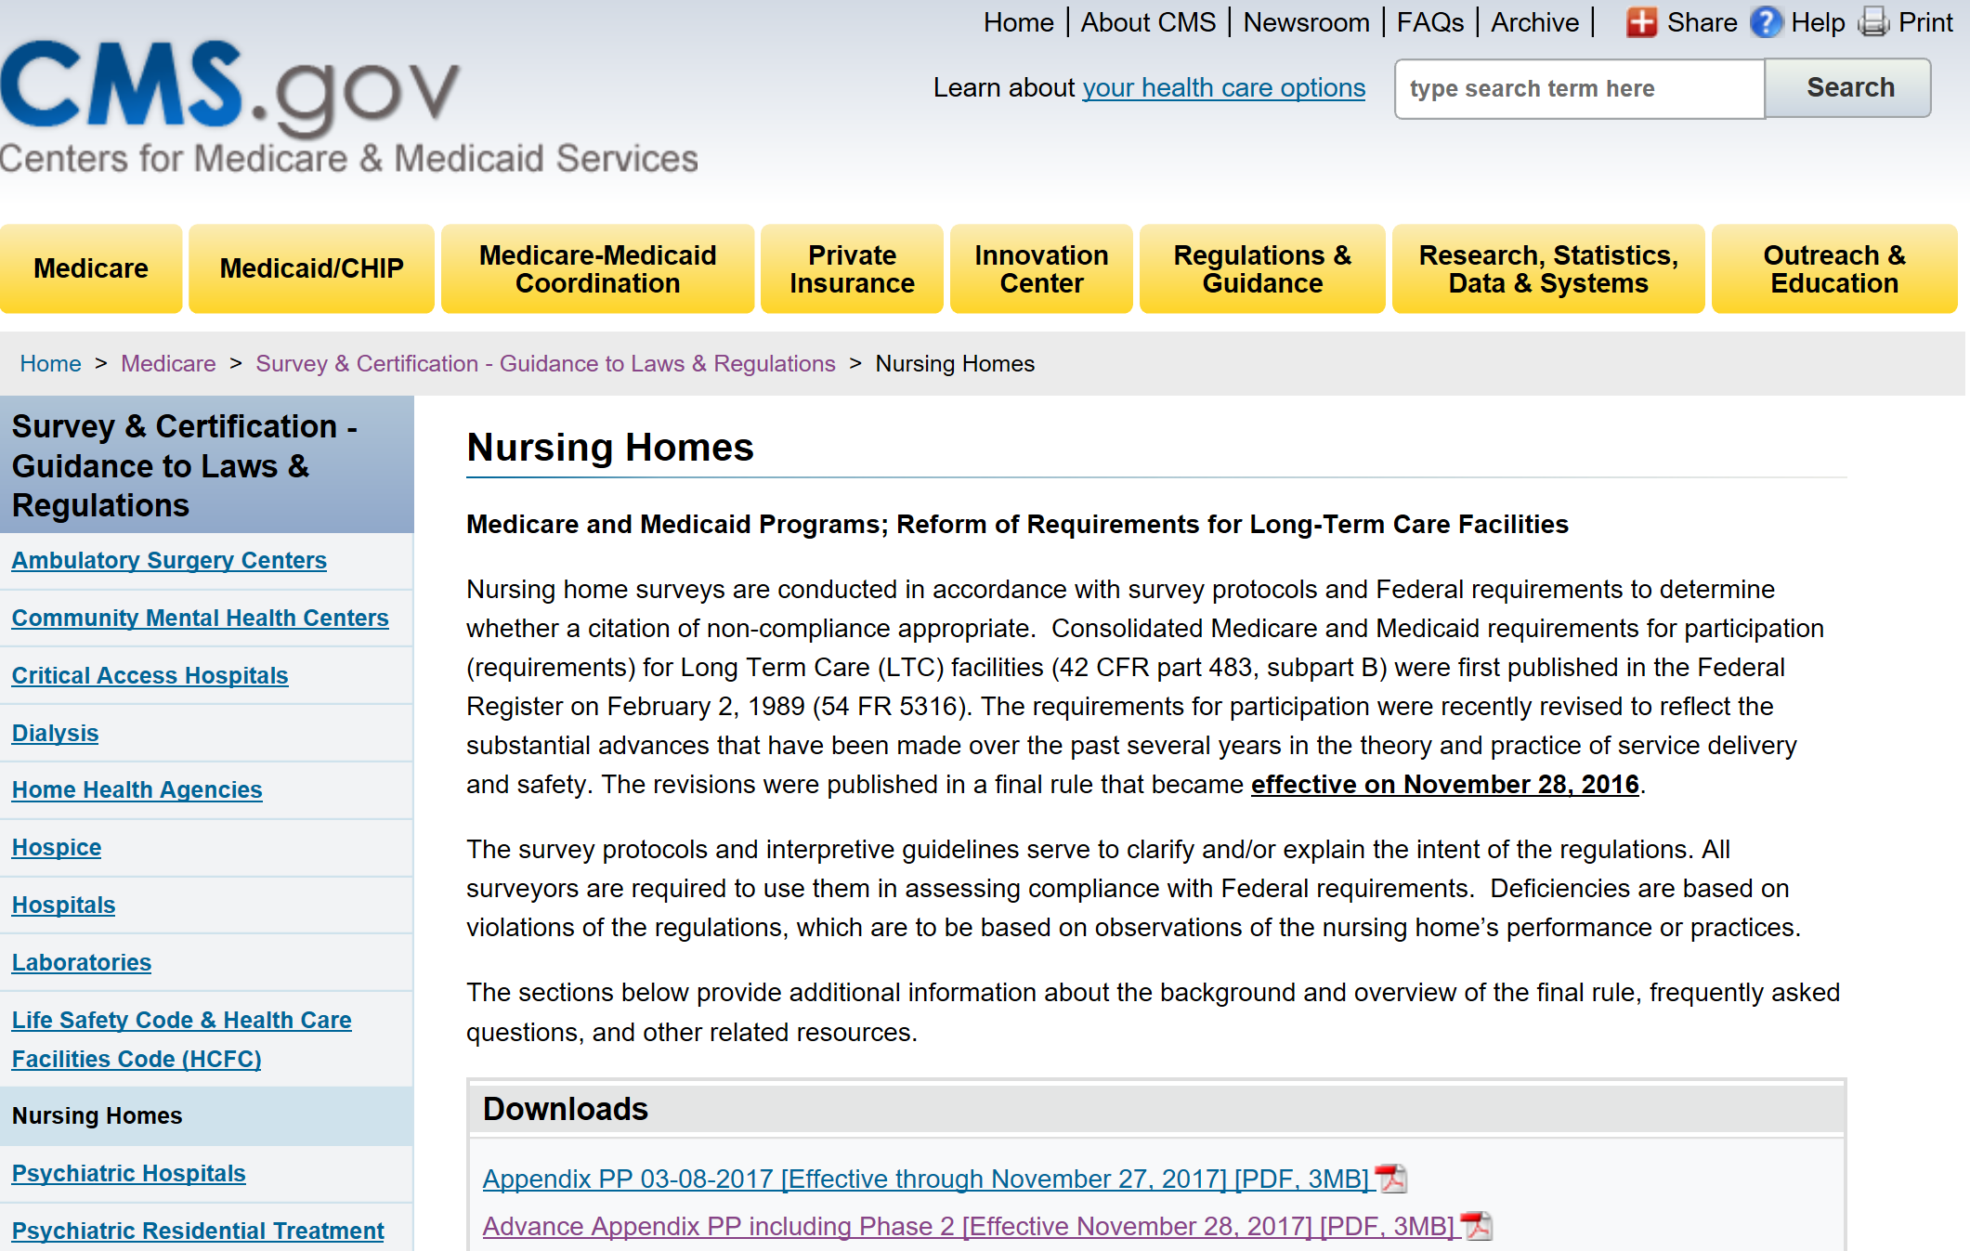
Information “hub”
https://www.cms.gov/Medicare/Provider-Enrollment-and-Certification/GuidanceforLawsAndRegulations/Nursing-Homes.html

Slide 20
Enforcement
Phase II Enforcement:
Focus on education for phase II requirements (e.g., facility assessment, antibiotic stewardship, etc.)
Surveys conducted between 11/28/17 and 11/28/18
Directed Plan of Correction, directed in-service training
Enforcement of Phase I requirements remains unchanged
Draft Immediate Imposition of Remedies Policy – Comments due 12/1
Release Waiver/Appeal of Disapproval of Nurse Aide Training Competency Evaluation Program (NATCEP)

Slide 21
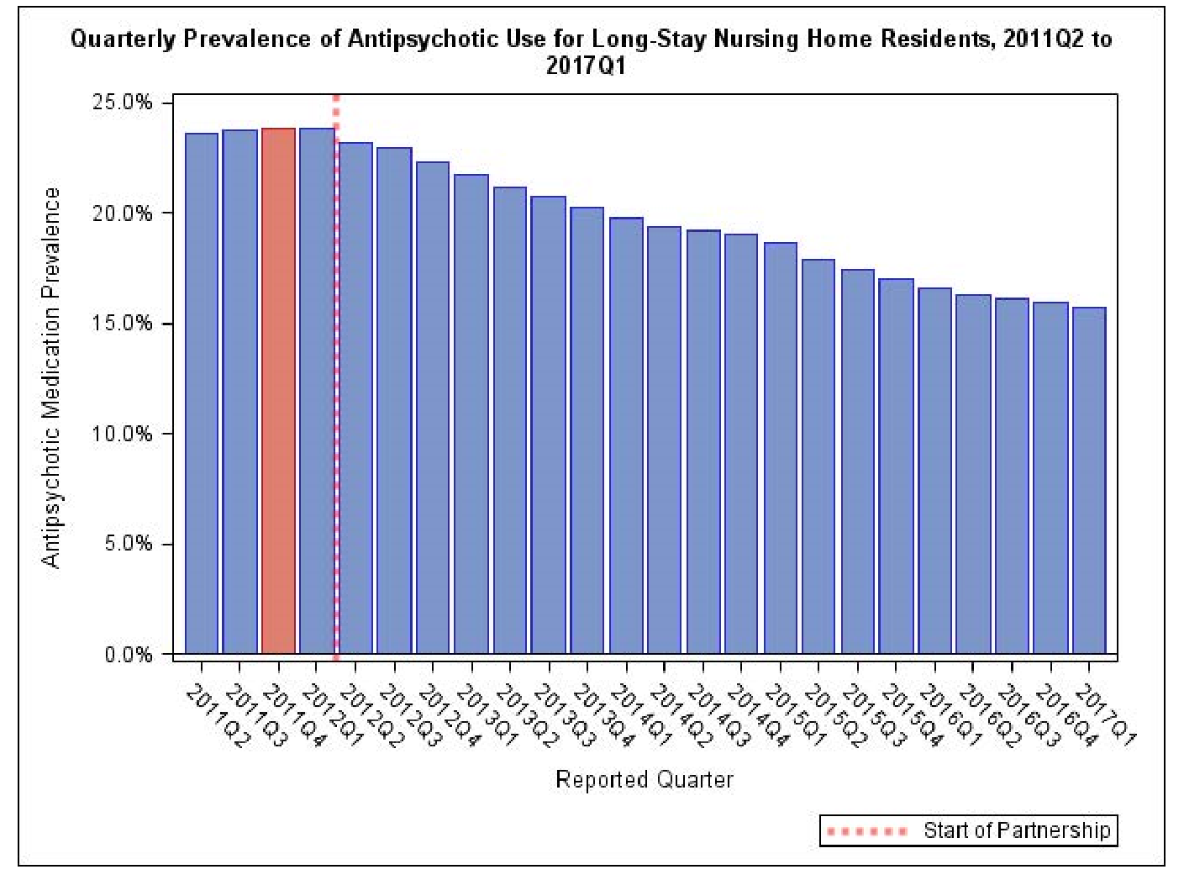
National Partnership to Improve Dementia Care
•
Notes:
2017 Q1 Long-Stay antipsychotic rate: 15.7%
• Reduction of 34.1% since program inception (2011 Q4)!
• Continued focus on improving dementia care: • New requirements (behavioral health services) • New goals • Focused surveys • Minimum Data Set assessment items (gradual dose reduction, position change alarms)

Slide 22
Emergency Preparedness
17 provider types
Effective November 15, 2017
Additional Requirement for Participation

Slide 23
Four Provisions for All Provider Types
Emergency Preparedness Program
Risk Assessment and Planning
Policies and Procedures
Communication Plan
Training and Testing

Slide 24
Risk Assessment and Planning
Develop an emergency plan based on a risk assessment.
Perform risk assessment using an “all-hazards” approach, focusing on capacities and capabilities.
Update emergency plan at least annually.

Slide 25
All-Hazards Approach:
An all-hazards approach approach to emergency preparedness planning
  focuses on critical capacities and capabilities
  full spectrum of emergencies or disasters, including internal emergencies and a man-made emergency (or both) or natural disaster.
  specific to the location of the provider or supplier and
  considers the particular type of hazards most likely to occur in their areas.
For example: care-related emergencies, equipment and power failures, interruptions in communications, including cyber-attacks, loss of a portion or all of a facility, and interruptions in the normal supply of essentials such as water and food.

Slide 26
All-Hazards Approach:
An all-hazards approach approach to emergency preparedness planning
  focuses on critical capacities and capabilities
  full spectrum of emergencies or disasters, including internal emergencies and a man-made emergency (or both) or natural disaster.
  specific to the location of the provider or supplier and
  considers the particular type of hazards most likely to occur in their areas.
For example: care-related emergencies, equipment and power failures, interruptions in communications, including cyber-attacks, loss of a portion or all of a facility, and interruptions in the normal supply of essentials such as water and food.

Slide 27
Fuel Bucket Line
Back-up generators in 13th floor but fuel pumps located in the flooded basement, requiring a bucket line up 13 flights of stairs.

Slide 28
Policies and Procedures
Develop and implement policies and procedures based on the emergency plan and risk assessment.
Policies and procedures must address a range of issues including subsistence needs, evacuation plans, procedures for sheltering in place, tracking patients and staff during an emergency.
Review and update policies and procedures at least annually.

Slide 29
Communication Plan
Develop a communication plan that complies with both Federal and State laws.
Coordinate patient care within the facility, across health care providers, and with state and local public health departments and emergency management systems.
Review and update plan annually.

Slide 30
Training and Testing Program
Develop and maintain training and testing programs, including initial training in policies and procedures.
Demonstrate knowledge of emergency procedures and provide training at least annually.
Conduct drills and exercises to test the emergency plan.

Slide 31
Temperature Controls and
Emergency and Standby Power Systems
Under the Policies and Procedures, Standard (b) there are requirements for subsistence needs and temperature controls.
Additional requirements for hospitals, critical access hospitals, and long-term care facilities are located within the Final Rule under Standard (e) for Emergency Power and Stand-by Systems.

Slide 32
Interpretive Guidelines
Released June 2, 2017
S&C 17-29
The IGs have been formatted into one new Appendix within the State Operations Manual (SOM) applicable to all 17 provider/supplier types
Appendix Z
https://www.cms.gov/Medicare/Provider-Enrollment-and-Certification/SurveyCertEmergPrep/index.html

Slide 33
Questions?

Slide 34
Thank You!

