Slide 1

Emergency Preparedness and Long Term Care
41st Annual Consumer Voice Conference
Monday, November 6, 2017

Slide 2
Emergency Preparedness and Long Term Care
Presenters:
Lori Smetanka, Executive Director, Consumer Voice
Patty Ducayet, Texas State Long-Term Care Ombudsman
Lisa Hayes, Managing Local Ombudsman, Houston-Galveston Area Agency on Aging
Michael Milliken, Florida State Long-Term Care Ombudsman

Slide 3
Emergency Preparedness (EP) and LTC Overview
Emergency preparedness and response guidance
CMS emergency preparedness rule for LTC facilities
Consumer Voice advocacy regarding emergency preparedness
Texas LTCOP’s experience with Hurricane Harvey
Florida LTCOP’s experience with Hurricane Irma
Emergency Preparedness resources
Questions

Slide 4
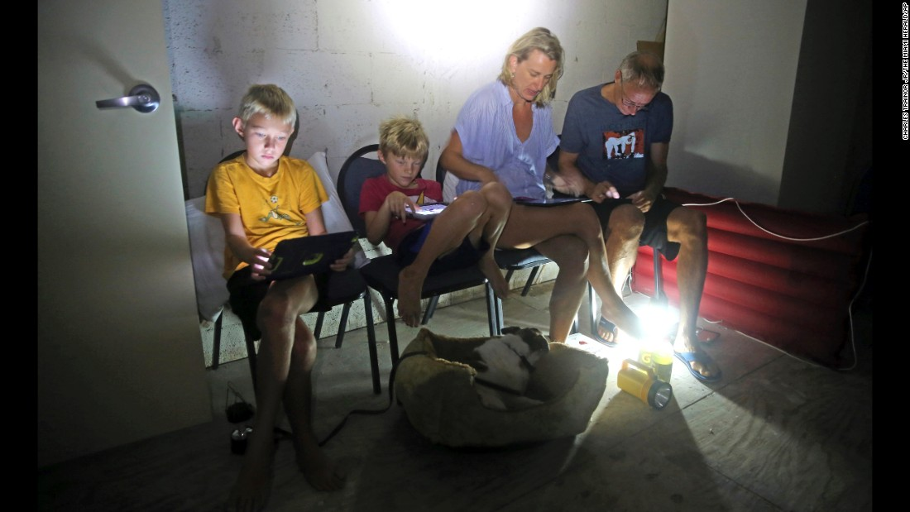
Emergency Preparedness – It’s Personal
Have a Plan
Practice the Plan
Communicate the Plan
ICE contacts
Supplies - food, water, medications, batteries, cash

Slide 5
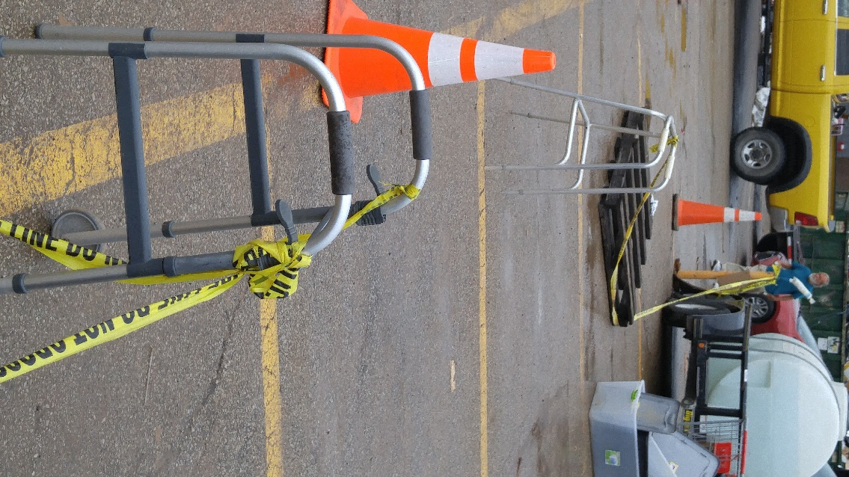
Emergency Preparedness for Residents of LTCFs
Residents should know:
Facility EP Plan
Practice Plan
Meet 1st Responders
Personal To-Go-Bag
ICE contacts

Slide 6
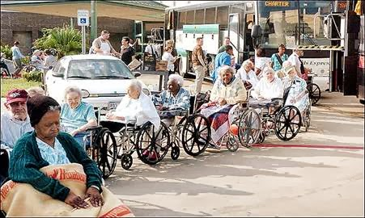
ACL Emergency Preparedness
LTCOP Model Policies and Procedures
Notes:
After Hurricane Katrina so many lives were lost and families were devastated in several states. The U.S. Office of Inspector General (OIG) has conducted at least two investigations into the response and failure of so many government agencies in providing adequate response and aide to citizens. The OIG report provided guidance and directives for in particular programs associated with the U.S. Health and Human Services. As a result the Administration for Community Living Office of the LTCOP offers guidance to state LTCOPs for development of emergency preparedness policies.

Slide 7
Model EP Policy
Functions & Responsibilities of EP by State & Local LTCO
Coordination & communications with others
Provision of LTCO services
Training on EP for LTCO
Resident & family EP education
Information & Consultation to facility providers
http://ltcombudsman.org/uploads/files/issues/EmResponse_ModelPPLTCO-11-23-15_Final.pdf
Notes:
Tips and expectations:
You and your family are personally prepared for emergencies.
The LTCO offices have emergency contingency plans.
Local LTCO & state LTCO coordinate all emergency response activities
Local LTCO learn of and participate in Health Care Coalitions led by Public Health or Emergency Preparedness coalitions led by local or regional emergency management agencies.
Ombudsman services to residents will vary based on the disaster. If local LTCO activities need to be adjusted to accommodate demand of work, discuss with the state LTCO.

Slide 8
CMS – Facility EP Responsibilities
CMS EP Final Rule implementation - November 15, 2017
Emergency plans based on risks assessments
Annual update of emergency plan
EP policies and procedures & update annually. Includes requirements for subsistence needs and temperature controls.
Communications plan
Training plan & provide training at least annually
Conduct drills and two exercises. One community based, full-scale exercise and one optional full scale or tabletop exercise.
Emergency and Standby Power Systems

Slide 9
Consumer Voice Advocacy
How will the regulations be implemented and enforced?
  Discussions with CMS
Are additional legislative options or solutions necessary?
  Research and support for members on the Hill
  Development of policy options
Consumer education, awareness
  Articles, media
Are there ways to support state efforts, advocacy?
  NORC Project with Alaska & Colorado

Slide 10
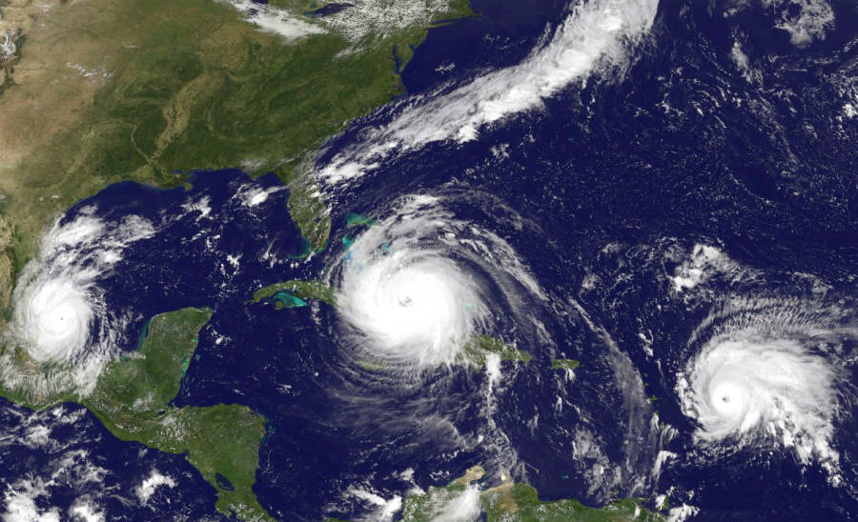
Recent Experiences

Slide 11
Questions?

Slide 12
resources

Slide 13
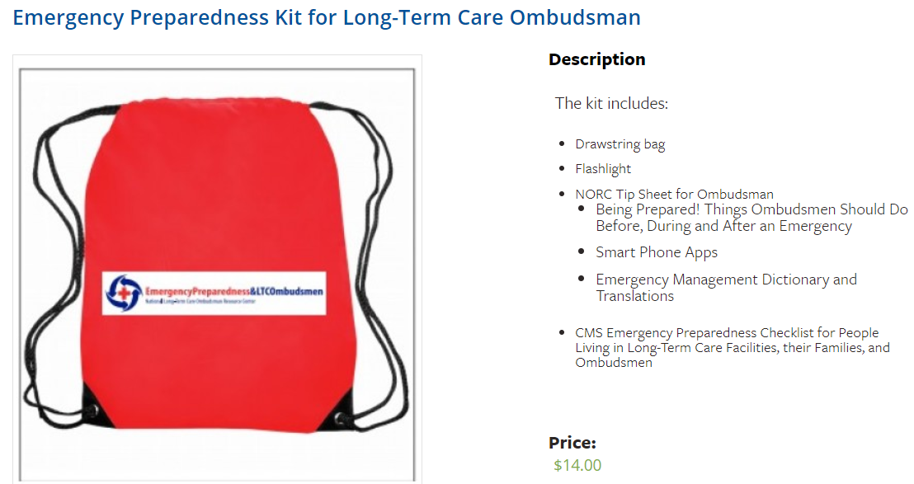
Consumer Voice EP Resources
http://theconsumervoice.org/product/emergency-preparedness-kit-for-long-term-care-ombudsman
http://theconsumervoice.org/uploads/files/issues/emergency-preparedness-factsheet-final.pdf

Slide 14


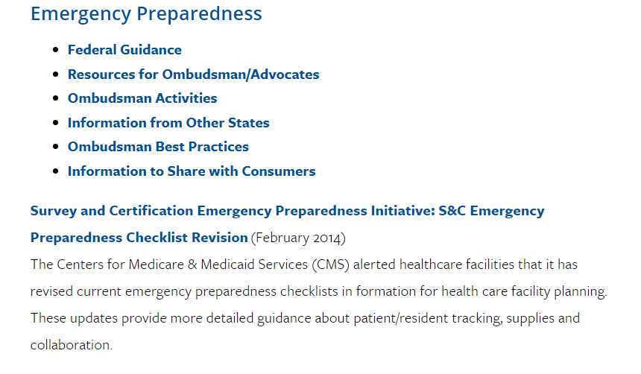
NORC EP Resources
Emergency Preparedness Issue Page
http://ltcombudsman.org/issues/emergency-preparedness
Emergency Preparedness and the LTCOP
http://ltcombudsman.org/issues/emergency-preparedness#Resources
Includes:
  Emergency Preparedness and Response: Model Policies and Procedures for State LTCOPs (ACL)
  Emergency Preparedness Kit
  Emergency Preparedness and LTCOPs Report
    Tip Sheets
    Successful Practices
    Additional Resources
    Webinar and In-person presentation materials

Slide 15


The National Consumer Voice for Quality Long-Term Care
www.theconsumervoice.org
Connect with us:
National Consumer Voice for Quality Long-Term Care
@ConsumerVoices

