Slide 1
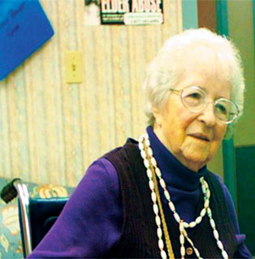
The New Survey Process for Nursing Homes
Presented by Richard Mollot
Long Term Care Community Coalition
www.nursinghome411.org

Slide 2
What is the Long Term Care Community Coalition?
LTCCC: Nonprofit organization dedicated to improving care & quality of life for the elderly & adult disabled in long term care (LTC). Home to the Hudson Valley LTC Ombudsman Program.
Our focus: People who live in nursing homes & assisted living.
What we do:
Policy analysis and systems advocacy in NYS & nationally;
Education of consumers and families, LTC Ombudsmen and other stakeholders.
Coalition members include several LTC Ombudsman Programs, the Center for Independence of the Disabled, AARP NY, several Alzheimer’s Association chapters, other senior and disabled organizations. Also individuals, including ombudsmen, who join in our mission to protect residents.
Richard Mollot: Joined LTCCC in 2002. Executive director since 2005.

Slide 3
What Will We Be Talking About TODAY?
Brief Background:
Overview of the Nursing Home System
Focus:
The New Nursing Home Survey (Inspection) System
Effective Date:
11/28/17

Slide 4
The Nursing Home System in a Nutshell
Virtually all nursing homes participate in Medicaid and/or Medicare.
In order to participate in Medicaid/Medicare, a facility agrees to meet the standards provided for in the federal Nursing Home Reform Law.
States may have additional protections, but no state can have less protections.
Federal protections are for all residents in a facility, whether their care is paid for by Medicare, Medicaid or private pay.
The federal agency, CMS, contracts with the state DOH to ensure that residents are protected and receive the services they need and deserve.
Notes:
To provide some background...

Slide 5
The Nursing Home Reform Law
The federal law requires that every nursing home resident is provided the care and quality of life services sufficient to attain and maintain her highest practicable physical, emotional &social well-being.
The law emphasizes individualized, patient-centered care.
Importantly, the law lays out specific resident rights, from good care and monitoring to a quality of life that maximizes choice, dignity &autonomy.
The law passed in 1987. Regulatory standards came out in 1991.

Slide 6
What Is Happening Now?
For the first time in 25 years, the federal regulatory system has been significantly revised and updated.
This will affect every aspect of care & quality of life.
All of the Regulations are changing. For 25 years everyone – nursing homes, surveyors, ombudsmen and advocates – knew what the rules were and where to find them. That entire structure has changed.
All of the Guidelines are changing. The guidelines detail what is expected of nursing homes in relation to each standard – what they are supposed to do and how they are suppose to do it.
The nation’s Survey System is changing. Starting November 2017, all state survey agencies will be utilizing a new survey process.
The F-tag system, used by nursing home inspectors, is changing. When a surveyor identifies a problem in care or living conditions in a nursing home, she cites the nursing home using a system called “F-tags” – numbers that correlate with the regulatory requirements.

Slide 7
Why is CMS Changing the LTC Survey Process?
Two different survey processes existed to review for a nursing home’s compliance with the Requirements of nursing home care (Traditional and QIS)
Strengths and weaknesses have been identified in the efficiency and effectiveness of both survey processes.
The two processes appeared to identify slightly different quality of care/quality of life issues.
CMS set out to build on the best of both the Traditional and QIS processes to establish a single nationwide survey process.

Slide 8
Goals of the New Process
Same survey for entire country
Combine strengths from Traditional & QIS
Add new innovative approaches
More effective and efficient
More resident-centered
Improve balance between structure and surveyor autonomy

Slide 9
What is in the New Survey Process?
Basic changes include:
Automation of surveyor tasks
Changes in how residents are selected for sampling by surveyors
Changes in off-site vs on-site surveyor activities
Changes to expected activities when surveyors enter and tour facility
Changes to survey structure
Changes to expectations for engaging resident council

Slide 10
How Will State Surveyors Know What to Do?
There were mandatory, live, computer-based trainings for all state surveyors over the summer of 2017.
In addition, CMS is providing:
Computer-Based Training Modules – Available on-demand
National Calls and Q&As – Summer/Fall 2017
Access to Surveyor Training Materials (RO/SA management webinar)
Videos on Highlights of the Interpretive Guidance
Training Tools access to Survey Forms and CE (Critical Element) Pathways

Slide 11
Overview of the New Survey Process
Three parts:
Initial pool process
Sample selection
Investigation

Slide 12
Initial Pool Process
Resident sample size based on facility census:
70% offsite selected
30% selected onsite by the survey team:
Vulnerable residents who are dependent on staff
New Admissions (within 30 days)
Complaints or FRI (Facility Reported Incidents)
Identified concern (any resident who has a significant concern but does not fall into any of the above sub-groups)
Why is this important? To address concerns that, too often, residents & families are not spoken to and have little input during the annual survey.
Day 1 of Survey:
Spent conducting observations, interviews, and a limited record review for the residents in the initial pool.

Slide 13
Sample Selection & Investigation
Day 2 of Survey & Beyond:
“[T]he remainder of the survey is spent investigating all concerns requiring further investigation for the residents in the sample. Facility tasks and closed-record investigations will also be conducted.”

Slide 14
Sample Selection:
Based on resident census
The survey team should “include any resident who has a potential harm identified”
Prioritize using sampling considerations:
Replace discharged residents selected offsite with those selected onsite
Can replace residents selected offsite with rationale
Harm, SQC if suspected, IJ if identified
Abuse Concern
Transmission based precautions
All MDS indicator areas if not already included.
Sample includes Unnecessary Medication Review:
Considers all psychotropic medications, insulin, anticoagulants, opioids, diuretics and antibiotics [Some exceptions, such as for residents with schizophrenia.]
Considers adverse consequences, including falls, weight loss, and sedation.

Slide 15
Some Of The Details Of The New Survey Relevant To Consumers, Advocates & LTC Ombudsmen…
Offsite Preparation & Review:
Facility data to identify patterns of repeat deficiencies
Results of the last Standard survey
Complaints since the last survey, including active complaints
Facility reported incidents

Slide 16
Some Of The Details Of The New Survey Relevant To Consumers, Advocates & LTC Ombudsmen…
Mandatory Tasks for the Survey Team:
Dining
Infection Control
Skilled Nursing Facility (SNF) Beneficiary Protection Notification Review
Resident Council Meeting
Kitchen
Medication administration and storage
Sufficient and competent nurse staffing
QAA/QAPI

Slide 17
Facility Completes & Provides to Survey Team a “Facility Matrix”
Note: Following is a draft which may change.
Residents Admitted within the Past 30 days
Alzheimer’s/Dementia
Mental Illness, Developmental Disability, or Intellectual Disability & No PASARR Level II
Medications – certain medications such as insulin, anticoagulants
Facility Acquired Pressure Ulcers (any stage):
Worsened Pressure Ulcer(s) at any stage
Excessive Weight Loss
Tube Feeding
Dehydration
Physical Restraints
Fall(s)
Indwelling Urinary Catheter
Dialysis
Hospice
End of Life/Comfort Care/Palliative Care
Tracheostomy
Ventilator
Transmission-Based Precautions
Central venous line/Intravenous therapy
Infections

Slide 18
Facility Completes & Provides to Survey Team a “Facility Matrix”
Note: Following is a draft which may change.

Slide 19
Components of Resident Interview:
Surveyors must complete a full observation, interview, and limited record review for each resident included in the initial pool.
Screening to see if resident is interviewable
Suggested questions are available, but surveyors have discretion
However, all care areas should be addressed
Care areas cover quality of life, resident rights & quality of care
Scenario from CMS surveyor training:
For any concern expressed by the resident, you will ask additional questions until you can determine whether the concern can be ruled out or needs to be investigated further, which means you think there may be deficient practice.
For example, if the resident says they had an issue with their roommate but the facility addressed the concern to their satisfaction, you would not need to investigate further; conversely, you would want to investigate a concern if the resident says they have lost weight recently because of their loose dentures unaddressed by the facility.
Interviews are expected to take about 20 minutes.

Slide 20
Resident Representative or Family Interview:
To be done if resident is not interviewable
The individual should be familiar with the resident’s care
The goal is to complete at least three interviews for the team on the first day
Note in CMS surveyor training:
If you are unable to complete three representative/family interviews during the initial pool process, you have until the end of the survey to complete them; however, the team should complete the interviews early enough in the survey to have enough time to follow up on any concerns.
EXPECTATIONS:
At least 3 family interviews.
Conducted early in survey to provide time for investigation.

Slide 21
Limited Review of Resident Records:
After observations and interviews are completed, surveyors will complete a “limited record review for certain conditions.” The intent is to ensure that the survey team spends the majority of its time on interview and observation.
For all residents in initial pool: a brief review for “advance directives or to confirm or clarify specific information based on your interviews and observations, such as confirming the presence of a pressure ulcer.”
For any resident not interviewed: review relevant care areas in the resident’s record. Example: “if a resident is not interviewable… review the record for pressure ulcers, infections, and elopements.”
“For any resident in the initial pool who is receiving insulin, an anticoagulant, or an antipsychotic with a diagnosis of Alzheimer’s or dementia, or if a resident has an appropriate diagnosis but is not receiving PASARR Level II services, …review the record to confirm the information.”
For newly admitted residents: review for high-risk medications.

Slide 22
Dining:
Surveyors are required to observe the first scheduled full meal that takes place in the facility.
Expected to have surveyors covering all dining areas in the facility and room trays. If there are more dining areas than surveyors, prioritize the dining areas with the most dependent residents.
Observe enough of the dining experience to adequately identify concerns.
If feasible, observe the meal for initial pool residents who have weight loss.
If concerns are identified, observe a subsequent meal.

Slide 23
Investigations:
Majority of time should be spent observing and interviewing, with relevant review of record to complete investigation
Use Appendix PP and critical elements (CE) pathways
Instructions from CMS on CE pathways:
The pathways include guidance on the areas (e.g., MDS, physician’s orders and care plan) that should be reviewed initially to help guide your observations and interviews. The pathways include observation, interview, and record review investigative probes for a number of care areas, including pressure ulcers and dialysis.
“The CEs are critical components of care—they cover provision of care and services, as well as the facility assessment and care planning.”

Slide 24
Medication
Recommend being done by nurse or pharmacist
If possible, observe medication administration for a sampled resident whose medication regimen is being reviewed
Otherwise, observe medications for any resident to whom the nurse is ready to administer meds
Observe during different units and shifts
Observe 25 medication opportunities
If observing administration of controlled medications, reconcile the count of the medication & ensure the medications haven’t expired
Observe half of medication storage rooms + half of medication carts. If issue identified? – Expand sample.

Slide 25
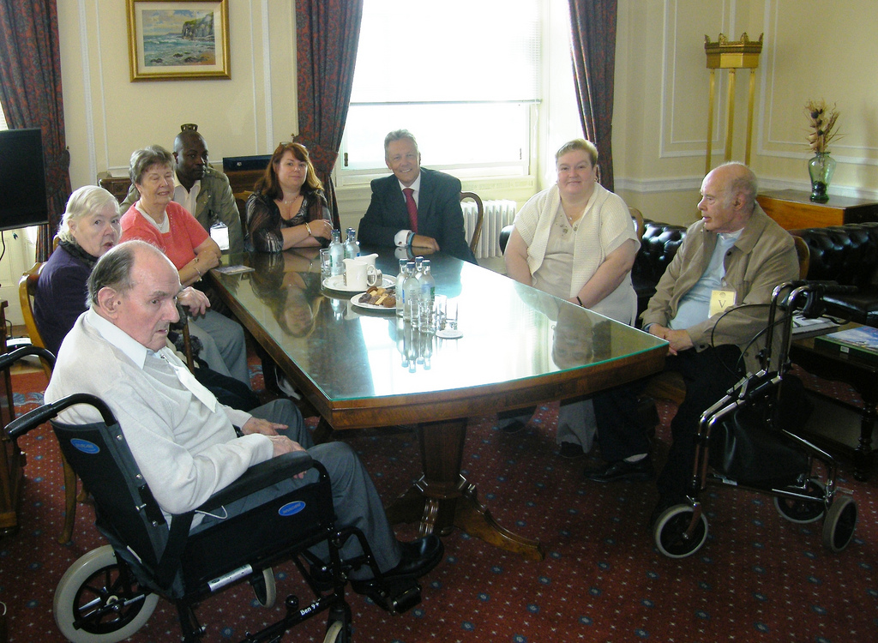
Resident Council Interview
Conduct a group interview with active members of the Resident Council
Interview should occur early enough in the survey to afford enough time to investigate any concerns
interview is focused on specific areas related to the functioning of the council and a few resident specific areas, such as abuse and sufficient staffing
In addition, ask the group about any identified concerns from the survey.

Slide 26
Sufficient & Competent Care Staff
It is a “mandatory task” that surveyors review to ensure that facility has sufficient and competent nurse staffing
CMS says…”surveyors are always considering whether staffing issues can be linked to resident complaints, or quality of life (QOL) and care (QOC) concerns”
Care Staff Requirements
Sufficient Number
Appropriate Training & Competency

Slide 27
The Bad New
In response to industry lobbying, CMS is now backpedaling on important resident protections relating to minimum standards of care, penalties for abuse and substandard care and fully implementing the new survey process.
Memorandum Summary
Freeze Health Inspection Star Ratings: Following the implementation of the new Long-Term Care survey process, the Centers for Medicare & Medicaid Services (CMS) plans to hold constant the current health inspection star ratings on the Nursing Home Compare (NHC) website for a period of one year, surveys occurring between November 28, 2017 and November 27, 2018.
Findings Available: The findings from the new Long-Term Care survey process will be reported on NHC but will not yet be incorporated into the Five-Star Quality Rating System. CMS will add indicators to NHC that summarize survey findings and deficiency free survey findings.
Methodological Changes: In early 2018, NHC health inspection star ratings will be based on the two most recent cycles of findings for standard health inspection surveys and the two most recent years of complaint inspections.

Slide 28
Some Current Concerns

Slide 29
Some Current Concerns

Slide 30
Some Current Concerns

Slide 31
Thank You!
Visit us @ www.nursinghome411.org for:
Fact sheets for resident-centered advocacy
Webinar programs & materials
Information on staffing, enforcement action and other data for every licensed U.S. nursing home
And more!
You can also…
Join us on Facebook @ www.facebook.com/ltccc.
Follow us on Twitter @ www.twitter.com/LTCconsumer.

Slide 32
Questions?
Comments?

