Slide 1
Managed Care Comes to LTSS: Get Ready!
Edith G. Walsh, PhD
RTI International
Waltham, MA
Edith G. Walsh, PhD, Managed Care Comes to LTSS: Get Ready!

Slide 2
Introduction to the issues and opportunities
Fragmentation between health care and LTSS
Poor care quality and unmet needs for people with disabilities
High and probably unnecessary costs
Cost shifting between Medicare and Medicaid
Basic hypothesis: Care coordination and integration will result in higher quality and lower costs
Basic premise: Managed care will provide incentives to reduce unnecessary hospitalization and nursing home use, which could be used to fund home and community-based services and achieve overall savings

Slide 3
Plan of Talk
Set overall context for managed care and LTSS- the problem and what states are doing
Take a look at what we know about care coordination within integrated Medicare/Medicaid Plans participating in the State demonstrations under the CMS Financial Alignment Initiative-- findings from the RTI evaluation

Slide 4
LTSS users are medically high need/high cost: Average Medicare Spending Per Enrollee Age 65 and Older, by Functional Limitations, 2005
Percent of enrollees: 86% 14% 7%
Note: ADLs = activities of daily living.
Source: Komisar, Tumlinson, Feder, & Burke. Long-Term Care in Health Care Reform: Policy Options to Improve Both. The SCAN Foundation, 2009.

Slide 5
Some Medicare costs reflect potentially avoidable hospitalizations: estimates of potentially avoidable hospitalizations among nursing home residents.
Study | Percentage of Hospitalizations Estimated to be Avoidable
Saliba et al. (2000) | 40
Carter (2003) | 25
Grabowski et al. (2007) | 23
Intrator et al. (2004) | 37
Ouslander et al. (2010) | 60
Walsh et al. (2012) | 42–47
Feng et al. (2014) | 50

Slide 6
Managed Long-Term Services and Supports (MLTSS)
Managed care for LTSS rare historically, but has grown dramatically over last 10 years
State goals include:
Rebalancing Medicaid spending
Improving consumer health and satisfaction
Reducing Medicaid home and community-based waiver waiting lists
Increasing budget predictability
Containing costs
Better coordinating medical care and LTSS

Slide 7
Types of MLTSS: alone or in combination with managed medical care
Medicaid-only MLTSS: Medicaid beneficiaries for Medicaid services only
For older people, Medicare cost sharing and LTSS
Some just MLTSS
For younger people with disabilities and older people who are not eligible for Medicare, medical care and LTSS
Medicaid-only MLTSS, with companion Medicare Dual Eligible-Special Needs Plan (D-SNP)
Financial Alignment Initiative: Fully integrated Medicare and Medicaid for dual eligibles
Program of All Inclusive Care for the Elderly (PACE)

Slide 8
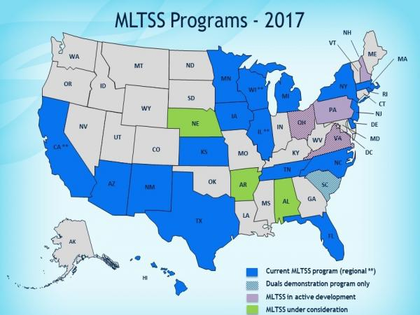
Where is MLTSS active or in development?

Slide 9
Issues
Managed care organizations are third parties that can receive both acute care and long-term care funding
Managed care provides the opportunity for plans to save money and improve care but there is also a financial incentive for managed care to underserve
Managed care organizations may not have adequate knowledge about people with disabilities and LTSS
Potential for medicalizing long-term care
Potential problems with provider network adequacy
Long-term care providers contract with managed care organizations, not the state. A change for both providers and for advocates.

Slide 10
The Role of Care Coordination in State Demonstrations under the CMS Financial Alignment Initiative
Early Findings

Slide 11
Acknowledgements and Disclaimer
RTI would like to thank the state officials, Medicare-Medicaid enrollees, managed care plan staff, consumer advocates, focus group participants, and other stakeholders who contributed information to this study. We also gratefully acknowledge the many contributions of CMS staff.
This research was supported by the Centers for Medicare & Medicaid Services (CMS) under CMS Contract No. HHSM500201000021i TO 3.
The views expressed in this presentation are those of the authors and do not necessarily represent the views of CMS or RTI International.

Slide 12
Financial Alignment Initiative (FAI)
Developed by the Medicare-Medicaid Coordination Office (MMCO) and Center for Medicare & Medicaid Innovation (CMMI) at the Centers for Medicare & Medicaid Services (CMS) to test integrated care models
Goal of developing person-centered care delivery models integrating the full range of medical, behavioral health, and long-term services and supports (LTSS) for Medicare-Medicaid enrollees
Expectation that integrated delivery models would improve care and reduce the rate of increase in expenditures

Slide 13
Why Care Coordination Is Needed
Financing and service delivery of medical care, LTSS, and behavioral health for older people and younger people with disabilities are splintered and uncoordinated.
Financing for medical and post-acute care for dually eligible individuals is primarily a Medicare responsibility, whereas financing for LTSS is primarily a state responsibility through Medicaid (with federal matching).
Medical providers have little financial incentive to be concerned about the LTSS needs of their patients, and LTSS providers have little financial incentive to be concerned about the medical care needs of their consumers.

Slide 14
States Included in This Study
This study focuses on 9 of the 11 capitated model demonstrations that began implementation prior to 2016, using interviews with state officials, consumer advocates, MMPs, collaborating agencies, beneficiary focus groups and other sources.
California
Illinois
Massachusetts
Michigan
New York FIDA
Ohio
South Carolina
Texas
Virginia

Slide 15
Care Coordination Components of the FAI Demonstrations
Care Coordination
Designated care coordinator
Health Risk Assessment (HRA) of medical, physical, and social support needs
Development of a personalized plan of care/action plan (ICP)
Interdisci-plinary care team (ICT)
Linkage to needed services and supports
Monitoring, clinical management, and reassessment

Slide 16
Findings

Slide 17
Early Implementation Activities
Initial work was devoted to:
Hiring and training care coordination staff
Defining workflows and workloads in MMPs
Designing information systems to support care coordination activities
MMPs reported investing heavily in:
Hiring language- and culture-concordant staff
Providing training to care coordinators on needs of special populations
Notes:
Health plans are working to improve care coordination capacity and infrastructure across demonstration States

Slide 18
Successes
Large numbers of new care coordinators have been hired and trained
MMPs reaching more beneficiaries over time and completing more HRAs and ICPs
Care coordinators are providing a new service that Medicare-Medicaid enrollees generally feel is beneficial
Beneficiaries who are able to establish a personal relationship with their care coordinator reported positive experiences and improved coordination of their services

Slide 19
Challenges
High turnover and competition among MMPs to hire care coordinators
Reaching passively enrolled dually eligible individuals and conducting HRAs and ICPs within required time frames difficult
Enrollees often do not understand the care coordination benefit and purpose of the care coordinator
Convening the interdisciplinary care teams and ensuring participation of primary care physicians

Slide 20
Challenges (cont.)
Overlap of MMP care coordination with other care management benefits
Confusion among enrollees with different care managers for behavioral health and LTSS
Implementing data management systems to support centralized enrollee tracking

Slide 21
Conclusions
States and MMPs are implementing new approaches designed to integrate care across medical, LTSS, and behavioral health systems
Key elements include care coordinators, health risk assessments, individualized care plans, integrated care teams, and integrated care coordination data systems
Large numbers of new care coordinators hired and trained, new system implemented
MMPs are providing new service that enrollees generally feel is beneficial

Slide 22
Conclusions (cont.)
States and MMPs faced several challenges:
Hiring and retaining large numbers of care coordinators
Locating and reaching enrollees
Completing the HRAs and ICPs within required time frames
Involving all members of the ICTs, including physicians and Medicare-Medicaid enrollees

Slide 23
Available Reports
Evaluation reports are available on the CMS FAI webpage:
Evaluation plans and state-specific annual reports
Cross-state issue briefs:
Report on Early Implementation of the Demonstrations under the Medicare-Medicaid FAI (January 2016)
Beneficiary Experience: Early Findings from Focus Groups with Enrollees Participating in the FAI (March 2017)

Slide 24
Available Reports (cont.)
Early Findings on Care Coordination in Capitated Medicare-Medicaid Plans under the FAI (March 2017)
Special Populations Enrolled in Demonstrations under the FAI (March 2017)

Slide 25
Contact Information
Edith G. Walsh, PhD
Program Director
Aging, Disability and Long-Term Care
RTI International
307 Waverley Oaks Road, Suite 101
Waltham, MA 02452-8413
ewalsh@rti.org

