Slide 1
Challenges and Innovations in Systems Advocacy by the Long-Term Care Ombudsman Program
2018 Consumer Voice Conference, Alexandria, VA
October 22, 2018
ACL/AoA –
  Introduction
NORC at the University of Chicago –
  Overview and Findings from the National Evaluation of the Long-Term Care Ombudsman Program (LTCOP)
Georgia Long-Term Care Ombudsman Program –
  Examples of Systems Advocacy

Slide 2

Challenges and Innovations in Systems Advocacy by the Long-Term Care Ombudsman Program
2018 Consumer Voice Conference Alexandria, VA
October 22, 2018
Kim Nguyen, PhD
Emily White, MA
NORC at the University of Chicago

Slide 3
Overview of LTCOP
As authorized by the Older Americans Act (OAA), the Long-Term Care Ombudsman Program (LTCOP) has the following responsibilities nationally:
  Identify, investigate, and resolve complaints made by or on behalf of residents of long-term care facilities
  Provide information to residents, families, staff
  Advocate for systemic changes to improve residents’ care and quality of life

Slide 4
Overview of LTCOP
The LTCOP is administered by the Administration on Aging
Each state has an Office of the Long-Term Care Ombudsman.
  53 programs, including Guam, Puerto Rico, and Washington DC. Each Office is led by a State Long-Term Care Ombudsman.
Ombudsmen/Representatives of the Office are advocates for residents of long-term care facilities.
  1,320 paid program staff (FTE) in 2016
  524 designated local Ombudsman entities in 2016
A large volunteer workforce supports the program to maintain a presence in facilities.
  7,331 certified volunteers in 2016

Slide 5
National Evaluation of the LTCOP

Slide 6
Evaluation Team
Process Evaluation and Special Studies Related to the LTCOP
NORC at the University of Chicago (NORC Chicago)
National Consumer Voice for Quality Long-Term Care (Consumer Voice)
Brooke Hollister, PhD, University of California, San Francisco
Helaine Resnick, PhD, Resnick, Chodorow & Associates
William Benson, Health Benefits ABCs
Human Services Research Institute (HSRI)

Slide 7
Process Evaluation and Special Studies Related to the LTCOP
Research Questions
How is the LTCOP structured and how does it operate at the local, State, and Federal levels?
How do LTCOPs use existing resources to resolve problems of individual residents and to bring about changes at the facility and local, State, and Federal levels that will improve the quality of services available/ provided?
With whom do LTCOPs partner, and how do LTCOPs work with partner programs?
How does the LTCOP provide feedback on successful practices and areas for improvement?

Slide 8
Data Collection
Process Evaluation and Special Studies Related to the LTCOP
Round 1 Data Collection (2017)
  Telephone Interviews
    Federal Staff (5) √
    Stakeholders (19) √
    State Ombudsmen (53) √
Round 2 Data Collection (2018)
  Online Surveys
    State Ombudsmen (52) √
    Local/Regional Ombudsmen (497 in 27 states) √
    Volunteers (711 of volunteers in 26 states) √

Slide 9
Process Evaluation and Special Studies Related to the LTCOP
Data Collection
Round 2 Local Data Collection (27 States)
AoA Region
  Reporting
Findings will be disseminated through a Final Report, research briefs, and conference presentations.
1 | 2 | 3 | 4 | 5 | 6 | 7 | 8 | 9 | 10
ME | NJ | DE | FL | IL | LA | IA | ND | AZ | AK
RI | NY | VA | KY | IN | NM | NE | SD | CA | WA
 |  |  | TN | OH |  |  |  | HI
 |  |  | SC | MN |  |  |  | NV
 |  |  |  | WI

Slide 10
What is Systems Advocacy?

Slide 11
What is Systems Advocacy?
Advocacy is defined as:
  “The act of pleading for, supporting, or recommending.”
Systems are defined as:
  “A combination of things or parts forming a complex or unitary whole” or “a coordinated body of methods or a scheme or plan of procedure.”
According to the OAA, systems advocacy involves the following:
  Representing interests of residents
  Seeking administrative, legal, or other remedies
  Analyzing, commenting on, and recommending changes to a system to benefit long-term care residents
  Facilitating public comment on laws, regulations, policies, and actions

Slide 12
LTCOP & Systems Advocacy

Slide 13
Who Performs Systems Advocacy?
Data: SLTCO Survey, Local/Regional Ombudsman Surveys, Volunteer Survey
State Ombudsmen
  46% report that their statewide program has expertise in systems advocacy.
Local/Regional Ombudsmen
  68% report that the Office of the State LTCO coordinates with local programs to carry out systems advocacy.
  88% report that the Office of the State LTCO encourages their local programs to carry out systems advocacy.
Volunteers
    13% monitor and work on laws, regulations, government policies and actions.
Notes:
Because systems advocacy is one of the Ombudsman Program’s mandates, we wanted to know, “Who is conducting systems advocacy?”
State Ombudsmen, Local & Regional Ombudsmen, and Volunteer Ombudsmen are all participating in systems advocacy, but to varying extents.
46% of SLTCOs say their statewide program has specific expertise in systems advocacy.
A large majority of Local & Regional Ombudsmen say that their SLTCO encourages them to carry out systems advocacy, and also coordinates with the local programs to conduct this work.
Volunteers are also doing this important work, including monitoring and working on laws, regulations and policies, as well as supporting the development of resident councils.

Slide 14
Who Performs Systems Advocacy?
Data: Local/Regional Ombudsman Surveys
As part of your responsibilities, do you perform any systems advocacy work? | Local/Regional Ombudsmen
Yes | 56%
No, systems advocacy is not part of my responsibilities | 25%
I don’t know | 17%
Among Local/Regional Ombudsmen with systems advocacy responsibilities:
  30% report that they are unable to perform this task for various reasons (e.g. lack of time, resources, training)
Notes:
When we asked the local and regional ombudsmen whether or not they perform systems advocacy as part of their responsibilities, we had two goals in mind:
The first was to get a sense of the percentage of ombudsmen who perform this work
And the second was to understand whether or not the term “systems advocacy” resonates with staff
What we found was that over half of local ombudsmen report that systems advocacy is part of their responsibilities, but nearly 1/3 of those individuals are unable to carry out this work (which we’ll discuss further in a moment.)
We also found that 1/5 are not sure whether they perform this work.

Slide 15
Systems Advocacy Activities – Paid Staff
Data: Local/Regional Ombudsman Surveys
Which of the following activities do you perform? | “Yes” | “No” | “I don’t know” | All Local Ombudsmen
Advocacy for changes to laws, regulations, or policies | 56% | 7% | 11% | 29%
Engagement in policy making | 25% | 5% | 3% | 13%
Grassroots organizing | 14% | 5% | 1% | 8%
Communication with the media | 22% | 2% | 7% | 12%
Representing consumers in administrative hearings or appeals processes | 43% | 21% | 36% | 34%
Involvement in committees such as work groups or task forces | 63% | 18% | 32% | 40%
Providing information to a public or private agency | 56% | 37% | 43% | 44%
None of the above | 2% | 29% | 24% | 13%
Notes:
We then asked local ombudsmen to tell us about the specific tasks or activities they carry out that are involved in systems advocacy, without calling it by that name.
What we found was that even those who said they weren’t sure, or that systems advocacy was not part of their responsibilities, reported carrying out a number of activities that fall under this umbrella of systems advocacy.
In fact, in some cases, they participate at a rate close to that of Ombudsmen who said advocacy IS part of their responsibilities.
These activities can include:
Advocacy for changes to laws and regulations
Grassroots organizing
Communicating with the media, and
Participating in work groups or task forces, as well as others
Overall, we found that many ombudsmen are carrying out systems advocacy without even knowing it!

Slide 16
Systems Advocacy Activities - Volunteers
Data: Volunteer Ombudsman Survey
Which of the following activities do you perform? | Volunteer Ombudsmen
Provide information, resources, and support to resident councils | 68%
Provide information, resources, and support to family councils | 28%
Monitor/work on laws, regulations, government policies and actions | 13%
Work with media on issues impacting residents of long-term care facilities | 3%
Average number of systems advocacy activities performed:
  Local/Regional staff: 2 activities (range = 0-7 out of 7).
  Volunteers: 1 activity (range = 0-4 out of 4).
Notes:
Volunteers are also participating in systems advocacy, most often by supporting the development of resident councils.
Though it is a much smaller percentage, volunteers are also monitoring and working on laws and regulations, and working with the media on issues that impact residents of long-term care facilities.
Other activities might include community education and outreach, and providing training to facility staff in so far as they relate to larger systemic advocacy issues (such as reducing the inappropriate use of antipsychotics in nursing homes)
Local & Regional Ombudsmen reported performing an average of 2 systems advocacy activities (out of the 7), and volunteers – an average of 1 (out of the 4). Though we also know that some Ombudsmen are participating in all of those activities, and others are not participating in any of them.
Overall, we learned that many Ombudsmen are participating in systems advocacy, without even knowing it!

Slide 17
Coordinating Entities
Data: SLTCO Survey, Local/Regional Ombudsman Surveys
Work together on systems advocacy | SLTCO | Local/Regional Ombudsmen
Area Agency on Aging | 63% | 48%
ADRC | 31% | 30%
Adult Protective Services | 62% | 35%
P&A Systems | 50% | 31%
Licensure & Certification | 79% | 44%
State Medicaid Fraud Control | 42% | 20%
Victim Assistance Programs | 25% | 18%
State/Local Law Enforcement | 35% | 25%
Courts | 19% | 17%
State Legal Assistance | 62% | 27%
Notes:
Ombudsman programs partner with a number of different entities to carry out their systems advocacy work, especially the AAAs, Adult Protective Services, and Licensure and Certification agencies.
State Ombudsmen more often partner with their legal assistance entity than do the local Ombudsmen.
These entities are outlined in the OAA as partner agencies, and ombudsmen also work with them to conduct individual advocacy work, as well as community education and outreach and other activities.

Slide 18
Relationship Benefits and Barriers
Data: SLTCO Interviews, Local/Regional Ombudsman Surveys
Benefits. Relationships are mostly positive and critical to carrying out work. State agencies and other stakeholder organizations assist with:
  Supporting systems advocacy to improve quality of care for residents
  Providing the “teeth” to compel LTC facilities to improve care
  Education on special populations
Barriers. Developing relationships can be challenging due to:
  Lack of understanding of the LTCOP’s role and responsibilities
  Different perspectives or priorities
  Time constraints for staff of both LTCOP and coordinating entities
Notes:
State and Local Ombudsmen cite both benefits and barriers to partnering with other entities.
For many, the relationships with coordinating entities are seen as positive and critical to advocating for improvements to long-term care.
They serve to support systems advocacy to improve the quality of care for residents
They provide the “Teeth” that compel facilities to make changes to improve care, and
They inform providers on how to meet the needs of special populations (such as those with cognitive impairment, or a mental health diagnosis)
However, developing these relationships can be challenging for Ombudsman programs:
In some cases, these agencies or organizations may lack a full understanding of the Ombudsman program’s role and responsibilities
They may have different perspectives or priorities from the Ombudsmen, and
Many State and Local Ombudsmen described a lack of time and resources on both sides to fully develop and take advantage of these partnerships

Slide 19
Program Resources
Data: SLTCO Survey
Types of systems advocacy activities not fully carried out due to a lack of resources | State LTCO
Resident and family council development and support | 60%
Facilitating public comment on proposed legislation, laws, regulations, policies, and actions | 48%
Research and policy analysis to inform systems advocacy work | 42%
Analyzing and monitoring federal, state, and local law, regulations, and other government policies and actions | 38%
Notes:
This lack of resources not only impacts relationships between the Ombudsman program and partnering agencies, but it can also impact the ability of program staff to participate in the activities we talked about a few minutes ago, including:
resident and family council development,
facilitating public comment on proposed legislation,
research and policy analysis, and
analyzing and monitoring federal, state and local laws and actions

Slide 20
Program Resources
Data: SLTCO Interviews, SLTCO Survey, Local/Regional Ombudsman Surveys
Prioritizing Resources
  Funding challenges may cause programs to prioritize facility visits and individual case work over systems advocacy
  Majority of State and Local/Regional Ombudsmen agree that funding and staffing are insufficient to meet federal mandates
Training
  Fewer than half of Local/Regional Ombudsmen surveyed reported receiving training on systems advocacy in the past year
  Some State Ombudsmen report a need for additional assistance in training staff to work with legislators
Notes:
Most often, this lack of resources stems from what Ombudsmen feel is a lack of adequate funding for the program to fully carry out its mandates.
These funding challenges compel State Ombudsmen to prioritize resources and program activities, which sometimes means putting facility visits and individual case work ahead of systems advocacy.
Additionally, State and Local Ombudsmen have reported that there is both a need and a desire for more training in this area.
Fewer than half of the local and regional ombudsmen surveyed reported receiving training on systems advocacy in the past year.
And some State Ombudsmen reported a need for additional assistance in providing training to staff on working with legislators.

Slide 21
Program Structure & Placement
Data: SLTCO Survey, Local/Regional Ombudsman Surveys
Program Structure & Placement | State Ombudsmen | Local/Regional Ombudsmen
Centralized | 40% | 26%
Decentralized | 60% | 74%
In SUA | 62% | 73%
Not in SUA | 38% | 27%
“My program’s organizational structure enables my local program to carry out systems advocacy activities.”
  75% of Local/Regional Ombudsmen in decentralized programs agree, compared to 49% of those in centralized programs.
  80% of Local/Regional Ombudsmen whose state programs are housed outside of the SUA agree, compared to 66% of those housed in the SUA.
Notes:
In addition to resources, a program’s structure and placement can also have an impact on the ability and freedom for Ombudsmen to participate in systems advocacy.
Here we show the breakdown of our State and Local Ombudsmen respondents by state program placement (either within or outside of the SUA), and program structure (either centralized or decentralized). Most state programs are located within the SUA, and most staff are in a decentralized program where local or regional offices are located throughout the state.
We found that 75% of local and regional ombudsmen in decentralized programs felt that this structure enabled their local program to carry out systems advocacy, compared to just 49% of those in centralized programs.
In addition, we found that local and regional ombudsmen in state programs housed outside of the SUA were more likely to feel that this placement enabled their local programs to carry out systems advocacy, than those whose state programs are housed within the SUA.
We also recognize that local program placement can have an impact on the ability of local program staff to carry out systems advocacy, but we are still in the process of analyzing this data to understand that relationship better. We hope to have more to say on this in the near future.

Slide 22
Systems Advocacy and Program Autonomy
Data: SLTCO Survey
 | Agree / Strongly Agree | Disagree / Strongly Disagree | Don’t Know
Unable to fulfill some program duties due to legislative or regulatory restrictions | 17% | 75% | 6%
Autonomy to carry out systems advocacy | 90% | 8% | 2%
Free to speak to the media | 80% | 15% | 4%
Able to represent residents’ interests to state agencies w/o political interference | 83% | 12% | 6%
Majority of SLTCO feel they have autonomy to carry out systems advocacy, although some report a lack of support from their host agency or the state government.
Program resources may be the most significant barrier to carrying out systems advocacy.
Notes:
Placement and structure aside, the majority of State Ombudsmen reported feeling that they have the autonomy to carry out systems advocacy, though some did report a lack of support from their host agency or the state government.
Given these findings, it seems that program resources may be the most significant barrier that programs face in conducting this work.
Just a note, that we’ve combined agree/strongly agree, and disagree/strongly disagree for simplicity.

Slide 23
Systems Advocacy Issues
Data: Local/Regional Ombudsman Surveys, Volunteer Survey
Improving facility staffing (ratios, turnover, training)
Adequate funding for the LTCOP
Proper care for residents with:
  mental health diagnoses
  cognitive impairment
  behavioral/substance use issues
Access to LTC for low income individuals, the formerly incarcerated, & registered sex offenders
Addressing inappropriate/involuntary discharges/transfers
Increasing Personal Needs Allowance (PNA)
Notes:
To end we wanted to share with you the systems advocacy issues that local and regional ombudsmen believe are the most important areas for their programs to address currently, and they include:

Slide 24
Kim Nguyen, PhD
301-634-9495
nguyen-kim@norc.org
Emily White
301-634-9314
white-emily@norc.org

Slide 25
Advocacy in Action
Melanie McNeil
Georgia State Long-Term Care Ombudsman
October 22, 2018

Slide 26
Advocacy
What is advocacy? The act or process of supporting a cause or proposal
Who are advocates: Everyone
How do we advocate: facility, local jurisdiction, state, federal
Two examples of state legislative advocacy
  Personal Needs Allowance (PNA)
  Benefits Trafficking

Slide 27

Where to begin
Identify the issue
Develop the message
Prepare strategy
Deploy

Slide 28

Who should participate
Residents
Family members
Facility staff
Community members
Influencers
Policy Makers

Slide 29

Strategy
Sign Petitions
Send Individual letters
Prepare personal stories
Meet with policy makers
Engage the media
Testify at hearings
Work the legislature

Slide 30

Personal Needs Allowance
More than 1,000 letters and petitions
Meet with key legislators
Testify at hearing
Draw media attention
Follow up

Slide 31

Benefits Trafficking
Meet with key legislators
Garner support from key influencers
Testify at hearings
Work the committee

Slide 32
Conclusion
Everyone can participate
Celebrate success
Don’t give up
Plan for on-going contact to create success in future

Slide 33
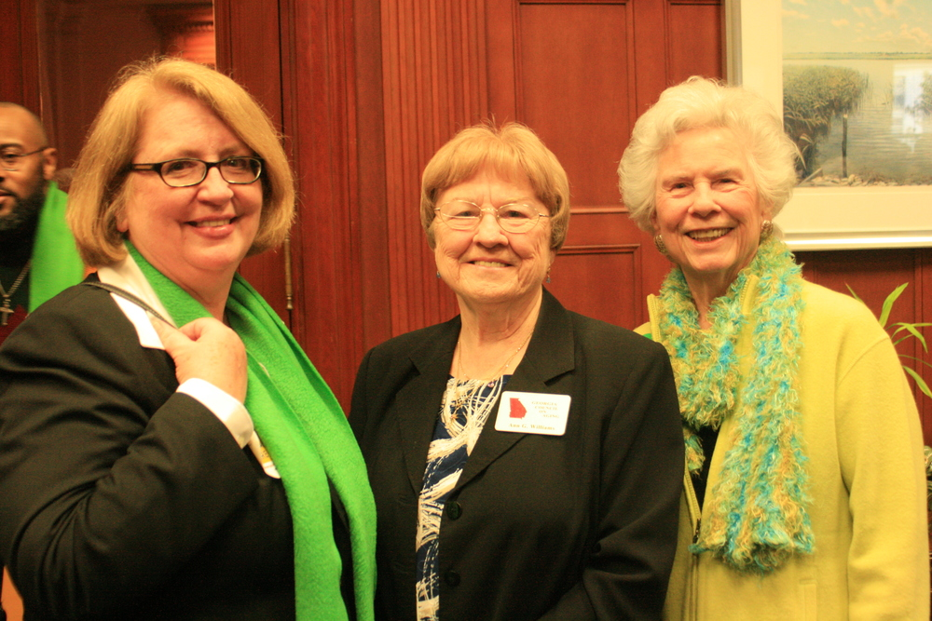
Results of Advocacy
Never doubt that a small group of thoughtful, committed citizens can change the world; indeed, it's the only thing that ever has.
Margaret Mead

