Slide 1
Advocating for Older Adults who have Experienced Trauma
Laura Cook, Esq. & Keeley Frank, LGSW

Slide 2
National Center for Victims of Crime
Mission: Forge a national commitment to help victims of crime rebuild their lives
Through collaboration with local, state, and federal partners, the National Center:
Advocates for stronger rights, protections, and services for crime victims
Provides education, training, and evaluation
Serves as a trusted source of current information on victims’ issues

Slide 3
Overview
Poll
Aging Process
Dementia
Trauma & the Brain
Best Practices
Resources

Slide 4
Poll
Who is in the room?
Ombudsmen
Law Enforcement
Advocates
Other

Slide 5
Aging Brain
Structural changes
Finding words
Learning new information
Recalling information
Multitasking
Problem solving
Processing information
Notes:
In general we know that as we age there are changes in the body. Additionally there are some structural changes that happen to the brain. These can occur in the prefrontal cortex, the hippocampus and the parietal lobe. As a result, you may work with an older adult that has difficulty finding the words they are trying to say so it takes longer for them to finish a sentence or respond to a question. It may also be more difficult for them to learn new information and then recall any information you’ve discussed with them as short term memory is impacted with age. Multitasking becomes more difficult so being in an environment with a lot of distractions while trying to answer questions may not produce the results you’re looking for.
Along with these problems, older adults may also have difficulty processing the information that is being presented to them. New information may be mixed with old which can confuse memories and distort memory recall. In general you may have noticed that for some older adults they have more difficulty communicating than others. There could be some neurological things going on, or it could just be the natural processes of aging.

Slide 6
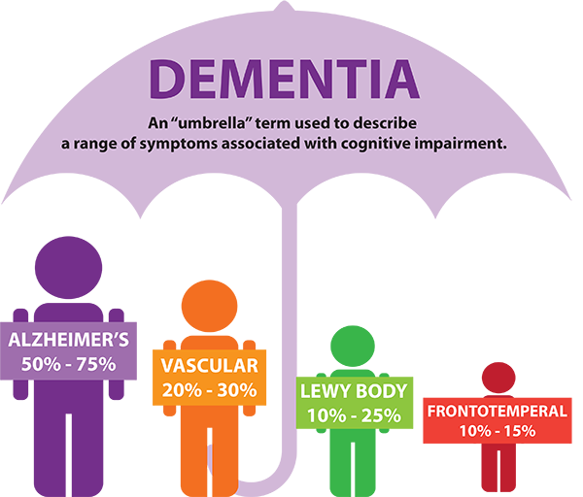
Dementia
Cluster of symptoms
Different Types
50% victimized
Trauma not forgotten
Notes:
We also can’t talk about the aging brain without mentioning dementia. Keep in mind that not every older adult has dementia, but a lot do. Remember that dementia is a catchall term for a cluster of symptoms rather than a set diagnosis. Someone can of course be told they have dementia, but what does that really mean for that person? I think of it like cancer. Let’s say someone tells me they have cancer. We all know that’s horrible. But it doesn’t really tell me much because there are so many different kinds that have different symptoms.
The difference here is that for the most part, dementia isn’t getting better. I say for the most part because in some (very few) cases there are other things going on that are mimicking dementia that do get better. But dementia is a progressive type of illness. It gets worse overtime. Just like cancer there are a bunch of different types and the kind that you have determines what types of symptoms you will have. The most common being Alzheimer’s (reminder that Alzheimer’s is a dementia – they are not two separate things). But even those with Alzheimer’s can have varying symptoms and progression.
Additionally keep in mind that there have been studies showing that trauma is not lost with the onset of dementia. The memories of the exact incident may be gone, but the emotions related to it remain.
And since such a large portion of those with dementia may be victimized, this may skew your interactions with victims. You may see more older adults with dementia than there actually are which can make it seem like every older adult has some form of cognitive impairment. It’s best to assume capacity until you are reliably shown otherwise (I say shown rather than told because too often we are told by a concerned family member or third party that an older adult must have dementia or some other issue when in reality they don’t).

Slide 7
Neurobiology of Trauma
Everyone has their own fluctuating equilibrium of balancing stress in their daily life - trauma throws off an individual’s equilibrium
Traumatic
Stress –
Eustress –
Normal
Stress
–
–
Distress –
Notes:
Good and bad things happen to us every day – usually we can roll with the punches and adjust to deal with those normal stressors.
Examples: finding money in an airport v. 6 hour flight delay
If a stressor is unique and disruptive enough to make it difficult for victims to re-establish their normal equilibrium, it may cause a trauma reaction
Trauma is like your brain/body declaring a state of emergency
Examples plane crash in VA v. oil spill on road in smaller state
Each victim’s reaction to trauma depends on their perception of the situation causing it, his or her ability to handle distress, coping mechanisms, and trauma history, among other factors (most of which are beyond one’s control).

Slide 8
Trauma’s Effect on Memory
Trauma disrupts the brain’s ability to form and recover memories
Dissociation
Fight/Flight/Freeze reaction
Tonic & Collapsed Immobility
Notes:
A person’s ability to form memories is often affected by traumatic situations. The ways in which the brain forms memories are extraordinarily complicated, and many different parts of the brain are utilized in storing new memories and retrieving old ones. Traumatic situations disrupt the brain’s ability to form memories, which in turn will affect the individual’s ability to recall what occurred during a traumatic situation.
Dissociation is a survival reflex that victims may experience during a traumatic situation. In essence, dissociation is a detachment from the present moment. It can range from a minor, short disengagement to a total disconnect from reality, and can also be a coping mechanism. Dissociation may result in memory loss, and thus may obscure an individual’s ability to remember a traumatic event. Notably, dissociation can occur after the trauma has occurred, and specifically when the individual is recalling the traumatic event. Thus, when crime victims are questioned about an incident, they may be minimally reactive, and sometimes even nonresponsive, to interviewers.
A number of reactions that may occur during traumatic events are known as the “defense cascade.” Previously, psychologists identified this as the “fight or flight” response. However, recent research indicates that this response is more complex than initially thought. Typically, in response to a perceived threat, individuals experience a freeze reaction, which allows them to assess and respond to the threat. The freeze reaction is more often followed by a flight reaction, rather than a fight reaction. None of these responses are consciously chosen by an individual; they are impulsive reactions.
The freeze reaction can cause significant confusion among advocates assisting victims of crime. It is not uncommon to assume that once the threat has been perceived, the crime victim will fight the perpetrator. However, this assumption is usually incorrect. Many victims do not fight, and this is erroneously perceived to be inconsistent with their allegations.
There are two notable survival reflexes that can occur during sexual assaults: tonic immobility and collapsed immobility.
Tonic immobility is a temporary state of motor inhibition believed to be a response to situations involving extreme fear, physical restraint, or the perception of instability.¹⁴ It usually occurs after a failed attempt to flee. It is estimated to occur in anywhere from 12% to 52% of sexual assault cases.
Collapsed immobility, on the other hand, can cause loss of muscle tone and changes in consciousness.¹⁵ Many victims describe the changes or a loss in consciousness as a blackout. Anyone working with victims of sexual abuse, including older adults who have experienced this horrific crime, should be familiar with tonic and collapsed immobility.
Example for immobility is a deer in the headlights – the amount of fear is so intense and severe that your body has shut down. It’s the concept of the engine being full blast but the brakes being on and there’s nothing you can do to change what’s happening.

Slide 9
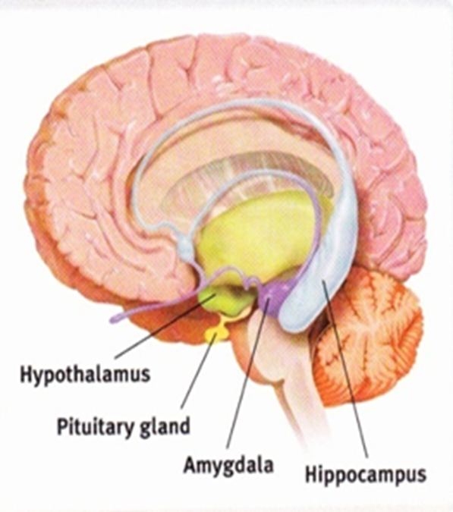
The Brain’s Responses to Trauma
Fear and terror
Anger, fury, and outrage
Confusion and frustration
Guilt or self-blame
Shame or humiliation
Grief or sorrow
Notes:
Brain/fist analogy
Amygdala is thumb in the middle – fingers (other parts of the brain) can basically go offline during a traumatic experience
Basic life functions, like breathing an blinking, are working, but other more complex functions do not
Fear/terror
seeing bank account at $0
Anger/fury/outrage
Realizing that perpetrator is someone that the victim knows/trusts
Confusion/frustration
trauma can be destablilizing; may help to write things down, bring support
Guilt/Self-blame
Victims of financial crime are often active participants in their own victimization
Shame/humiliation
a savvy businessperson may not want to talk about the crime
Grief/sorrow
loss of future dreams and plans

Slide 10
Polyvictimization
Generally, exposure to more than one criminal traumatic event in the course of a victim’s life
“Polyvictimization later in life is when a person aged over the age of 60 is harmed through multiple co-occurring or sequential types of elder abuse by one or more perpetrators, or when an older adult experiences one type of abuse perpetrated by multiple others with whom the older adult has a personal, professional or care recipient relationship in which there is a societal expectation of trust”
Compounds the effects of trauma, causing post-traumatic stress, depression, and decreased physical health
Notes:
As many older victims are abused by people they know, including friends, family, caregivers, and others in positions of confidence, polyvictimization may be prevalent. Just by virtue of being older and having more life experience, there’s a higher probability that older adults have experienced a trauma (as compared to, e.g., an adolescent). In addition, those who have experienced abuse earlier in life are at a greater risk of victimization as they age.¹⁷ The effects of trauma can compound and worsen as additional trauma is experienced, so victims with a trauma history may have more severe reactions than others.

Slide 11
Financial Exploitation
Improper use of an vulnerable person’s assets for someone else’s benefit
Covers a wide range of activities and transaction—any instance in which an asset is taken or misappropriated by deception, harassment, threats, or undue influence
Often committed by caretakers, family members, neighbors, friends, acquaintances, attorneys, bank employees, religious advisors, doctors, nurses, and others that the vulnerable adults knows and trusts
Notes:
While on the topic of Polyvictimization, I want to make sure to mention financial exploitation, as it commonly co-occurs with one or more other forms of elder abuse (often physical or psychological).

Slide 12
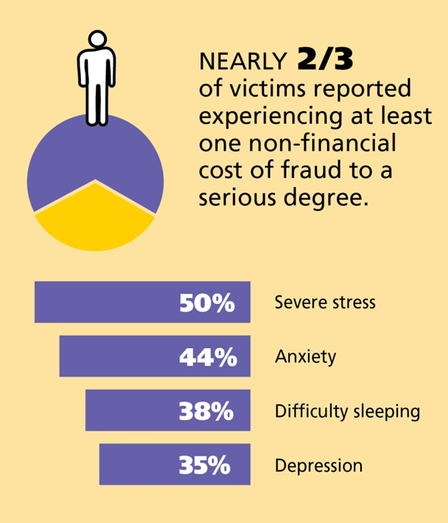
Is Financial Victimization Traumatic?
Yes, if it is unique and disruptive enough to make it difficult for victims to re-establish their normal equilibrium.
*Statistics from FINRA Investor Education Foundation study
Notes:
While financial crimes are not violent in nature, there are emotional costs of financial victimization. Nearly two-thirds of victims report experiencing at least one non-financial cost of fraud to a serious degree, including severe stress, anxiety, depression, and difficulty sleeping.
Loss of property, loss of relationship, threatened, loss of status
Harm is not often outwardly apparent

Slide 13
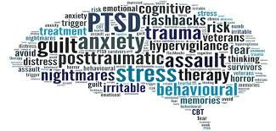
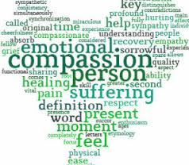
Trauma-Informed Response
Assuming that an individual may have a trauma history, minimize re-victimization
Understanding trauma can affect peoples’ perceptions of situations, intent, trust, and more
Emphasizes physical, psychological, emotional safety
Creates opportunities for victims to rebuild a sense of control & empowerment
Notes:
Trauma-informed care is an approach to engaging people that have experienced trauma.
Trauma is cumulative – may not have time to collect individual history, so it is best to assume that people have a trauma history
- ACES study
The word “victim” can have a negative connotation
- Just means that at some point in time, someone else had control
- Regaining control and taking action is part of the healing process
Hard eyes = I have a job to do
Soft eyes = I honor your experience and humanity & I have a job to do

Slide 14
Best Practices
Speak with the victim
Use preferred language
Assume capacity
Remember routines
Don’t forget about trauma!
Acknowledge relationships
Notes:
Like we mentioned earlier you always want to assume capacity until you are shown otherwise. If you are provided with actual medical documentation or legal documentation of conversatorship/guardianship that states that an older adult does not have capacity, okay go with that. But in every other circumstance going into any new conversation or relationship with a victim with the assumption that they are unable to speak for themselves or care for themselves is degrading and not victim centered.
With older adults you also want to keep in mind possible physical health needs that may come up during their time in court. Keep in mind their regular routines and schedules. Ask when they normally take any medications, do they have a home health aide that visits during a certain hour, etc. Try to avoid disrupting this process if at all possible within the confines of the court schedule.
90% of crimes committed against older adults are done so by someone in a trusting relationship with that person. Whether that be a family member, spouse, friend, or someone they know in the neighborhood that agreed to fix their kitchen floor. Remember that these relationships can be extremely important to the older victim and may be the only interaction they have during the week. This can have a huge impact on their willingness to participate in the criminal justice process. Acknowledging the importance of these relationships and listening to what the victim would like to happen is extremely important. Being up front with them about what you are able to do is also just as important. You don’t want your victim to assume everything is going to be fine and the offender will be able to return home when the judge is actually going to send them away. That doesn’t mean your victim is always going to be happy.

Slide 15
Audience Experiences
What issues do you have that are unique to representing older adults?
What issues do you have that are unique to working in long-term care?

Slide 16
Resources
VictimConnect: 1-855-4-VICTIM
FINRA Securities Helpline for Seniors: 844-57-HELPS
NCVBA Attorney Referral Service: 1-844-LAW-HELP
Elder Justice Initiative: justice.gov/elderjustice
NAPSA: napsa-now.org

