Slide 1

The effects of the opioid crisis on residents: points of advocacy
November 19, 2019

Slide 2

The Consumer Voice
The National Consumer Voice for Quality Long-Term Care is a national non-profit organization in Washington, DC that advocates for people receiving care and services at home, in assisted living, or in a nursing home.
Advocates for, educates, empowers consumers, families, caregivers, advocates and ombudsmen in seeking quality care.
Operates the National Long-Term Care Ombudsman Resource Center through a grant by the Administration for Community Living to provide training, support and technical assistance to Long-Term Care Ombudsman Programs.

Slide 3
Opioid Crisis in the U.S.
Usage quadrupled between 1999 and 2010
Changes in prescribing practices
Centers for Disease Control guidelines for managing chronic pain
Commonly used opioids:
  Hydrocodone
  Tramadol
  Fentanyl
  Oxycodone
  Morphine

Slide 4
Opioid Use in Older Adults
Persistent pain – arthritis, fractures – or post surgery
Concerns about:
  Sedating side effects of opioids
  Adverse drug events- i.e., falls
  Drug interactions
Notes:
Drug interactions can interfere with pain management

Slide 5
Opioid Use in Long-Term Care (LTC) Facilities
Twice as prevalent as in community settings
Often started on opioids in hospitals
Concerns about drug diversion
Alternatives not widely available, used
Pain often under-treated
Notes:
60% of NH residents in persistent pain
A recent study of the prevalence of opioid use in long-stay nursing home residents found that 1/3 of long-stay residents prescribed opioids during the study period, and 1 in 7 prescribed opioids long-term

Slide 6
NORC-Consumer Voice Project
What are Nursing Home Residents saying about opioids? What do they need/want to know?
Methods:
  A questionnaire asking about complaints investigated by the Long-Term Care Ombudsman Program (LTCOP)
  Dialogues with Resident Councils
Partner with NCEA

Slide 7


The National Center on Elder Abuse (NCEA)
An information clearinghouse designed to improve the national response to elder abuse, neglect and exploitation by a) gathering, housing and disseminating current b) stimulating and identifying new approaches, and c) detecting and addressing gaps in the field.
The NCEA disseminates resources, provides expert technical assistance and participates in nationwide training.

Slide 8
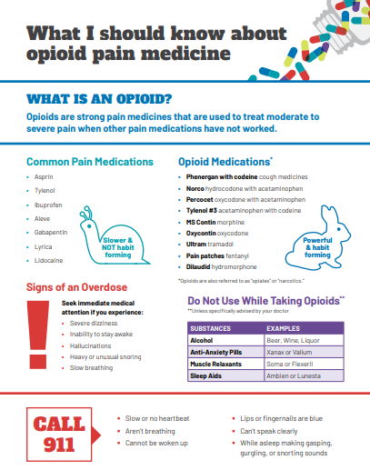
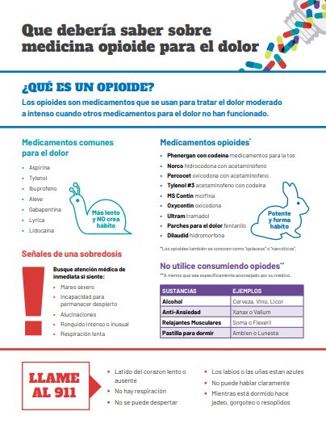

A Priority Area of Focus: Opioid Pain Medicine

Slide 9
Web-based Resources
Useful and FREE web based tools:
  National Center on Elder Abuse (NCEA)
  USC Center on Elder Mistreatment (USC CEM)
    Supports and Tools for Elder Abuse Prevention (STEAP)
    Reframing Elder Abuse (Frameworks)
  Training Resources on Elder Abuse (TREA)
  Elder Abuse Guide for Law Enforcement (EAGLE)
Notes:
1 min

Slide 10

Opioid Use and Long-Term Care
LTCOP Questionnaire Findings
Notes:
State and local Ombudsman in 34 states submitted responses to the questionnaire for a total of 137 respondents.

Slide 11
Primary Findings
Top two complaints reported to the Ombudsman program
  Drug Diversion
  Medication unaccounted for
Most reported negative effect from reducing or removing opioids
  Unmanaged Pain
Significant needs
  Education and Training
Notes:
Education and training for both Ombudsmen and residents

Slide 12
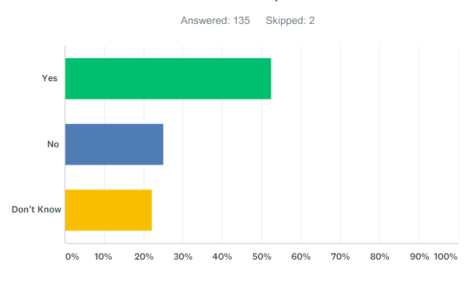
Complaints Received Involving Opioid Misuse
Examples include diverting drugs for recreational use, drug theft, and/or financial exploitation due to opioid addiction
53% Yes
25% No
22% I Don’t Know

Slide 13
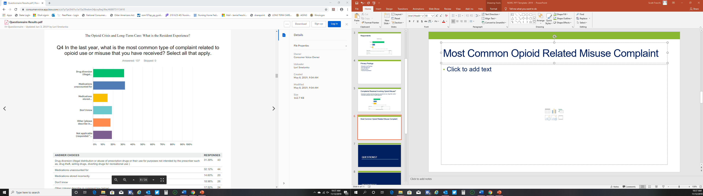
Most Common Opioid Related Misuse Complaint
Other
Physicians reducing dosage
Residents taken off opioids completely
Increased pain due to reducing dosage or eliminating the medication
Notes:
Medications unaccounted for 32%
Drug Diversion 31%
Medications stored incorrectly 15%
19% don’t know
18% said “Other
Almost 20% answered not applicable

Slide 14
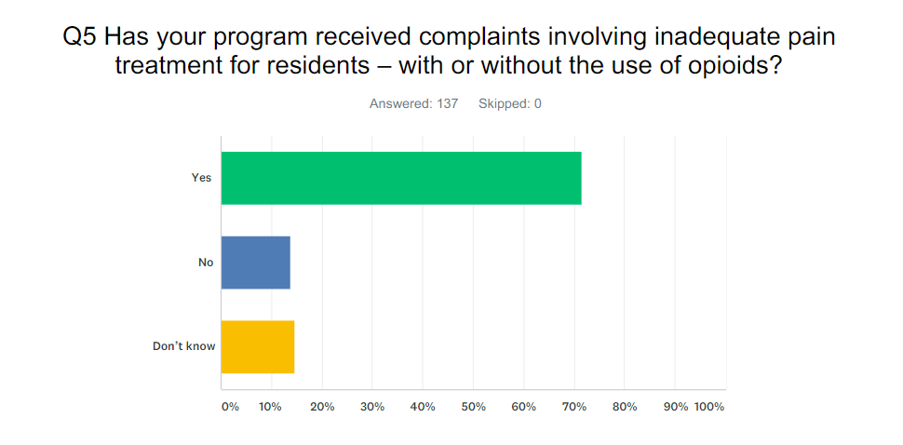
Inadequate Pain Treatment
Notes:
71.53% or 98 respondents said yes
13.87 or 19 respondents said no
14.60 or 20 said they did not know
This slide shows that whether or not opioids are part of the picture, there is a real need for better pain management for residents.

Slide 15
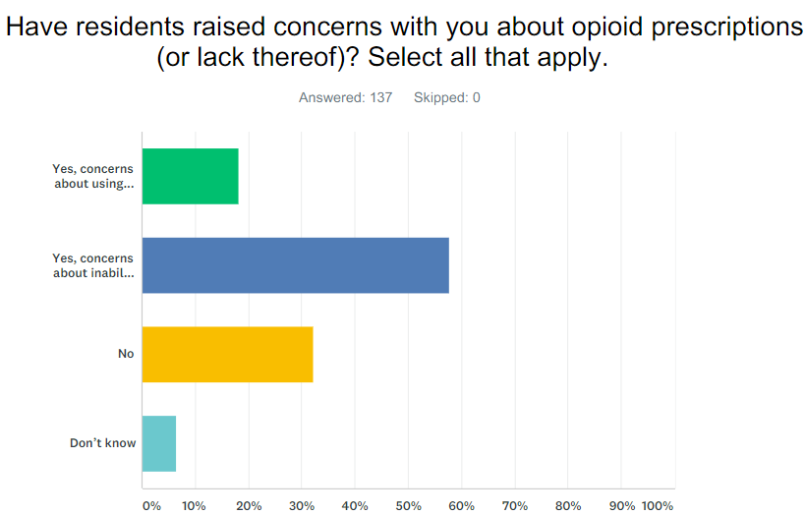
Residents Reporting Concerns
104 of the responses said “yes” residents have raised concerns
44 responses said “no”
Notes:
9 were unsure. One respondent wrote “Residents have reported that they are in so much pain that they have attempted suicide due to their untreated pain… Another resident reported she has to go through so many hoops just to get relief from her pain. For example, she has to go to the doctor weekly or every two weeks just to get a scrip for her chronic pain. She is in her 90’s.”
Another respondent wrote “Residents who have been prescribed opioids by doctors for many years are now being told that "the government" is prohibiting doctors from prescribing them anymore. Doctors generally do not have much in the way of effective alternative pain management programs to replace the opioids and the residents are very unhappy.”
Yet another respondent summarized the concerns by stating “I had one facility that a nurse was exchanging the opioid pain meds for Tylenols and then another resident who was concerned that she would get addicted because of what she saw on the news. Then I had a veteran who was denied the drugs because of the crisis, but he had been on the same pill and mg for over 15 years, without any abuse.”

Slide 16
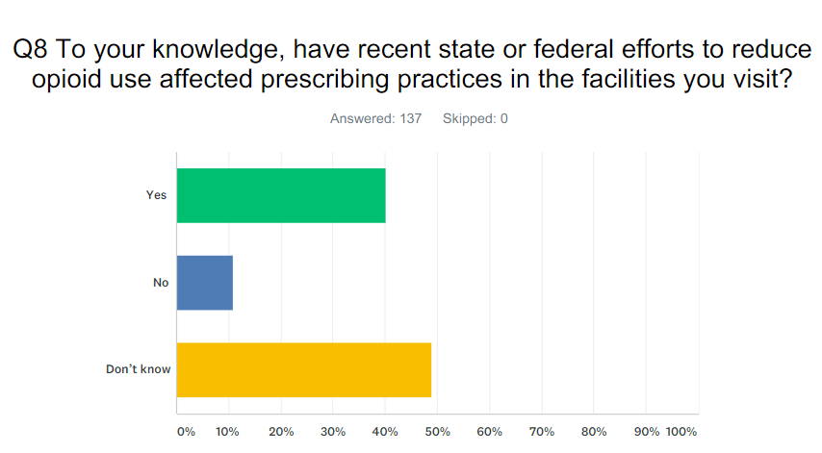
Effects of Efforts to Reduce Opioid Use
Notes:
While most respondents answered that they did not know, 40% of respondents indicated that physicians are either less likely to prescribe opioids or will no longer prescribe opioids. Some indicate that it is harder for residents to continue to get the same dosage that was prescribed to them previously -- All leading to reported uncontrolled pain and suffering for residents.

Slide 17
Alternatives to Opioids to Manage Pain
Ombudsmen were asked if to their knowledge most facilities in their state/region are informing residents of potential alternatives to opioids to manage chronic pain.
58% did not know
23% said “yes”
19% said “no”
Notes:
Some of the alternatives reported on are yoga, massage, meditation, physical therapy, counselors, addiction programs, and pain management clinics

Slide 18
Opioid Addiction and Facility Admission
Ombudsmen were asked if to their knowledge residents seeking admission to a nursing facility or assisted living facility being turned away if they are taking medication to treat opioid addiction
55% did not know
40% said “no”
7% said “yes”

Slide 19
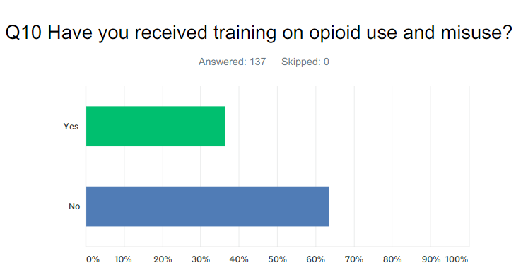
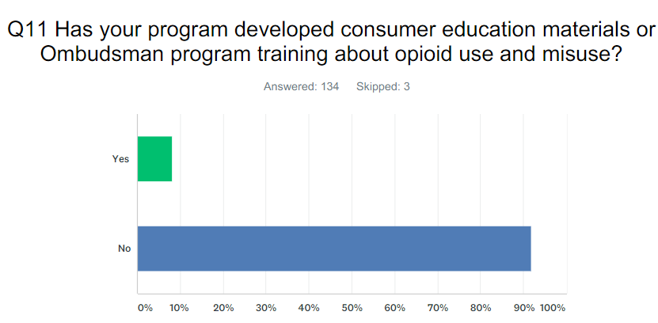
Training and Education
Notes:
50 respondents said that they have received training, but 87 said they have not. Several Ombudsmen who responded yes to having received training, report that the training was provided outside of the Ombudsman Program by federal and state agencies and online webinars. Very few reported receiving training through the Ombudsman Program.
Only 8% stated their program has developed a training program while 92% said they have not.

Slide 20
Opioid Crisis and Long-Term Care
Resident Dialogue Findings

Slide 21
Resident Dialogues
Discussion with Resident Groups/Resident Councils:
105 Residents
7 different facilities
6 different states

Slide 22
Lack of Information
Has anyone (your doctor or facility staff) talked about issues with prescribing opioids or any changes they might be putting in place around use of opioid medications in the facility?
Has the resident council had any discussions or expressed any concerns about the opioid crisis?
Notes:
Most residents from the 7 facilities answered no to the first two questions. The few who answered yes said their doctor discussed alternatives or limiting pain medications in response to the resident’s history of substance use disorder.
Some residents were aware of the opioid crisis but reported that they were not informed by facility staff or doctors about changes in prescription practices.

Slide 23
Lack of Information
Does your doctor, a pharmacist, or nurse talk to you about the benefits and potential negative effects of your pain medications?
  Most of the responses were “No”
  One of the residents who said “yes” explained that her doctor said the good outweighs the bad in her situation. The resident and her doctor will monitor her response to the medication to make sure she isn’t overmedicated and/or has other negative side effects.
Notes:
One resident said “Not really. Doctor is invisible”

Slide 24
Changing Pain Medications
Has your doctor changed your medications because of concerns about prescribing of opioids?
  Most residents reported no changes in medication
  One resident requested the doctor reduce dose because she felt like a zombie.
  One resident said his doctor suggested lowering his dosage, but the resident said no and the doctor obliged.
  One resident was referred to a pain clinic and was happy with the outcome.
  Other residents said that their physicians did change their opioid prescription to Tylenol and it was not effective.

Slide 25
Non-Opioid Treatments
Residents reported being offered
Residents reported on effectiveness of these treatments
  Physical therapy
  Nerve stimulation (e.g. Transcutaneous Electrical Nerve Stimulation (TENS))
  Yoga
  Massages
  Other non-opioid paid medications
Physical therapy can help, but there is a limit to what Medicare and insurance will pay.
TENS can help and be used along with pain medication
Yoga offered infrequently.
Facility won’t allow massage therapists to come into the facility.
Non-opioid pain medications don’t work for those who were previously taking opioids.
Notes:
transcutaneous electrical nerve stimulation

Slide 26
Are Residents Getting Pain Medication When Needed?
Most residents reported that they do get their medication on time or when needed
Residents from 4 of the facilities reported that they have to wait too long for their pain medication (hours, even days late)
Residents in 3 of the facilities reported that the facility does not order the medication from the pharmacy in a timely manner resulting in residents going without treatment
Notes:
One resident was supposed to have his pain patch changed every three days, but went a week without a new patch. Other residents said they have to be assertive to get meds. Another resident says he is supposed to take it every four hours but only able to take it every 6 hours –been made to wait in pain when it wears off

Slide 27
Concerns about Opioid Misuse in the Facility
4 out of 7 resident groups said they had no concerns
2 resident groups said yes and here is why:
  A nurse was diverting fentanyl patches for herself in one facility
  High staff turnover
  Residents expressed worry that caregivers might be using drugs
    “Some days they are ‘with you’ but not always”
    “Sometimes we’ll joke among ourselves ‘wonder what they are smoking today’”
    “They should drug test around here”
No resident group raised resident addiction as a concern

Slide 28
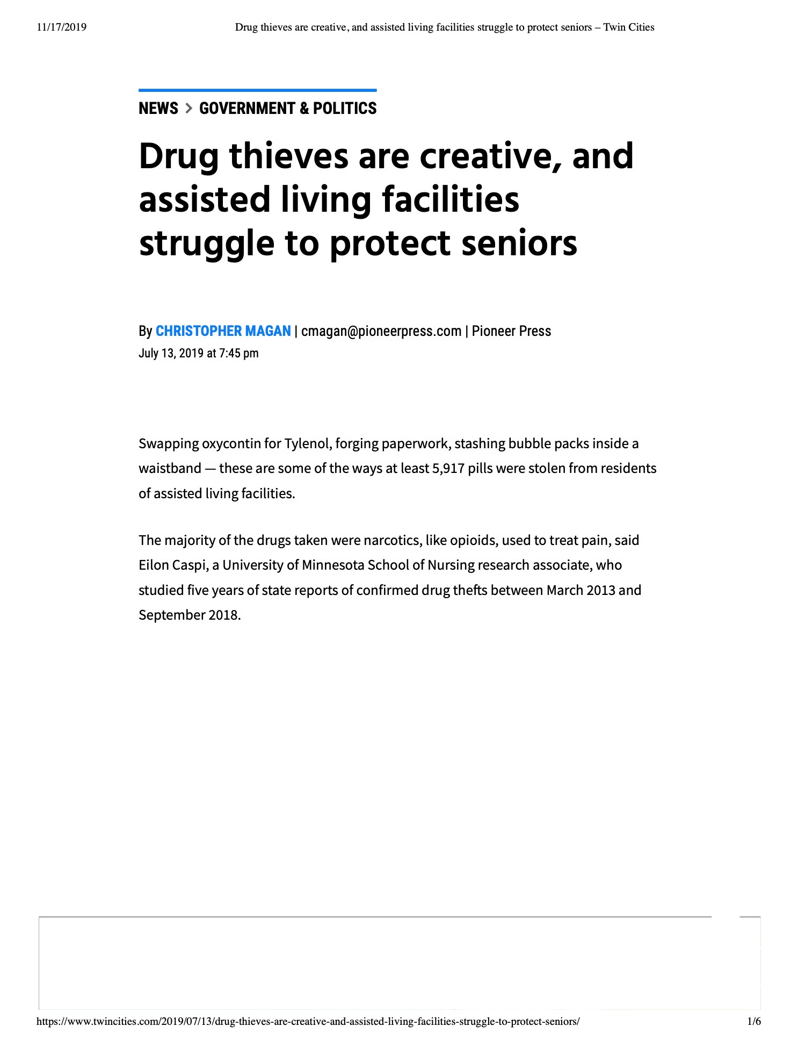
Drug Diversion Concerns
(diversion by staff)
Switching pain medications for other pills
Forging paperwork
Stealing drugs
Signing out PRN pain medications purportedly at the request of residents
Notes:
LTCOP raised diversion as an issue; and recent studies and a conversation I had with a daughter last week indicated that this is a universal problem.

Slide 29

Supporting Residents
Photo by Neil Thomas on Unsplash

Slide 30

Themes
Meds changed – from opioids to non-opioids, like Tylenol
Changes in prescribing practices
Insufficient access to alternative treatments
Theft/diversion of medications
Need for information, communication
UNRESOLVED PAIN

Slide 31

Points of Advocacy
Assessment and Care Planning
  Proper assessment of pain
  Monitor medication side-effects
  Discuss tapering off opioids, use alternative or secondary pain medications
Medication Review by Long-Term Care Pharmacist
Alternative pain management strategies
  e.g., pain specialists, clinics, massage
For residents with potential substance use disorders– incorporate appropriate protocols, monitoring of drug use
This Photo by Unknown Author is licensed under CC BY-SA

Slide 32
Points of Advocacy
LTC Facility Responsibility
  Policies and Procedures
  Monitoring/Oversight – Medication Management, Staff
  Staff education, training about substance abuse
  Implementation of alternative treatments
Coordination with State and Local Elder Justice Task Forces, Law Enforcement
Communication, education of residents and families
This Photo by Unknown Author is licensed under CC BY-SA

Slide 33
What Tools do Residents Want?
A list of questions for residents and their family members to ask their doctors
  What are opioids and how are they used?
  What are the risks vs benefits of opioid use?
  What are the side-effects?
  At our age, why worry about getting addicted?
  What other options are available to treat pain?
A list of questions for residents to ask facility nurses
  What am I getting?
  How much am I getting?
  Why am I getting it?

Slide 34
What Tools do Residents Want?
An informational brochure, presentation and a video
How do I know if I’m taking too much?
How do I know if I’m becoming addicted?
What are the signs of addiction?
What are the risks vs benefits of opioid use?
What are the side effects?
How long is too long to take opioids?
Where do I go to share my concerns?

Slide 35
Words of Wisdom from Residents
Tips
Become familiar with your medications and what they look like.
Look at the medication that you are given.
If you don’t recognize a pill, ask what it is.
If it doesn’t look right, it probably isn’t.
Residents have the right to know when and why a medication or dosage has been changed. Speak up!

Slide 36
Questions?

Slide 37
resources

Slide 38
Additional Information
Administration for Community Living, https://acl.gov/programs/addressing-opioid-crisis
Centers for Disease Control - https://www.cdc.gov/drugoverdose/opioids/index.html
SAMHSA - https://store.samhsa.gov/tags/opioids-or-opiates
AMDA The Society for Post-Acute and Long-Term Care Medicine, https://paltc.org/topic/opioids

Slide 39
Contact Information
Lori Smetanka, Executive Director, lsmetanka@theconsumervoice.org
Jamie Freschi, Consumer Voice/NORC Consultant, jfreschi@fsconsultinghelps.com
Eden Ruiz-Lopez, National Center on Elder Abuse, eden.ruiz-lopez@med.usc.edu

Slide 40

www.theconsumervoice.org
www.ltcombudsman.org
This project was supported, in part, by grant number 90OMRC0001-01-00, from the U.S. Administration for Community Living, Department of Health and Human Services, Washington, D.C. 20201. Grantees undertaking projects under government sponsorship are encouraged to express freely their findings and conclusions. Points of view or opinions do not, therefore, necessarily represent official Administration for Community Living policy.

