Slide 1

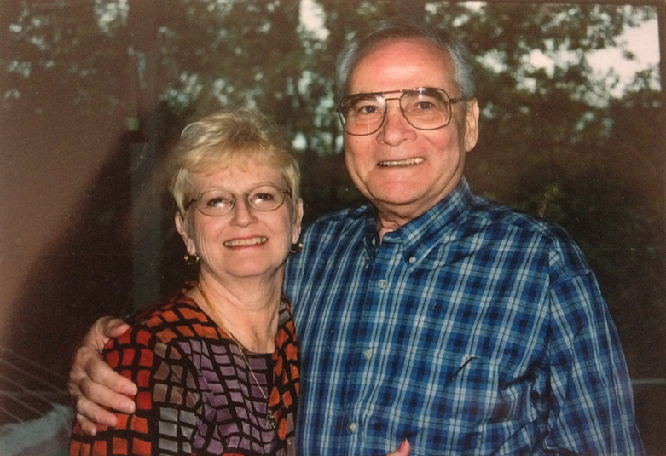

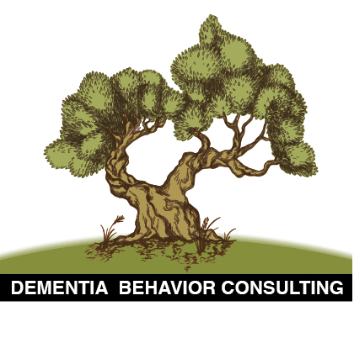
The Circumstances Surrounding the Death of 105 Elders as a Result of Resident-to-Resident Incidents (RRI) in Dementia in Long-Term Care Homes:
A Pilot Exploratory Study
Dwayne E. Walls
&
Judy Hand
Eilon Caspi PhD
Research Associate, School of Nursing, University of Minnesota
National Consumer Voice for Quality LTC Conference, October 23 2018
* Permission to use the above image was received from Dwayne’s wife Judy Hand
Notes:
General notes: x y z + The poster should be uploaded to the conference website…
Then share the story…
On Sep 11th 2008 after 9:00pm Dwayne E. Walls, a Korean War Veteran with Alzheimer’s disease, walked into another resident’s bedroom and climbed into his bed. Moments later a resident with dementia whose bed was invaded walked into the bedroom and beat him repeatedly with his cane. Dwayne was found severely injured, bleeding, and unconscious in a fetal position on the floor with the man still beating him. Dwayne died a week later.

Slide 2
Acknowledgments
The study was supported by Theresa Piccolo, wife of Frank Piccolo, Toronto, Canada
Warning
Some of the images in this presentation are disturbing and may be hard to watch

Slide 3
Disclaimer
The study findings are not meant to suggest that people with dementia are inherently aggressive or dangerous. Adopting this view would run the risk of reinforcing the stigma already experienced by this population. Rather, the findings suggest that distressing factors in the physical and social environment contribute to their engagement in these incidents.
The majority of people with dementia do not engage in serious aggressive behaviors toward others, and those who do typically do so because their human needs and situational frustrations are not met in a timely manner by well-meaning but understaffed and under trained direct care staff (the intersection between unmet needs and cognitive disabilities often contribute to these incidents).

Slide 4
Disclaimer (Cont.)
The majority of people living with dementia are not inherently dangerous (though a small subset may have lifelong aggressive tendencies that continue or exacerbate after dementia onset).
The majority are doing their best to cope with distressing situations using their remaining abilities despite cognitive disabilities caused by a brain disease such as Alzheimer’s disease or other forms of dementia.

Slide 5
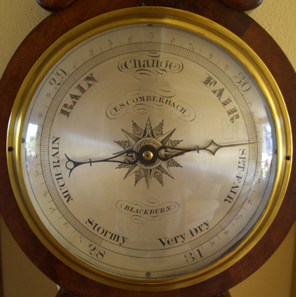
Behavioral Expressions labeled as “Aggressive” in people with dementia are mostly…
Expressions of unmet human needs
Have meaning, purpose & function to the person…
Attempts at communication that need be explored with validation – Judy Berry, president, Dementia Specialist Consulting
Attempts at gaining control over unwanted, frustrating, frightening or threatening situations
Attempts at preserving identity & dignity
=> BAROMETERS for resident’s tolerance to stressful stimuli…
Notes:
REFLECTION QUESTION:
ANY THOUGHTS ABOUT THAT YOU WANT TO SHARE? + [DO YOU FIND THAT THIS IS NOT THE CASE?]
When you look closely at these behavioral expressions…what you usually see is… [READ SLIDE]
Barometers for tolerance to stressful stimuli…and therefore can be useful in guiding development of individualized interventions…
Caspi, E. (2013). Time for change: Persons with dementia and “behavioral expressions,” not “behavior symptoms.” Journal of the American Medical Directors Association, 14(10), 768-769.
The role of language and labeling – Beyond my letter to the editor of JAMDA (separate from my Editorial), there are a few great White Papers and other resources on this issue.
…
[Definition of Barometer: an instrument that is used to measure air pressure and predict changes in the weather; + something that is used to indicate or predict something]

Slide 6
Fighting for Dignity
Dignity: “The quality or state of being worthy, honored or esteemed”
(Webster Dictionary)
Notes:
After focusing on this phenomenon for over a decade, I can tell you that in most situations residents are “fighting” with each other in an attempt to preserve their dignity.

Slide 7
Over a Century-long Problem
"…when walking about groped the faces of other patients, and was often struck by them in return."
Book: Lock (2013). The Alzheimer’s Conundrum: Entanglements of Dementia and Aging.
Auguste D. Year: 1901
Notes:
Direct care staff and practitioners who care for residents with dementia know about and cope with these behaviors for decades…Nothing new!
REFLECTION QUESTION:
WHO HERE WORKED IN LTC HOMES FOR OVER 10 YEARS? 20 YEARS? 30 YEASRS?
+ DID YOU SEE THESE INCIDENTS BACK THEN? [YES] => NOTHING NEW…RIGHT? IT IS RESEARCH THAT IS SLOW TO CATCH UP…
Say: Auguste D. is the first person to be diagnosed with Alzheimer’s disease – |||| [She died in Frankfurt on April 8 1906]
…
Grope (Google) = To feel about with the hands or To touch or handle someone… OR Webster: 1. To feel about or search for blindly or uncertainly 2. To feel one’s way by groping

Slide 8
Definition of RRI
“Negative, aggressive and intrusive verbal, physical, material, and sexual interactions between LTC residents that in a community setting would likely be unwelcome and potentially cause physical or psychological distress or harm in the recipient.”
(Rosen, Pillemer, & Lachs, 2008; McDonald et al. 2014)
Dangerous normalization of these incidents in LTC homes…
Notes:
Say at end of slide:
Prof Mark Lachs: “If someone would enter my office in Cornell U and say ‘Mark [blank] you,’ I would have to lie down for two hours. Never mind if the person would lay a hand on me.”
He added: “If those events would happen in our homes and communities, we would be horrified” (Lachs, 2014)

Slide 9
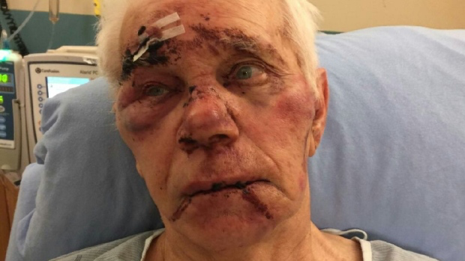
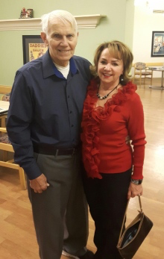
“If this happened to a child at Sick Kids hospital, people wouldn’t stand for it” – Daughter
85 years old James Acker
Attacked in his bed on Saturday after 2am by a resident with dementia in Dundas, ON
With wife Diane
Source: McLaughlin (Feb 3, 2017). CBC News
Notes:
A STAFF MEMBER SAW IT BUT COULDN’T STOP THE BEATING…
Mandatory Behavior Emergency Course
(Physical De-Escalation Techniques)
Nonviolent Crisis Intervention Training (CPI):
http://tinyurl.com/mrl5ltz
Carly Hellen & Peter Sternberg (1999). Dealing with Physical Aggression in Caregiving: Physical and Non-Physical Interventions
Violence Prevention Course (SafeCare B.C.):
http://safecarebc.ca/violence-prevention-course/
Both residents were reported to have Alzheimer’s disease ||| (according to police spokesperson).
Injuries: Head trauma (bleeding on his brain), black eyes, a fat lip, and a swollen bloody face.
The incident took place just a few weeks ago…around 2am on Saturday January 28…
! It happened after a staff member watched the other resident walk into James’ private bedroom and attack him (according to president of St. Joseph’s Villa where it took place).
The report in the newspaper article said that the staff member tried to stop the attack but wasn’t able to until police came. !!!
+
Wife: “They saw him walking down the hall, called out his name. They saw him going in, they followed him in and they couldn’t restrain him. James was beaten while kind of they watched because they couldn’t get him off, they couldn’t do anything. I don’t know if its lack of training, but they were frightful for their lives.”
Tammy Carbino, the daughter of 85 years old James Acker who has Alzheimer’s disease and was injured after being attacked by another resident with Alzheimer’s disease while he was in his own bed in his private bedroom, said she is in shock and added: “If this happened to a child at Sick Kids hospital, people wouldn’t stand for it.”

Slide 10
Underreporting
“The majority of resident-to-resident mistreatment incidents are not reported in most nursing homes” - Professor Jeanne Teresi
Low or poor quality documentation and reporting
Under investigated – Internally and externally…
Barriers for learning and prevention…
Notes:
“Complaints received in FY 2016 that did not result in serious harm and therefore were not investigated “4,031 resident-to-resident altercations.”
[in nursing homes, hospitals, and other state-licensed facilities]
OHFC prioritizes current caseload based on severity of complaints, and is only able to investigate complaints alleging actual harm due to funding constraints.
Underreporting (internally and externally) is a major barrier for prevention of these behaviors… I’ll talk about it more later…
If we don’t report it, it doesn’t exist. => Not recognizing it as a problem makes it less likely that we’re going to do something about it. It also represents a missed opportunity for prevention.
LTC homes must find ways to instill in staff the belief that reporting has tremendous preventative value, seeing it as a learning tool…not as a way to judge their performance or use punitive measures against them!
Conclusion: “Improved reporting may have the unanticipated benefit of reducing physical aggression, perhaps by fostering recognition of and intervention in events that might otherwise escalate into more serious aggression.” [Source: Article: Nolan & Citrome 2007. Reducing inpatient aggression: Does paying attention pay off?] Link: http://link.springer.com/article/10.1007/s11126-007-9058-7#/page-1
…
The MDS 3.0 (Behavior E Section) does not include questions that enable to identify the target of aggressive behaviors.
Caspi, E. (2013e). M.D.S. 3.0 – A giant step forward but what about items on resident-to-resident aggression? [Letter to the Editor]. Journal of the American Medical Directors Association, 14(8), 624-625.
I also developed a draft of new MDS 3.0 Items on DHRRI…which will be published in my book… I can share these with those interested, would love feedback, and we need to test it first…

Slide 11
Unwitnessed
“Nearly 40% of ‘resident-to-resident physical aggressive’ incidents not witnessed by staff” – Bharucha et al. (2008)
Majority of entries into other residents’ bedrooms were not witnessed by direct care staff – MacAndrew (2016)

Slide 12
High Prevalence & Incidence of RRI
Lachs et al. (2016): n= 2011 residents; 10 NHs in NY;
Resident & staff interviews, chart reviews, direct observation
1-month prevalence of residents “involved” in R-REM = 20% (Verbal = 16%; Physical = 6%; Sexual = 1%; Other = 11%)
Castle, (2012): 249 NHs in 10 states;
Mail questionnaire: n = 4,451 nurse aides; past 3 months
The number of resident-to-resident “abuse” cases is high
McDonald et al. (2015): Review found high incidence:
One-third of all cases of “abuse” in LTC homes
Notes:
To my knowledge, no study has looked at fatal RRI in dementia in LTC homes in North America.
+ A group of researchers at Monash University just published in JAGS the 1st nationwide study on 28 fatal RRI in Australia.
[DO NOT go over each of the 3 sources. ONLY SAY]: Two large studies and one literature review found that the prevalence and incidence of RRNI is high!
Non dementia-specific figures…but we know that the majority of residents in NHs have dementia ||||| (and the majority of the residents in these studies had dementia…).
Add: [Re Cornell study prevalence findings]: “Highly conservative estimate.”
+
“Other” category = e.g. taunting = “remark made in order to anger or provoke someone.” [dictionary]
McDonald et al. (in press). In most situations we should not use the term abuse in the context of residents with dementia.
…
Scale = “the number of resident-to-resident abuse cases in nursing homes.”
Scope = “the number of nursing homes with any resident-to-resident abuse.”

Slide 13
Prevalent in Minnesota
4,031 complaints related to RRI (that did not result in serious harm) were not investigated on-site by MDH during FY 2016:
Star Tribune article: When Senior Home Residents are the Abusers, State Rarely Investigates (November 14, 2018): https://tinyurl.com/yaryrhoh
Second highest only after Falls with 4,128 complaints!
“Thousands of complaints are not investigated so maltreatment continues, and less severe issues may escalate to more serious harm”
– Minnesota Department of Health (2017)
Notes:
“If less serious issues like these were addressed early on, individuals might not be seriously harmed in subsequent incidents.” – MDH
OLA MN found and expressed major concern in 2005 Audit report that lower level deficiency citations are not examined to inform prevention…

Slide 14
Consequences
Resident on the receiving end ⬅
Resident exhibiting the behavioral expression
Residents witnessing
Care staff members
Family members
Visitors
LTC home
Society
+ Substantial cost implications…
Notes:
Mild to serious consequences…
Cost implications:
Expensive emergency room visits, injuries (medical care; hip replacements), psychotropic meds, liability, higher insurance premiums, staff turnover & replacement, absenteeism, loss of productivity, property damage…
In the interest of time I will focus mostly on consequences for residents involved… --
[DASHAL: PREPARE BRIEF KEY EXAMPLES FOR EACH OF THE OTHER GROUPS]
[Next slide = Quotations from my study]

Slide 15
$1.9 Million Settlement in Oakland, CA
Resident deceased: 88 years old Olivia Deloney
Elder law attorney Felicia Curran against Integral Senior Living LLC / The Point at Rockridge (Residential Care Facility) for Negligence (October 16, 2017): https://tinyurl.com/y9s8qf5x
“We can try to make such conduct too expensive for corporate owners to risk it in another instance with other elders.”
Notes:
…and I heard that there was another separate fatal RRI leading to $1.2 million settlement…so a total of $3.2 million!!!

Slide 16
Consequences
Psychological: frustration, anger, anxiety, fear, sadness, depression, social isolation, avoidance of activities
Physical Injuries: Falls, dislocations, bruises or hematomas, reddened areas, lacerations, abrasions, fractures (hip), brain injuries
Deaths
Permission to use the image was received from Frank Piccolo’s wife Theresa
Notes:
REFLECTION QUESTION:
ANY OTHER CONSEQUENCES OF THESE INCIDENTS THAT YOU KNOW OF?
Another psychological consequence of being beaten is PTSD…
Another direct URL link to Shinoda-Tagawa et al. study: http://jama.jamanetwork.com/article.aspx?articleid=198137
Falls
One study in 2 LTC homes in Canada using video recordings in common spaces found that 9% of the falls took place during episodes of DHRRI (Robinovitch et al. 2013). [Lancet, 381; 47-54]
+
Another video-based study on circumstances and causes of imbalance found that approximately 80% of falls classified from video analysis as due to “hit-bump” (44 falls) were caused by “aggressive behavior between two residents.” The majority of these cases (63%) were not witnessed. The researchers stated, “the results illustrate that aggressive behavior between residents is a frequent, and often undetected, cause of falls in LTC” (Yang, Feldman, Leung, Scott, & Robinovitch, 2015). Only 26 falls were documented in Incident Reports as caused by “hit/bump” compared to 44 falls captured in video recordings (59%). While additional research is needed to replicate these findings, the alarming annual falls rates in nursing home may translate these figures into large ones (Nursing Home Abuse Center, 2017).
DO NOT READ ANY OF THE BELOW [THESE ARE JUST NOTES FOR ME]
…
Frank Piccolo, in 2012…a elder resident with dementia in care home in Toronto, was hit violently and repeatedly over the face and head with an activity board by another resident with dementia who entered HIS bedroom after 8:00pm. Frank’s physical condition deteriorated after the episode and he died 3 months later. His wife Theresa said: “My husband couldn’t defend himself or yell for help.” She added: “They killed [his] desire to live and he stopped eating.”
Special Investigation Division (2001) report: Abuse of residents is a major problem in U.S. nursing homes. U.S. House of Representatives:
Found: failure of many NHs to protect residents from other (abusive) residents.
“Repeated and not addressed RRA may be considered neglect” (Lachs, et al. 2007). Neglect is “the refusal or failure to fulfill any part of a person’s obligation or duties to an older adult” (National Center on Elder Abuse, 2011). +Zhang et al. (2011) found: “Residents who were victims of resident-to-resident abuse in the past year are 4 times more likely to be neglected than those w/o such mistreatment (as reported by their family members). [Study: Neglect of older adults in Michigan NHs]
Deaths subsequent to injury and/or health complications after injuries… / Numerous deaths – as documented on my archival blog…

Slide 17
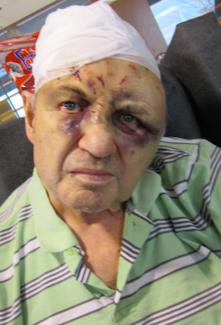
Frank Piccolo
On February 18 2012 around 8:30pm Frank Piccolo, a resident with dementia in a nursing home in Toronto, was hit repeatedly over the face and head with an activity board by another resident with dementia who entered his bedroom.
His physical condition deteriorated and he died 3 months later.
Wife Theresa: “My husband couldn’t defend himself or yell for help.”

Slide 18
Quotes
“This is a matter of serious concern. It happens very often and will be fatal.” – Resident
“Some of them really get afraid of him, and when I say get afraid…I mean get afraid…When they see him coming, they don’t want to sit in the dining room…” – CNA
“I am afraid that he will hurt someone when we don’t see it…especially someone frail whom he can take down with one blow.” – CNA
Notes:
QUESTION:
DOES THIS RESONATE WITH YOUR EXPERIENCES?
Source: Caspi, E. (2015). Aggressive behaviors between residents with dementia in an assisted living residence. Dementia: The International Journal of Social Research and Practice, 14(4), 528-546.

Slide 19
1st study on injurious RRI in nursing home in MA in 2004
Identified 294 physical injuries during a 1-year period !
Shinoda-Tagawa et al. (2004). Resident-to-resident violent incidents in nursing homes. JAMA, 291(5), 591-598: https://jamanetwork.com/journals/jama/fullarticle/198137
1st nationwide study on fatal RRI in Australia in 2017
Examined 28 deaths using Coroner records
Murphy et al. (2017). Deaths from resident-to-resident aggression in Australian nursing homes. JAGS, “Early View,” Nov 13, 2017: http://onlinelibrary.wiley.com/doi/10.1111/jgs.15051/full
Notes:
1st (and only) studies…
Monash University + Victorian Institute of Forensic Medicine
Cases were identified using National Coronial Information System (NCIS) and data on various factors were collected through review of paper-based coroners’ files.

Slide 20
“The amount of attention given to phenomena such as resident-to-resident aggression has increased over the last decade…its occurrence produces injuries and wounds identical to those resulting from abuse and may result when institutions fail to take action to prevent or manage aggression or take actions that are not sufficient to assure resident health and safety”
– CDC Division for Violence Prevention (2016)
Notes:
CDC’s good amount of focus on violence among youth and in the context of domestic violence…but what about elders’ injuries and deaths in LTC homes…

Slide 21
Gap in Research
No study on fatal RRI in dementia in LTC homes in U.S. & Canada
Notes:
Please do let me know if you are aware of a study in the U.S. that examined fatal RRI in LTC homes…

Slide 22
Study Objectives
1. Examine the circumstances surrounding the death of elders as a result of RRI in dementia in LTC homes
“In dementia” – At least one of the residents involved in the incident – either the exhibitor or target – was reported to have dementia
2. Identify practically useful patterns to inform prevention
The study is Not meant to identify the incidence of fatal RRI
The focus of the presentation is not on detailed strategies for prevention and de-escalation of DHRRI
Notes:
Objectives of the exploratory study

Slide 23
Study Citation
Caspi, E. (2018). The circumstances surrounding the death of 105 elders as a result of resident-to-resident incidents in dementia in long-term care homes. Journal of Elder Abuse & Neglect, 30(4), 284-308.
Link to abstract: https://tinyurl.com/ybrj7dew
Notes:
The study was published earlier this summer in the Journal of Elder Abuse & Neglect…

Slide 24
Qualitative Research Methods
Source of data (All publically available information):
Newspaper articles published online (over 150)
Death Review Reports (GTLCRC to CCO, 1990-2016)
Comprehensive Internet search: Spring 2012 – Fall 2017
Data detection and extraction: Structured Guide
Data Analysis (Time period: Summer – Fall 2017):
Miles & Huberman (1994) approach
Qualitative review and abstraction of narratives
Complemented with tabulation by aggregation / counts
Simple descriptive statistics
Notes:
Given lack of centralized datasets on RRI, I had to rely on a non-traditional data collection approach...

Slide 25
Findings n = Number of deaths for which data were available
Identified 105 deaths of elders (> 60 y/o) as a result of RRI in dementia in LTC homes
Time period: Deaths occurred between 1988 - 2017
Type of LTC home (n=50): Majority in nursing homes; 26% assisted living residences
Countries: Canada (n=51); USA (n=42);
Australia & New Zealand (n=4 & n=2); UK (n=5); Singapore (n=1)
Notes:
I am now aware of over 150 deaths due to RRI…

Slide 26
Findings
Characteristics of Residents
Age deceased (n=103): 84.5 years old (average)
Age exhibitors (n=76): 75.2 years old (average)
Gender deceased (n=100): Men 52%; Women 48%
Gender exhibitors (n=99): Men 74%
Newly admitted residents (< 3 months): 23 deaths

Slide 27
Findings
The Circumstances Surrounding the Deaths:
Location (n=84): Inside bedrooms (59%)
Time of day (n=63): Evening (44%) and Night (14%)
Weekend (n=94): 38%
Roommates (n=77): 43%
Not witnessed by staff (n=84): 62%
Nature of physical contact (n=99):
“Push-Fall” incidents (44%); Head and/or face beating (22%)
Object used against target (n=88): 31%

Slide 28
Findings
Nature of physical injury (n=79):
Head/face or brain injuries (50%); Hip fractures (33%)
Cause of death (n=69):
Blunt head trauma (29%)
Complications from fractures (20%)
Pneumonia (11%); Strangulation/Suffocation (10%)
Time until death (n=95): 16 days (average);
One-quarter died on same day

Slide 29
Common Triggers
Invasion of personal space
Unwanted entries into one’s bedroom
Taking personal belongings from others
Reaching a breaking point
Conflicts between roommates
Unmet human needs and situational frustrations…
Notes:
Interpersonal stressors…

Slide 30
Practical Implications
The patterns, gaps in supervision, and vulnerability areas identified could inform efforts to prevent injuries and deaths in similar circumstances.
This could be accomplished through:
Staff training programs (e.g. recognition, prevention, de-escalation).
Increase staffing levels/supervision – general & during vulnerability time periods.
Strengthen residents’ meaningful engagement (“activities”) program.
Policies and procedures (e.g. admission; roommates’ assignment; risk assessment).
Physical environment (e.g. shift to private bedrooms; floor plan/layout, etc.).
Develop and use assistive technology (e.g., to alert staff in real time).

Slide 31
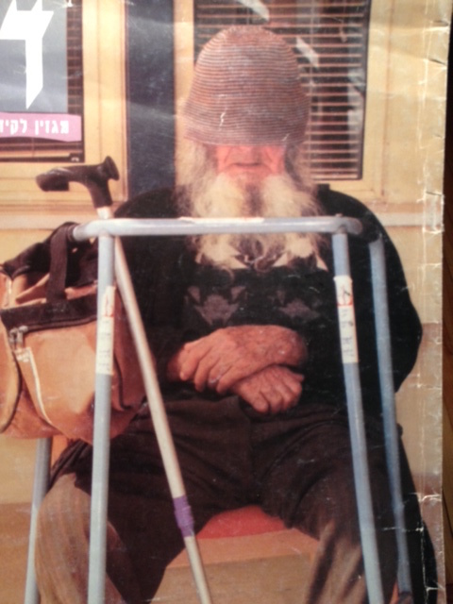
Meaningful Engagement
The reality is…
Most residents are not engaged in activities most of the time
(Cohen-Mansfield et al. 1992; Burgio et al. 1994;
Schreiner et al. 2005; Wood et al. 2005)
Boredom = The enemy of a subgroup of residents with dementia…
“A resident most at risk of an assault is bored!” - Administrator of a nursing home
Notes:
QUESTION
DOES THIS RESONATE WITH YOU?
[No notes to read here]
…
[“The number of residents who spend less than one-third of their waking time in activities is monitored by the MDS” (probably MDS 2.0). => When we’ll have even one variable in the MDS specifically on RRA, we could examine and perhaps demonstrate that higher level of engagement in activities is associated with lower number and severity of RRA episodes…- beyond the many other large-scale studies that we could conduct to enhance understanding of RRA (risk factors, characteristics, outcomes, and strategies to address these behaviors…]

Slide 32
“A wise lawyer will first approach the activity director and ask: ‘How did you engage the resident in a way that would have prevented the violence/injury against my client?’”
– Dr. Paul Raia
Notes:
Dr. Raia said in the context of RRA in dementia…
The Baby Boomers are here…they care for their parents, they see the care they receive in NHs,…and they will use lawyers…
Make sure that Recreation Therapy Department have adequate resources and funding to do their critical job as best they can…

Slide 33
Study Limitations
Inherent limitations in newspaper articles such as:
Incomplete data
Limited ability to verify accuracy of data elements (such as diagnosis of dementia)
Small sample limiting generalizability

Slide 34
Devastated Family Members Ask…
“We want to see a solution. We don’t want the death of our father to be in vain….I want to see something done so this doesn’t happen again.”
– Son of a resident with Alzheimer’s disease who died 4 days after being pushed by a resident with dementia
Inquest (2015): https://tinyurl.com/j2lc5fd (Winnipeg, MB)

Slide 35
Tragic Double Death Incident
Casa Verde Inquest, Toronto (2005):
https://tinyurl.com/zh68jlu
The Inquest contains dozens of potentially life-saving recommendations…
Notes:
Anyone who is serious about addressing this phenomenon needs to read the over 80 recommendations contained in this report….

Slide 36
Experts’ Recommendation
“We talk about violence-free schools. Why we don’t talk about violence-free nursing homes? What about ending violence in nursing homes as a policy goal?”
“Develop a comprehensive and data-driven national action plan to eliminate violence in nursing homes”
– Professor Karl Pillemer (2018)
Notes:
Note: The second statement was made in the general context of “violence” in nursing homes (in a CV webinar on resident-to-resident incidents).
Pillemer also said, “Set baselines and targets, and track progress” – but without data being collected by CMS and in ALR, how would that be possible?

Slide 37
“If we ever want to deal with this problem, we will need a national strategy”
– Professor Lynn McDonald, Toronto
Caspi, E. (2015). Policy recommendation: The National Center for Prevention of Resident-to-Resident Aggression in Dementia. JAMDA, 16, 527-534.

Slide 38

But how can we get there without a centralized national dataset?
MDS 3.0
F-Tag
Assisted Living
NORS
Tracking at state level?
Caspi, E. (2013). MDS 3.0: A giant step forward but what about items on resident-to-resident aggression? JAMDA, 14(8), 624-625.
Caspi, E. (2017). A federal survey deficiency citation is needed for resident-to-resident aggression in U.S. nursing homes. Journal of Elder Abuse & Neglect, 29(4), 193-212. Link to abstract: https://tinyurl.com/yaf3zdgg
Notes:
NORS – Tracks RRI (two codes) but my understanding is that for various reasons NORS is not meant to be used for comparison b/w states…

Slide 39
Historians of Bad Care
“What are we accomplishing if we find the same deficiencies every year? We should not be the historians of bad things that happen in nursing homes. We need to be preventive of bad things from happening… We need more analysis.”
– David Wright, director, Quality & Safety Oversight Group, CMS
Notes:
Source: Wright & Tritz, 2016 during their planery session a couple of years ago at Consumer Voice conference…

Slide 40
Buried (not) Forever
Buried (not) Forever: A Hidden Source of Injuries and Deaths in Nursing Homes. ChangingAging Guest Blog Post, August 14, 2018:
https://changingaging.org/dementia/buried-not-forever/
If you don’t track it, it doesn’t exist so you don’t have to do anything to address it…and harm to vulnerable and frail residents continues…

Slide 41
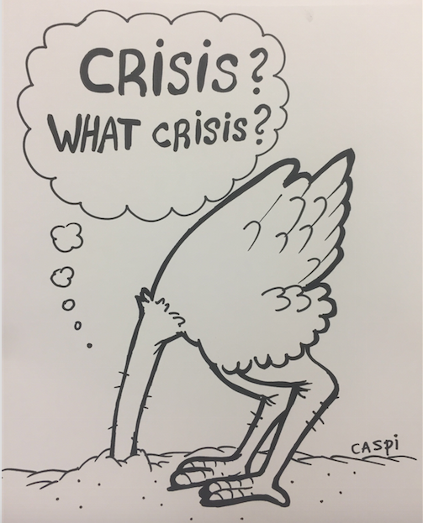
Notes:
Pandora box…

Slide 42
South Australia
Coroner calls for National Register of aggressive incidents between residents at aged care homes (ABC News, September 28, 2018):
http://www.abc.net.au/news/2018-09-28/sa-coroner-oakden/10315934?pfmredir=sm

Slide 43
Next Steps
Develop a centralized surveillance / medico-legal dataset (CMS & CDC).
Conduct the first regional and national study on injurious and fatal RRI (such as using coroner records and police records).
Bridge gap in MDS 3.0 Section E Behaviors (Caspi, 2013).
Develop a survey deficiency citation (F-Tag) for RRI in CMS-certified nursing homes (for 20 reasons why it is needed, see Caspi, 2017).
Conduct research in assisted living residences (Caspi, 2015) & VA LTC homes (CLCs & SVHs).
Evaluate staff training program to demonstrate reduction in RRI.
Evaluate the healthcare costs of distressing and harmful RRI.

Slide 44
Next Step
Analysis of Medico-Legal Databases
National Coronial Information System (Australia)
(Murphy et al. 2016: Monash University)
Canadian Coroners & Medical Examiner Database (Canada)
Review all “resident-related homicides in LTC facilities in the past 15 years”
– Dr. Roger Skinner, Office of the Chief Coroner of Ontario
Notes:
“The Committee is regularly asked to review homicides in LTC homes, where one resident causes the death of another.” – Dr. Roger Skinner
A key next step in examining fatal incidents should be to analyze coroner records on fatal RRI at the state and national levels…
VIFM = Victorian Institute of Forensic Medicine
Briony Murphy (Australia): Told me a few days ago that she completed analyzing 28 DEATHS (due to RRI) that took place OVER 14 YEARS.
[Used Coroner records which are a rich source of information on unnatural deaths]
Murphy & Ibrahim et al. (2016) [in response to my Editorial in JAMDA]:
Our research is beginning to address this gap, with a study that identified 7 fatal cases of RRA in the state of Victoria, Australia, over 12 years. We are currently completing the first nationwide study in Australia of fatal incidents of RRA in nursing homes based on coroners’ records. This study will comprise a detailed examination of the individual, organizational, and systemic factors present and contributory to these deaths, using coronial records. Coronial records are the richest source of information on unnatural deaths, as they include witness statements, police reports, autopsy findings, medical and/or nursing home records where available, and the coroner’s finding. ||| This approach is a considerable undertaking, requiring sophisticated search methods to identify cases, permission from each coronial office to attend in person to review the records, in addition to obtaining human ethics approval. Issues surrounding consistency in recorded coronial information and limitations in postmortem testing (e.g. toxicology analysis, medical autopsy) in this population of older adults also must be considered.” [Source: Response to my Editorial in JAMDA]
VIFM, Monash U: “Doctoral candidates with the Unit are investigation preventable deaths from suicide and resident-to-resident aggression; deaths from choking and; barriers to implementing dignity of risk in aged care services. In 2016-17 we anticipate commencing research investigating health care related premature deaths investigated by the coroner in Australia over the past decade.” [Source: Dr. Ibrahim’s Research profile webpage]
+ e.g. Ontario Ministry of Health & Long-Term Care’s Inspection Reports…
? = I put “?” next to 2 of the databases b/c it is unclear at this point if they contain enough information and in good quality re fatal RRI…
If these datasets do not contain relevant and good quality data on harmful RRI, these data should be developed and added to these and other datasets…
Recommendation: Review resident-to-resident homicides in LTC homes in Ontario that occurred in the past 15 years.
[Source: Report by the Office of the Chief Coroner of Ontario (2015) – Regional Supervising Coroner Dr. Roger Skinner]
+ Inquests…e.g. Chief Coroner of Ontario re the deaths of two residents in one episode – El-Roubi & Lopez – by another Pira Sing Sandhu
[Inquest = an inquiry into the deaths of people]

Slide 45
Goal
“Preventing future deaths in similar circumstances”
– Dr. Roger Skinner, Office of the Chief Coroner, Toronto
“We speak for the dead to protect the living”
– Thomas D’Arcy McGee (1825-1868)
Notes:
JUST SAY: A LOT CAN BE LEARNED FROM INJURIES AND FATAL INCIDENTS…
Fatal incident in Kansas City Missouri. Pearl Booker (95 y/o) woman was beaten to death by 84 y/o John Wallace Borden who had Alzheimer’s disease. Pearl was found dead in her bed on April 17, 1988. Borden was admitted to the care home just 5 days earlier (April 12, 1988). Warning signs: “The police investigation showed Borden bothered Booker in her adjoining bedroom for 3 straight nights. For example, police said that on “His 1st night there, Borden beat Booker on the legs.” The fatal incident occurred at Blue Hills Centre Nursing Home.
According to the report, Borden may have been the 1st person with AD to be charged with murder.

Slide 46
Recommendation
Death Review Teams
Geriatric Long-Term Care Review Committee (GLTCRC) Office of the Chief Coroner of Ontario
Reviews sudden and unexpected deaths – such as due to “violence” – in publicly funded LTC homes in Ontario since early 1990’s (under the Coroners Act)
…and makes reviews publicly available in Annual Reports: https://tinyurl.com/y96l689w
Notes:
Such as deaths as a result of violence and negligence…

Slide 47
Call for Action
CMS
CDC Division for Violence Prevention
U.S. OIG
U.S. Government Accountability Office
AARP
Alzheimer’s Association
Argentum (formerly Assisted Living Federation of America)
Department of Veterans Affairs (Geriatrics & Extended Care)
Urgently need to examine and address this phenomenon to ensure that vulnerable and frail residents realize their human and Federal right to live in a safe care environment
Notes:
AARP. Alzheimer’s Association,

Slide 48
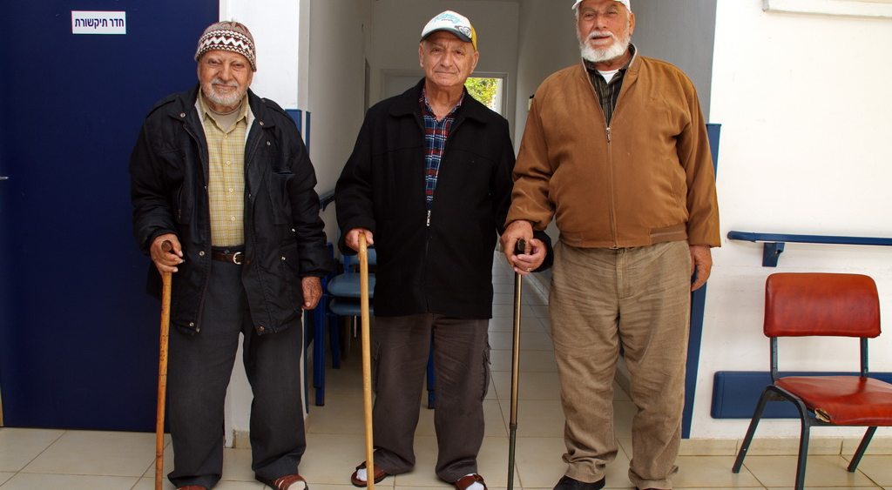
Questions / Discussion
Permission to use this image was received from Ofir Ben Natan, ESHEL, Israel
Notes:
We’ll open for discussion, comments, and questions…
I hope to learn from you about how all this plays out among Veterans with dementia!

Slide 49
Notes:
Systemic issues (oftentimes) -- …and therefore we need a comprehensive and well-orchestrated approach and interventions…

Slide 50

Assessment-based
“Anticipatory Care Approach”
(Professor Christine Kovach)
What’s in your quiver?
Recognizing Early Warning Signs of Distress (Caspi)
Behavioral Expressions Log (Caspi)
R-REM Instrument (Teresi et al. 2013)
ABRAT-L for newly admitted residents (Kim et al. 2017)
Brøset Violence Checklist (Almvik et al. 2007)
Evaluation of Urgency of DHRRI Form (Caspi)
Interdisciplinary Screening Form (DHRRI & dementia-specific) (Caspi)
Behavior Intervention Plan Form (adapted from Dr. Paul Raia)
Notes:
ABRAT-L = Aggressive Behavior Risk Assessment Tool for newly admitted residents in LTC homes (Kim et al. 2017)
Six items: 1. History of physical aggression; 2. Physically aggressive/threatening; 3. Anxiety; 4. Confusion/Cognitive impairment; 5. Threatening to leave
+ 6. Age less than 85 y/o
SAY
THOSE OF YOU WHO ARE interested IN LEARNING MORE ABOUT THESE TOOLD, JUST EMAIL ME…
Recognizing early warning signs: 7 domains:
Physiological signs of anxiety; 2. Tense body language; 3. General signs of anxiety; 4. Facial expressions signaling anxiety;
5. Hands Signals of anxiety; 6. Signs of anger; 7. Frightened facial expression.
Handout:
Interdisciplinary Screening Form – RRA & Dementia-specific – is in late stages of development / work in progress…
Behavior Intervention Plan Form (Dr. Paul Raia) = late stages of development…
Proactively assess & treat physical discomfort, medical needs (UTI; Constipation, etc.) and pain (assessment tools: Hadjistavropoulos et al. 2010)
Assess risk of imminent violence using the 6-item Brøset Violence Checklist (Almvik et al. 2007)
Good prediction of violent behavior within the same shift or next shift…and fairy good within 24 hours…
Evaluation of Urgency of DHRRI Form
…
(Discomfort Scale in Dementia of Alz Type – Hurley et al. 1992)
+
Assess & treat pain (assessment tools in LTC residents with dementia – Hadjistavropoulos et al. 2010)

Slide 51
Contact Information
Email: eiloncaspi@gmail.com
Website: http://dementiabehaviorconsulting.com
Webpage at University of Minnesota:
https://www.nursing.umn.edu/bio/faculty-staff/eilon-caspi
Archival Blog (Since April 2012):
The International Center for Prevention of DHRRI in dementia in LTC Homes:
http://eiloncaspiabbr.tumblr.com
Notes:
I will make the Vimeo on prevention available online free of charge soon…

