Slide 1
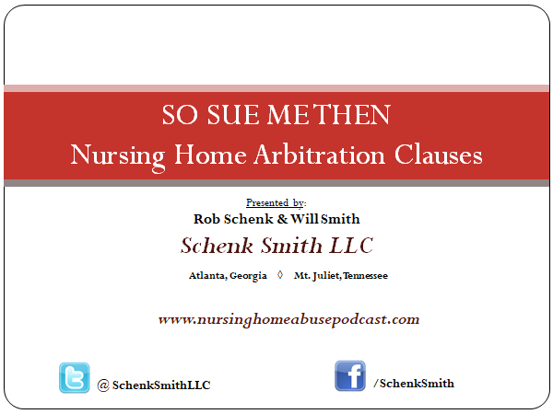

Slide 2

Notes:
Fifty thousand foot view of arbitration in nursing home contracts so you have the necessary knowledge and understanding to discuss this issue with lawmakers both locally and on the federal level

Slide 3
YOU KNEW WE’D HAVE A DISCLAIMER!
This is not legal advice nor is it meant to be an in depth discussion of litigation or arbitration.
Each state has different laws and regulations regarding civil litigation and arbitration.
If a resident or a family member has legal questions you should always refer them to a local attorney in your state.
Notes:
WE ARE LAWYERS OF COURSE WE HAVE FINE PRINT AND A DISCLAIMER

Slide 4
What is Arbitration?
What are the benefits?
What are the problems with it?
What is the current CMS rule on Arbitration Clauses?
What rights do residents have with Arbitration Clauses?

Slide 5

TORT
Notes:
Before we talk about arbitration we have to discuss torts. What is a tort?

Slide 6
TORT
A tort is a civil wrong committed by one individual (or corporation) against another.
Not a criminal wrong against society and not a breach of contract.
There are several types of torts: Intentional torts, privacy torts, negligence, and products liability.
We are primarily looking at negligence. Although abuse can have intent.

Slide 7
NEGLIGENCE
Duty - The defendant owed a legal duty to the plaintiff under the circumstances;
Breach - The defendant breached that legal duty by acting or failing to act in a certain way;
Causation - It was the defendant's actions (or inaction) that actually caused the plaintiff's injury; and
Damages - The plaintiff was harmed or injured as a result of the defendant's actions

Slide 8


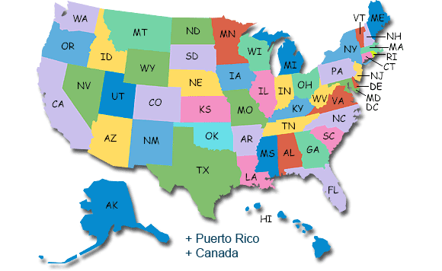

Notes:
DUTY is imposed by government regulations and guidelines, state regulations and guidelines, and by principals of common law.

Slide 9
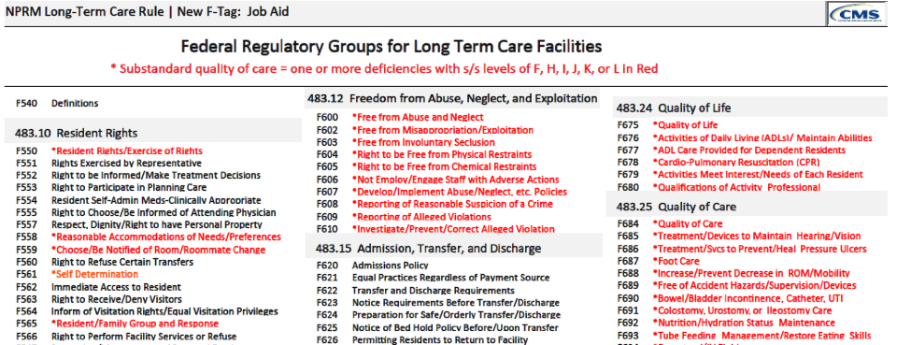
DUTY

Slide 10


CIVIL MONETARY PENALTIES
Notes:
State inspectors can impose CMP’s for violations of federal regulations.

Slide 11
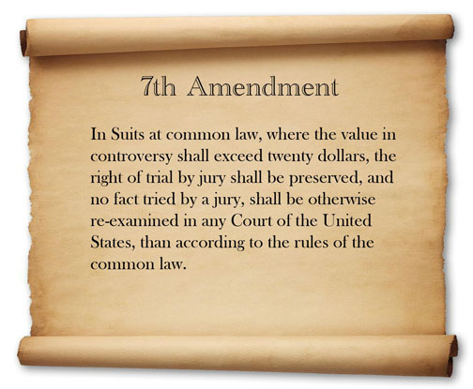
Notes:
So what does all this matter? We have a right to sue when someone breaches a duty and it causes us damages.

Slide 12
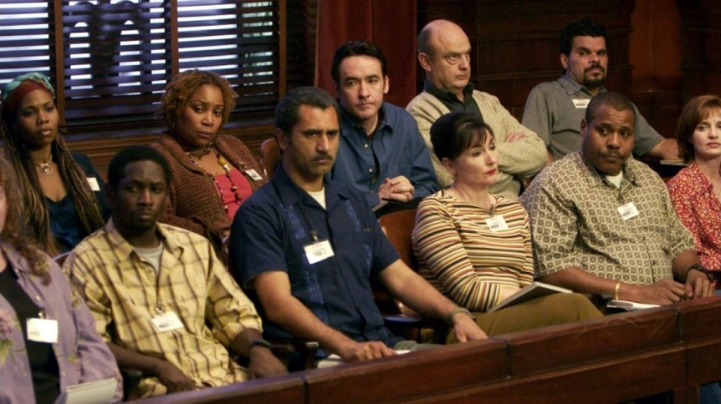
Notes:
This is the very heart of the matter we are dealing with. Public awareness.

Slide 13

DAMAGES
Notes:
One objective in a negligence suit is monetary compensation. We can’t undo a harm, we can’t bring back the dead.

Slide 14
Notes:
In addition to monetary compensation there is public awareness
All these people will know what the nursing home did.

Slide 15
LITIGATION
MEDIATION
ARBITRATION
Notes:
There are three terms you may hear when people discuss lawsuits. Litigation is the actual process of proceeding with a lawsuit. Arbitration is an alternative to litigation. Mediation is simply the process by which two parties use a third party to help them settle the case. The big difference in these three terms is that litigation seeks to have a jury trial. Both Mediation and Arbitration are known as Alternative Dispute Resolution.

Slide 16
ADR- Alternative Dispute Resolution
Arbitration v. Mediation
Mediation -> Let’s try and work this out BEFORE we go to trial.
Arbitration -> Let’s work this out INSTEAD of trial.
Notes:
Both Arbitration and Mediation are ADR

Slide 17

Plaintiff Mediator DEFENDANT Defendant

Slide 18
ARBITRATION v. JURY TRIAL
Arbitration - Arbitrator listens to both sides and makes decision. Arbitrator or a panel of arbitrators, sits as both judge and jury.
Jury Trial - A group of local citizens hear evidence from both sides and determine whether the defendant is liable and if so what, if any, money is owed to the plaintiff.

Slide 19
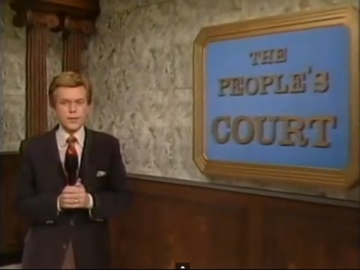
The litigants are real...
Notes:
Daytime Judge shows are Arbitration

Slide 21
Except as prohibited by applicable law, pursuant to the Federal Arbitration Act, any action, dispute, claim, or controversy of any kind (e.g., whether in contract or in tort, statutory or common law, legal or equitable, or otherwise) now existing or hereafter arising between the parties in any way arising out of, pertaining to or in connection with the provision of health care services, any agreement between the parties, the provision of any other goods or services by the health care center or other transactions, contracts or agreements of any kind whatsoever, any past, present or future incidents, omissions, acts, errors, practices or occurrence causing injury to either party whereby the other party or its agents, employees or representatives may be liable, in whole or in part, or any other aspect of the past, present, or future relationships between the parties shall be resolved by binding arbitration administered by the National Health Lawyers Association ( the “NHLA”)
Notes:
Example of what the clause looks like.

Slide 22
Notes:
In addition to monetary compensation there is public awareness
All these people will know what the nursing home did.

Slide 23
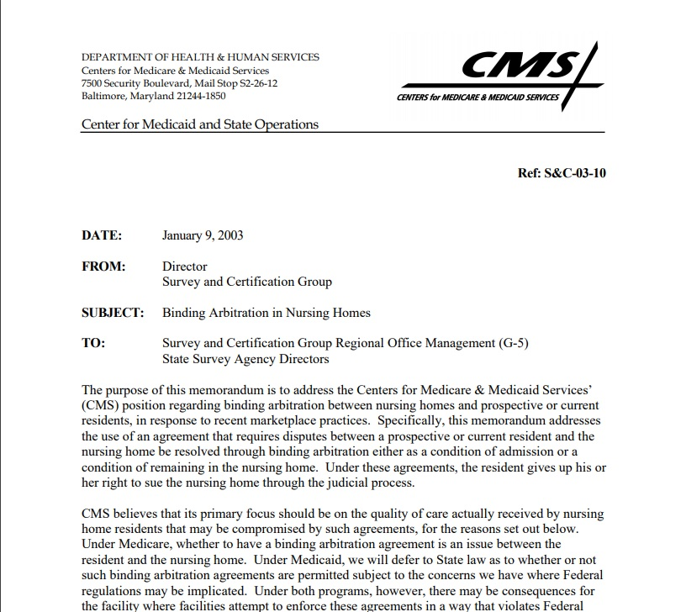
Notes:
In 2003 under HHS Secretary Tommy Johnson of the Bush administration CMS addressed the issue of pre-dispute arbitration agreements and left it to the residents and the states.

Slide 24


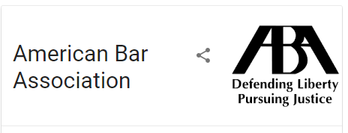
Notes:
CMS received 10k comments regarding their proposed reforms. 1k of which were related to arbitration

Slide 25
SEPTEMBER 2016
CMS issued a Final Rule that beginning November 28, 2016, nursing homes and other covered facilities can no longer require or even ask residents to sign agreements to submit future disputes to negotiation
The regulations were published in the Federal Register on October 4, 2016. 81 Fed. Reg. 68688 (Oct. 4, 2016)

Slide 26
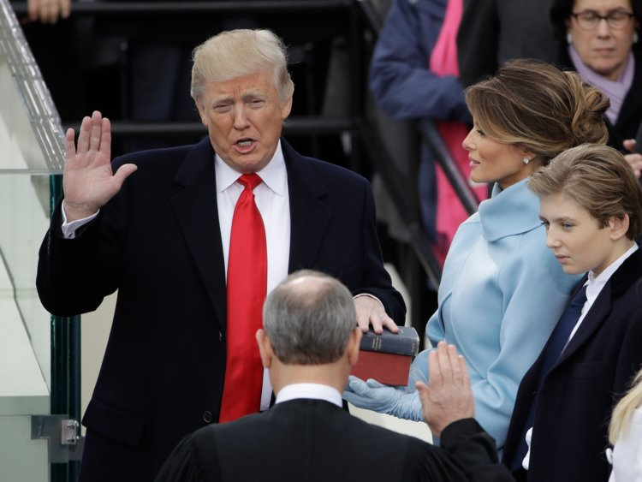
Notes:
Then something happened in 2016

Slide 27
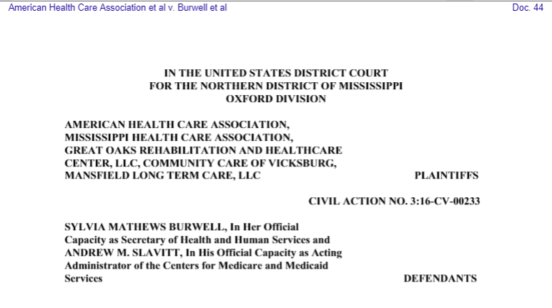
The healthcare industry fought back...
Notes:
Sought prelim injunction to prevent HHS and CMS from implementing rule on arbitration

Slide 28
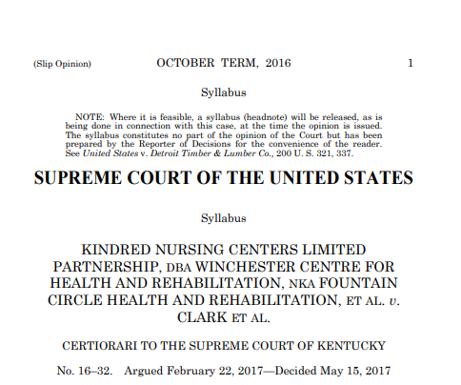
Notes:
Appealed Kentucky court’s ruling that extra measure was required to waive right to 7th amendment

Slide 29

Notes:
Where are we now.

Slide 30
New Proposed rules on pre-dispute arbitration agreements
The prohibition on pre-dispute binding arbitration agreements is removed.
All agreements for binding arbitration must be in plain language.
If signing the agreement for binding arbitration is a condition of admission into the facility, the language of the agreement must be in plain writing and in the admissions contract.
The agreement must be explained to the resident and his or her representative in a form and manner they understand, including that it must be in a language they understand.
The resident must acknowledge that he or she understands the agreement.
The agreement must not contain any language that prohibits or discourages the resident or anyone else from communicating with federal, state, or local officials, including federal and state surveyors, other federal or state
health department employees, or representatives of the State Long-Term Care Ombudsman.
If a facility resolves a dispute with a resident through arbitration, it must retain a copy of the signed agreement for binding arbitration and the arbitrator’s final decision so it can be inspected by CMS or its designee.
The facility must post a notice regarding its use of binding arbitration in an area that is visible to both residents and visitors.

Slide 31

Good, Bad, and the Ugly

Slide 32

Why they say it’s good for residents
Notes:
Why the nursing home industry says arbitration is good for residents.

Slide 33

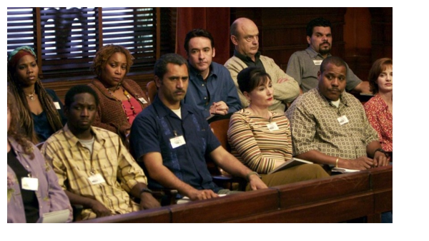
The bad
Notes:
It costs money to hire arbitration judges. It also pays out less money than a jury trial.

Slide 34
The Ugly

Slide 35
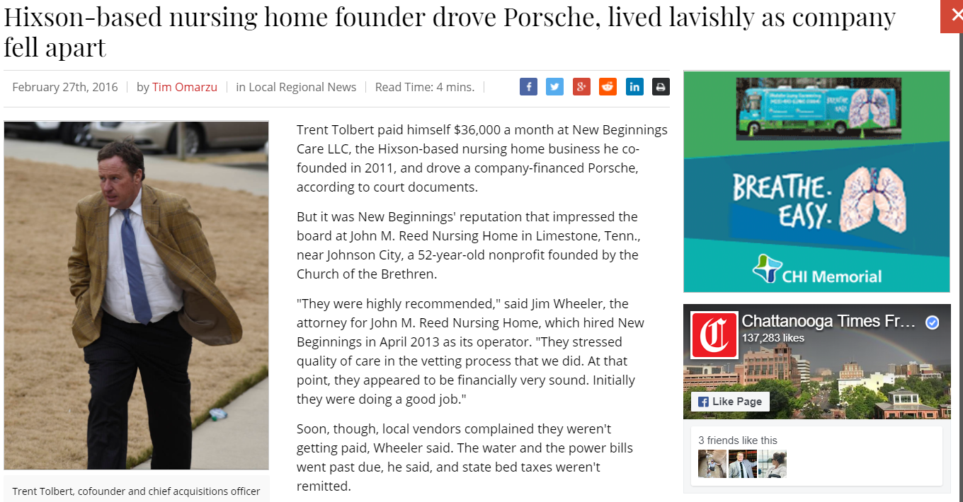
Notes:
$36000 a month but not enough money for staffing?

Slide 36
Office of Inspector General 2014
22% of Medicare beneficiaries experienced abuse
11% Experienced harm
$2.8 Billion spent on hospital treatment for harm caused in 2011

Slide 37
Know this…….
Contracts of Adhesion
CMS is reimbursed in successful LTC lawsuits by plaintiffs
There is no SCOTUS rule against CMS prohibition
Congress may still make a law prohibiting them
Arbitration agreements are still subject to state contract laws.
Residents do not “have to” sign them, period.

