Slide 1

Successfully challenging facility-initiated transfers and discharges
42nd Annual Consumer Voice Conference
Tuesday, October 23

Slide 2
SUCCESSFULLY CHALLENGING FACILITY- INITIATED TRANSFERS AND DISCHARGES
CONSUMER VOICE
Oct. 23, 2018
Toby S. Edelman
Center for Medicare Advocacy

Slide 3
OVERVIEW OF TRANSFER AND DISCHARGE
LAW, REGULATIONS, SURVEYOR GUIDANCE
Nursing Home Reform Law (1987) carried forward limited permissible reasons for involuntary transfer and discharge; established notice, appeal, and hearing rights for residents; made bed-hold under Medicaid a resident’s right. 42 U.S.C. §§1395i-3(c)(2)(A)-(C), 1396r(c)(2)(A)-(D), Medicare and Medicaid, respectively.
Comprehensive regulations, 42 C.F.R. §483.15(c)-(e).
Surveyor guidance, State Operations Manual, CMS 100-07, Appendix PP, pp. 167-188, https://www.cms.gov/Regulations-and-Guidance/Guidance/Manuals/downloads/som107ap_pp_guidelines_ltcf.pdf.

Slide 4
NURSING HOME REFORM LAW
Detailed provisions in the 1987 Nursing Home Reform Law address permissible bases for involuntary transfer/discharge; notice; documentation; appeal rights; discharge planning
42 U.S.C. §1395i-3(c)(2)(A)-(C), 1396r(c)(2)(A)-(D), Medicare and Medicaid, respectively.
Identical provisions in Medicare and Medicaid laws, except that Medicaid includes bed-hold rights (right to return to facility/bed).

Slide 5
REGULATIONS
42 c.f.r. §483.15
Involuntary transfer or discharge only for 6 specified reasons
Written advance notice required
Documentation required
Appeal rights
Discharge planning
Bed-hold (Medicaid only)
Issue brief: http://theconsumervoice.org/uploads/files/issues/Revised_Nursing_Facility_Regulations_Involuntary_Transfer_and_Discharge.pdf

Slide 6
SURVEYOR GUIDANCE
State operations manual, appendix PP, F622-F626
More detail, representing CMS’s official interpretation of the law and regulations.
CMS 100-07, Appendix PP, pp. 167-188 (F622-F626), https://www.cms.gov/Regulations-and-Guidance/Guidance/Manuals/downloads/som107ap_pp_guidelines_ltcf.pdf

Slide 7
SURVEYOR GUIDANCE
Helpful guidance
  Non-payment means
    resident has not submitted paperwork for third-party payment (i.e., has not applied for Medicaid) or
    resident refused to pay after third party denied payment.
  Facility cannot discharge resident while appeal is pending.

Slide 8
TRANSFER/DISCHARGE ARE #1 COMPLAINT TO OMBUDSPROGRAM
Why is transfer/discharge the #1 issue for the ombudsman program, when rules defining transfer and discharge have been clear and essentially unchanged for decades?

Slide 9
MULTIPLE REASONS
Non-enforcement of the Requirements
Major disconnect between requirements and which state agency is responsible for transfer/discharge

Slide 10
Non-enforcement
CMA analysis of enforcement deficiencies since new survey process was implemented in Nov. 2017 (through July 2018) found 137 deficiencies were cited nationwide.
  1 immediate jeopardy; 3 actual harm
  133 no harm or substantial compliance (97%)
Noncompliance is treated solely like an issue of paperwork; surveyors typically do not look beyond paperwork.
Report at http://www.medicareadvocacy.org/wp-content/uploads/2018/09/Nursing-Homes-Report-Transfer-and-Discharge-Deficiencies.pdf

Slide 11
REASONS FOR TRANSFER/DISCHARGE
To the extent we can tell from survey reports,
  Most often: Resident resisted care, was difficult to care for, complained, violated facility rules (e.g., smoking), used wheelchair unsafely.
  Emergency discharge to hospital (no detail, just that paperwork was not completed)
  1 case: facility “downsizing” (i.e., creating 56 private rooms)
  Reason not given; surveyors find that facility did not comply with federal requirements for consultation before issuing notice, for content of notice, for determination that facility could not meet resident’s needs.

Slide 12
IMMEDIATE JEOPARDY TRANSFER/DISCHARGE DEFICIENCY
Special Focus Facility in Tennessee discharged resident to hotel while administrative appeal was pending (ALJ had delayed hearing so that resident could get an attorney).
Facility discharged resident Friday night; drove resident to hotel in facility van; paid for 3 nights at hotel; did not send all medications; did not consult physician; by Monday, resident had eaten 2 boxes of peanut butter crackers and candy.
6 jeopardy deficiencies cited.

Slide 13
disconnect between requirements and which state agency is responsible for transfer/discharge
ALJs are generally in Medicaid agencies.
State survey agencies do not enforce decisions of Medicaid agencies.

Slide 14


“Make room for MCAs”:
How Two State Agencies Challenged a
Discharge-Driven Nursing Home Business Model
October 23 - Morning Plenary
Joshua N. Auerbach
Assistant Attorney General, Office of the Attorney General of Maryland
Stevanne Ellis
Maryland State Long-Term Care Ombudsman

Slide 15

Impact of involuntary discharge on residents and families
“Discharge/eviction” has long been the most frequent nursing facility complaint category processed by Long-Term Care Ombudsman programs nationally; 8,478 “discharge/eviction” complaints processed in FY 2013
“Discharge/eviction” was most frequent type of nursing home complaint received by Maryland LTC Ombudsman program from FY10-FY17

Slide 16
Harms associated with involuntary discharge
Immediate risk to resident safety and health
Disruption of existing healthcare arrangements and provider relationships
Isolation of resident from family, social network and community
Trauma of eviction/transfer trauma

Slide 17
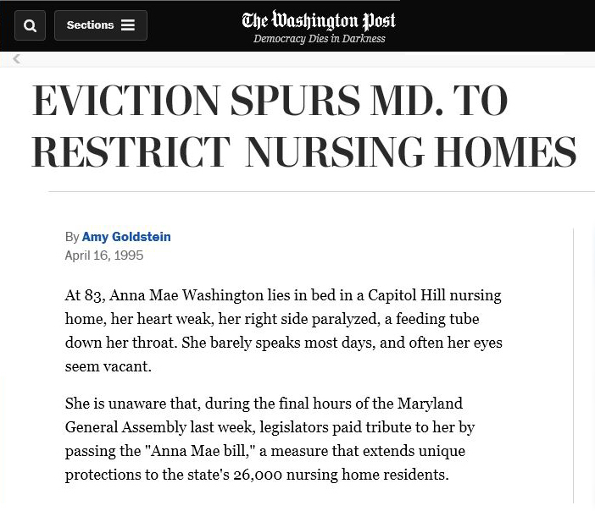
“Anna Mae’s Law,” 1995

Slide 18
Maryland Patient’s Bill of Rights & “Anna Mae’s Law”
Maryland Patient’s Bill of Rights recognizes that nursing facility residents have “basic rights,” including “[t]he right to be treated with consideration, respect, and recognition of human dignity and individuality.”
Amended in 1995 as part of “Anna Mae’s Law” to include substantial new protections against unfair and unsafe discharges, after Maryland facility left an 83-year-old, wheelchair-dependent resident on front porch of her guardian’s home in late December 1993
Then-Attorney General J. Joseph Curran was lead advocate for “Anna Mae’s Law”
Limits involuntary discharge to six circumstances recognized in federal law, including non-payment “after reasonable and appropriate notice,” see also 42 C.F.R. § 483.15(c)(1)(i)
Establishes presumption that involuntary discharge is unlawful “if the resident is or becomes eligible for Medicaid benefits”
Requires “post discharge plan of care” and discharge to a “safe and secure environment”
Authorizes Attorney General to obtain “injunctive relief” against unlawful discharges

Slide 19
LTC Ombudsman process in cases of involuntary discharge
As a result of “Anna Mae’s Law,” Maryland nursing facilities have been required since 1995 to provide copies of all involuntary discharge notices to the LTC Ombudsman Program (recently made a requirement of federal law)
Program attempts to contact resident or responsible party in all cases
Explains the resident’s rights related to involuntary discharge, including right to mediation and administrative hearing
Offers ombudsman assistance throughout the process
Resident’s right to legal counsel
Resident’s right to a safe and appropriate discharge

Slide 20
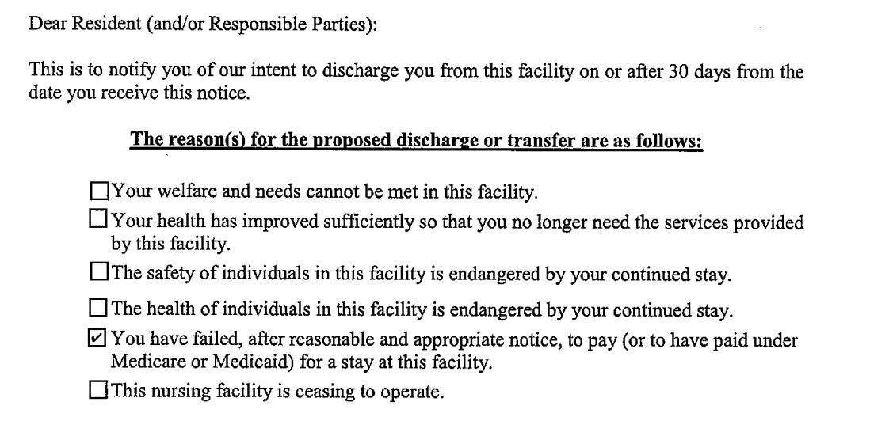
“You have failed, after reasonable and appropriate notice, to pay…”

Slide 21
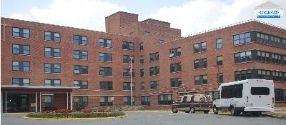
Neiswanger Management Services (NMS)
Operated five Maryland nursing homes, with 782 beds
Real estate acquired by healthcare real estate investment trust (REIT) in 2015 and 2016 for $284 million
More than $100 million in annual revenues; approximately 90% of revenues from Medicare and Medicaid

Slide 22
Patterns observed: timing of discharges
Extraordinary number of discharge notices, more than any other company
Discharge notices issued before Medicare coverage was exhausted.
Vast majority of notices identified, as reason for eviction: “You have failed, after reasonable and appropriate notice, to pay . . . for a stay at the facility.”
At times, the notices were issued to resident’s former address or an incorrect address and not received by resident or family.
Residents discharged after 100 days, when Medicare coverage for post-acute care was exhausted.
Residents and families often not informed about how to apply for long-term care Medicaid, or the facility applied for Medicaid without informing the resident and family.

Slide 23
Patterns observed: discharge planning
Residents, families and guardians often were not included in the discharge planning process.
Residents, families and guardians often received no advance notice of the date of discharge or the discharge destination.
Over time, certain residents admitted and discharged on multiple occasions from various NMS facilities after exhaustion of multiple Medicare-paid stays for post-acute care.
Inadequately-trained discharge planners, few if any were social workers, and some had been reassigned from other responsibilities in the facilities.

Slide 24

Impact on residents and families
Discharges away from family members, separated from family members
Discharges to shelters and motels
Discharges to unlicensed assisted living facilities and other inappropriate placements
Discharge to a storage unit (it had electricity)
Improper care and in some cases abuse by
owners and staff at unlicensed facilities

Slide 25
Impact on the Ombudsman program
Ombudsman staff spent more time working on these cases than others including the mediation and hearing meetings which led to a major commitment of program resources.
Involuntary discharge notices were sent to incorrect or out-of-date addresses. In these cases, the ombudsman office was informed of the discharge notice before the resident and family, and had to explain to resident and family the prospect of discharge.
Ombudsman staff had to provide information that the facility had not provided, including information about discharge planning and the application process for Medicaid long-term care benefits.

Slide 26

Ombudsman program meeting with NMS, May 2015
Local and State Ombudsmen
Discussed the number of discharges – more discharge notices than any other company
Discussed the timing of involuntary discharge notices
Encouraged the facility to explain payment options including Medicaid and to assist residents and families with the application process
Discussed the importance of discharge planning
The ombudsman program goal was to meet to try to resolve the problems

Slide 27
Office of the Attorney General investigation, May 2016
LTC Ombudsman program seeks OAG assistance in addressing discharge practices at NMS
In May 2016, OAG initiates civil investigation under Maryland False Health Claims Act, including pre-litigation discovery requests
  Discharge planning as nursing facility service
  “Implied false certification” of compliance with Patient’s Bill of Rights, see Universal Health Services, Inc. v. United States ex rel. Escobar, 136 S. Ct. 1989 (2016)
Review of deficiency statements
Interviews with evicted residents, family members, and others
Statewide review of involuntary discharge notices
Analysis of MDS length-of-stay data

Slide 28
OAG findings, as alleged in State v NMS
From 1/1/15 to 5/31/16, issued 1,061 involuntary discharge notices (1,038 for failure to pay); during same period, Maryland’s 225 other licensed facilities sent a total of 510 notices
Most notices issued on or around Day 70 of resident’s stay
Stated policy to issue involuntary discharge notices for “failure to pay” in advance of exhaustion of Medicare benefits
From 7/1/15 to 6/30/16, discharged 182 residents on exactly Day 101 of resident’s stay; during same period, Maryland’s 225 other licensed facilities discharged a total of 260 residents on exactly Day 101
Reimbursement differential: e.g., Medicaid LTC = $274; Medicare RUB/RUC = $611
Questionable capacity determinations
Inaccurate documentation
“Low CMI” [case mix index]
“Make room for MCAs” [Medicare Part A]

Slide 29


Impact on evicted residents, as alleged in State v. NMS
Dozens of residents discharged to predatory “personal care homes” (unlicensed assisted living facilities) in Baltimore and Washington
Many residents discharged to Baltimore had no connection to the city
Dozens of residents discharged to homeless shelters, including out-of-state homeless shelters in West Virginia and DC
Many residents discharged to motels
Many residents discharged home, but without adequate notice, support or planning for continuity of care
Frequent appearances in hospital emergency rooms within days of discharge
Medical emergencies precipitated by lack of discharge planning, e.g., dialysis not scheduled, nebulizer not provided, resident left alone and disoriented in driveway, wheelchair-dependent resident left without operable wheelchair
Multiple evictions of people with mental illness or intellectual disabilities, with re-admission after Medicare “qualifying hospital stay”

Slide 30
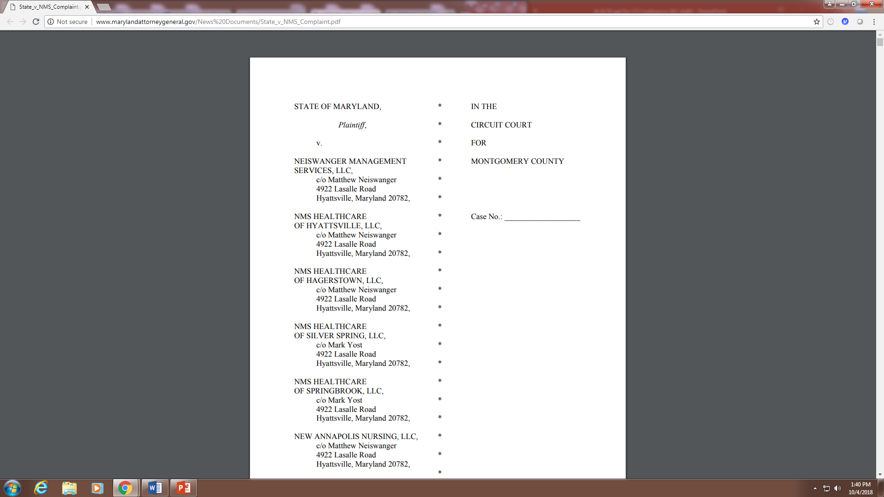
State of Maryland v. Neiswanger Management Services, LLC, et al., Circuit Court for Montgomery County, Case No. 428607V, filed December 2016
http://www.marylandattorneygeneral.gov/News%20Documents/State_v_NMS_Complaint.pdf

Slide 31
Legal claims in State v. NMS
Two counts: (1) Injunctive relief under Patient’s Bill of Rights against unlawful discharge practices; (2) Treble damages and penalties under False Health Claims Act
Request injunction that would, among other things:
  Require, before issuance of discharge notice, an actual failure to pay and “reasonable and appropriate notice” of non-payment
  Prohibit targeting of residents for discharge based on Medicaid participation, likely Medicaid participation, or CMI score
  Require facilities to “cooperate with and assist” residents and families in applying for Medicaid LTC benefits
  Require development of “post-discharge plan of care,” with specific attention to continuity of care
  Require attempts to engage family in discharge planning process
  Require advance notice of date of discharge and discharge destination
  Prohibit discharge of residents requiring nursing home level-of-care to homeless shelter or unlicensed assisted living facilities
Almost no prior state court litigation on merits under either statute

Slide 32

State v. NMS, Court of Appeals of Maryland, February 2018
In April 2017, Circuit Court dismissed claims for injunctive relief under Patient’s Bill of Rights but declined to dismiss claims under False Health Claims Act
In February 2018, Court of Appeals of Maryland reinstated injunctive relief claims, holding that Attorney General has authority under Patient’s Bill of Rights to obtain “complete injunctive relief” against unlawful company-wide practices, see State v. Neiswanger Management Services, LLC, 457 Md. 447, 474 (2018)
The Patient’s Bill of Rights “demonstrate[s] clear legislative intent to limit involuntary discharges and transfers, and ensure that, when they do occur, they are subject to procedural controls ensuring a resident’s health and
safety,” id. at 464-65
Scheduled for trial February 2019

Slide 33

Media Accounts
“Md. attorney general says nursing homes kicked out patients to boost Medicare payments”, Washington Post
“Operator of Hagerstown nursing home charged with dumping residents”, Herald-Mail Media
“Maryland Sues ‘Inhumane’ Nursing Home Provider”, Courthouse News Service
“As Nursing Homes Evict Patients, States Question Motives”, NPR
“When Nursing Homes Push Out Poor And Disabled Patients”, Kaiser Health News

Slide 34
Post-filing events
NMS filed suit in federal court against State regulators in March 2017, alleging that State regulatory activities were retaliatory
Federal and State agencies terminated participation of NMS Hagerstown in Medicare and Medicaid programs; NMS Hagerstown closed in June 2017
Healthcare real estate investment trust (REIT) terminated leases with NMS at all five facilities
In February 2018, new operator assumed responsibility for operating four of the five facilities

Slide 35
Interagency convening
Challenges:
  Resource scarcity
  Incomplete expertise: discharge planning, capacity evaluation, eligibility processes, intellectual disabilities and mental illness, Medicaid conditions of participation/payment, MDS data, corporate governance
  Diffuse enforcement authority: licensure regulations, Medicaid conditions, Ombudsman advocacy, False Claims Act enforcement
State agencies: LTC Ombudsman, Office of the Attorney General, Office of Health Care Quality (OHCQ), Maryland Medicaid, Area Agencies on Aging, Adult Protective Services
Others: Maryland Legal Aid Bureau, guardians and elder law bar
Who can convene?

Slide 36
Questions…
Are residents pressured or misled into “voluntary” discharges upon exhaustion of Medicare benefits?
Does existing law sufficiently protect residents, particularly those who are cognitively impaired, those who have experienced poverty or homelessness or who come from marginalized communities, and those who have no advocate?
Do reimbursement rules and emerging ownership models impede effective regulation, respect for residents’ rights, and quality care?
Is there sufficient support for quality discharge planning?
Who cares for the most vulnerable?

Slide 37
Maryland laws and regulations
Maryland Patient’s Bill of Rights, Md. Code Ann., Health-Gen. §§ 19-342 to 19-353
Discharge regulations: Code of Maryland Regulations (COMAR) 10.07.09 (implementing regulations for Patient’s Bill of Rights); COMAR 10.07.02.10 (responsibilities of attending physician to support safe discharge); COMAR 10.09.10.03 (Medicaid conditions for participation for nursing facilities, including “predischarge plan”)
Maryland False Health Claims Act, Md. Code Ann., Health-Gen. §§ 2-601 to 2-611

Slide 38
Thank You
Joshua N. Auerbach
Assistant Attorney General, Office of the Attorney General of Maryland
Stevanne Ellis
Maryland State Long-Term Care Ombudsman

Slide 39
what is happening and what can advocates do?
Just heard extraordinary, inspiring presentation about Maryland ombudsman and Attorney General.
Your facts may not be as extreme (with such a major outlier as NMS), but analyze what is happening in your state, write report, get media attention.

Slide 40
WHAT ELSE CAN ADVOCATES DO?
Talk to the state Attorney General.
Talk to City Attorney.
  Los Angeles City Attorney sued nursing facility for discharging residents to homeless shelter.

Slide 41
Cms initiative
“An Initiative to Address Facility Initiated Discharges that Violate Federal Regulations,” S&C: 18-08-NH (Dec. 22, 2017), https://www.cms.gov/Medicare/Provider-Enrollment-and-Certification/SurveyCertificationGenInfo/Downloads/Survey-and-Cert-Letter-18-08.pdf, describes:
  involuntary transfer/discharges as sometimes “unsafe and/or traumatic for residents and their families,”
  “reasons” for transfers/discharges (payment concerns, “behavioral, mental, and/or emotional expressions or indications of resident distress”).

Slide 42
CMS INITIATIVE
CMS requires Regional Offices to review deficiencies for transfer/discharge
  Not reviewing Administrative Law Judge decisions in resident appeals
  Not consulting with Ombudsman program

Slide 43
CMS INITIATIVE
Regional Offices’ limited review means residents must file complaint with state survey agency (as well as request ALJ hearing).

Slide 44
For further information, or to receive the
Center’s free weekly electronic newsletter, CMA Alert,
update emails and webinar announcements, contact:
Communications@MedicareAdvocacy.org
Or visit
www.MedicareAdvocacy.org

Slide 45
Consumer Voice Advocacy
Gathering and analysis of data
Conducting project to enhance effectiveness of ombudsman advocacy regarding nursing facility-initiated discharges
Advocating for increased action by CMS Regional Offices (ROs)
  “Unless directed otherwise by the CMS Regional Office (CMS RO), State survey agencies must transfer any case involving facility initiated discharge violations to the CMS RO for review where there is placement in a questionable or unsafe setting, where residents remain hospitalized, where there is a facility pattern, or other circumstances that the RO may identify of cases they would like transferred…. Following review, the ROs may take enforcement action if they deem it is proper.”
Seeking enforcement of appeal decisions favorable to residents

Slide 46
Opportunities for Advocates
Explore legal action
  Toby’s suggestions – AG, city attorney
Monitor cases sent by state survey agency to your CMS RO
  Make sure they’re being sent
  Request copies so you can follow up
  Bring additional cases to attention of state survey agency if necessary
Advocate with your CMS RO
  Raise concerns about enforcement actions, scope/severity
  Share information about t/d cases in your state with RO
    ex. Include situations where deficiencies weren’t cited
  Contact RO in real time when resident not being admitted, etc.
Share stories about transfer/discharge cases that are:
  Particularly egregious
  Inappropriately assigned scope/severity

Slide 47
Resources - Consumer Education
http://theconsumervoice.org/uploads/files/issues/Involuntary_transfer_and_discharge_brochure1.pdf
http://theconsumervoice.org/uploads/files/issues/nursing-home-discharges-final_-_8_2018.pdf
http://theconsumervoice.org/uploads/files/issues/involuntary-transfer-and-discharge_-final.pdf

Slide 48
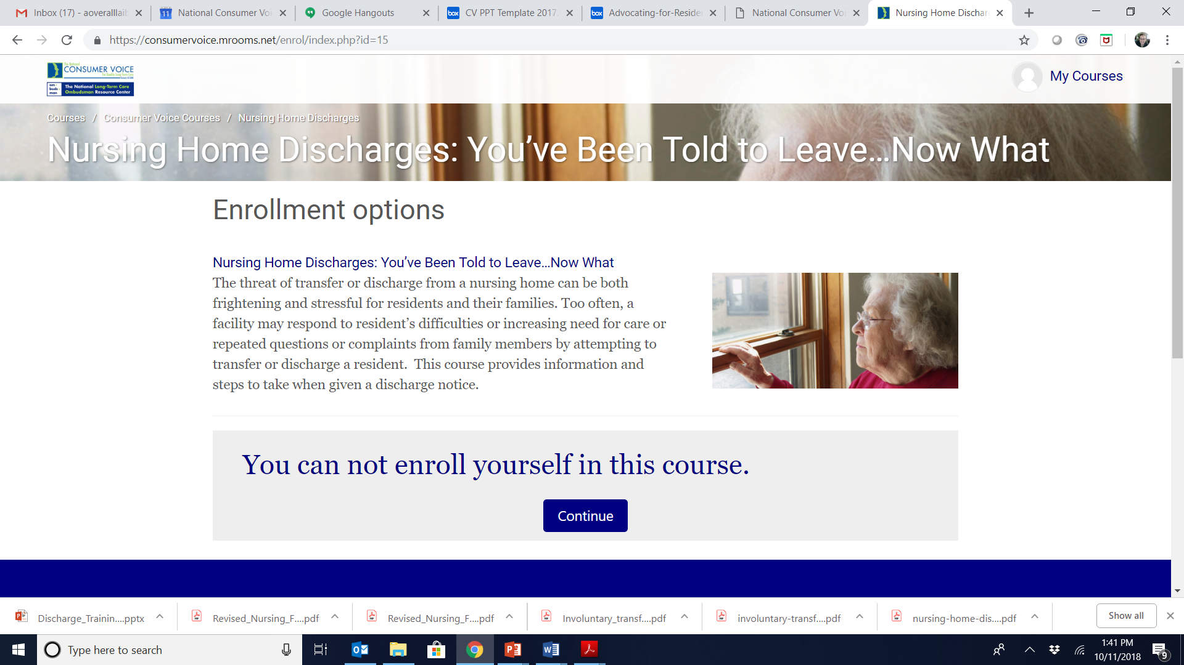
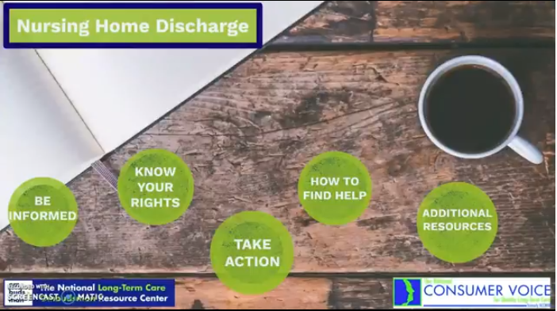
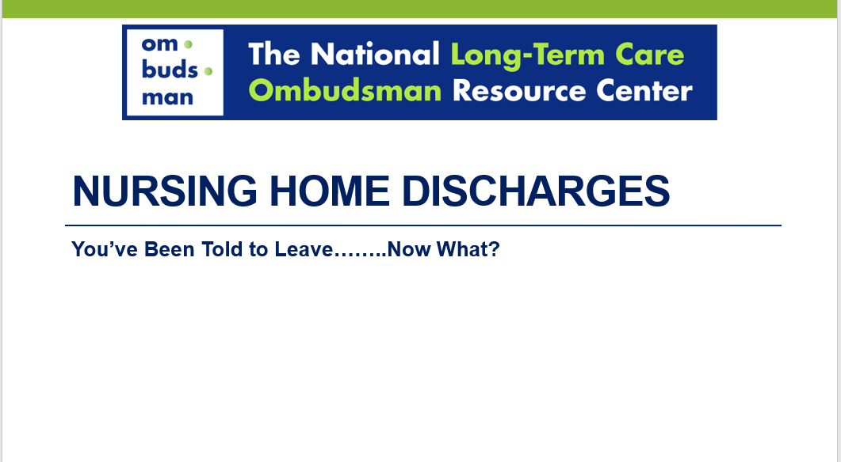
Resources - Consumer Education & Training
Prezi presentation – visual storytelling recording with voiceover or clickable with a script
On-demand training course
PowerPoint with presenter notes for consumer education
http://ltcombudsman.org/issues/transfer-discharge#Consumers

Slide 49
Additional Information
Consumer Voice
  Transfer, Discharge, and Transitions issue page http://theconsumervoice.org/issues/other-issues-and-resources/transfer-discharge
  Revised Federal Nursing Home Regulations http://theconsumervoice.org/issues/issue_details/proposed-revisions-to-the-federal-nursing-home-regulations
NORC
  Transfer/Discharge issue page http://ltcombudsman.org/issues/transfer-discharge
  Federal Nursing Home Regulations http://ltcombudsman.org/library/fed_laws/federal-nursing-home-regulations

Slide 50


The National Consumer Voice for Quality Long-Term Care
www.theconsumervoice.org
Connect with us:
National Consumer Voice for Quality Long-Term Care
@ConsumerVoices

