Slide 1



COVID-19: advocating for nursing home residents, PARt X
June 26, 2020

Slide 2
Agenda
Introduction and housekeeping
CMS Guidance on Reporting of Staffing Data
Preparing Comments on Interim Rule on Reporting Requirements
Reuniting Residents and Families
  Ohio experience
  West Virginia experience
  New CMS FAQs
  Social media campaign – Tuesday, June 30
Q&A/Discussion

Slide 3
Presenters
Richard Mollot, Long-Term Care Community Coalition
Robyn Grant, Consumer Voice
Beverley Laubert, State Ombudsman, Ohio
Suzanne Messenger, State Ombudsman, West Virginia
Lori Smetanka, Consumer Voice
Mike Dark, CANHR

Slide 4
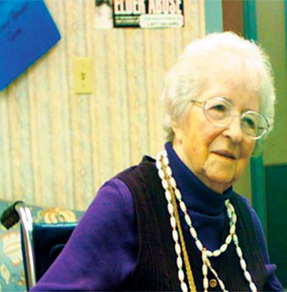
NEW!
Changes to Star Ratings & Reporting of Staffing Levels, Quality Measures on NH Compare
Richard Mollot
Long Term Care Community Coalition
www.nursinghome411.org

Slide 5
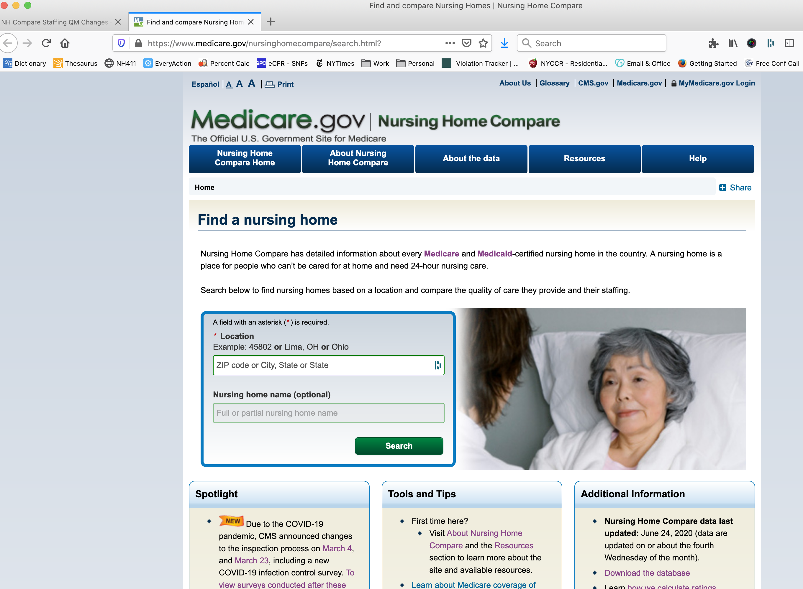
Brief Background
Nursing Home Compare and the Five Star Quality Rating System provide a variety of information for the public on every nursing home that is licensed under Medicare and Medicaid.
Though it is not perfect, it is by far the most reliable source for information about a nursing home’s quality.
The star ratings are based on three indicators:
  Survey results;
  Staffing levels;
  Quality measures.

Slide 6
COVID-19 Pandemic Changes
CMS waived a number of important rules in response to the pandemic, including:
  Regular inspections and complaint investigations;
  Minimum staff training/certification requirements;
  30-day notice for facility-initiated transfer; and
  Requirements to report daily staffing levels and MDS (Minimum Data Set) “quality measures.”
Yesterday (June 25), CMS announced resumption of the reporting requirements (#4 above).
  Facilities must submit staffing data for 2020 Q2 by August 14.
  Facilities may – but are not required – to submit for 2020 Q1.
  NHCompare staffing measures and ratings will be updated in October 2020.
  Beginning July 29, 2020, quality measures based on data collection period ending December 31, 2019 will be held constant.
  CMS is not holding quality measure ratings constant, as a facility’s quality measure rating can still be updated by a quality measure with underlying data that is earlier than December 31, 2019.
https://www.cms.gov/files/document/qso-20-34-nh.pdf

Slide 7
Consumer Perspectives & Concerns
We are glad to hear that the requirement will be reinstated.
However, we are extremely concerned about nursing homes being given a permanent holiday on reporting their payroll-based staffing data and other measures during the first several months of the pandemic.
Without this vital information, we will never know what happened in our nursing homes during crucial, horrific months of the pandemic.
In addition, as a result, we will be significantly hobbled in being able to address a second wave or other emergency situation in the future.
In addition to concerns about the availability of important information, we are all very concerned by the blockade on family and ombudsman visitation, the continued absence of regular surveys and complaint investigations, relaxed staff certification requirements, and freedom to discharge residents without notice or due process.

Slide 8
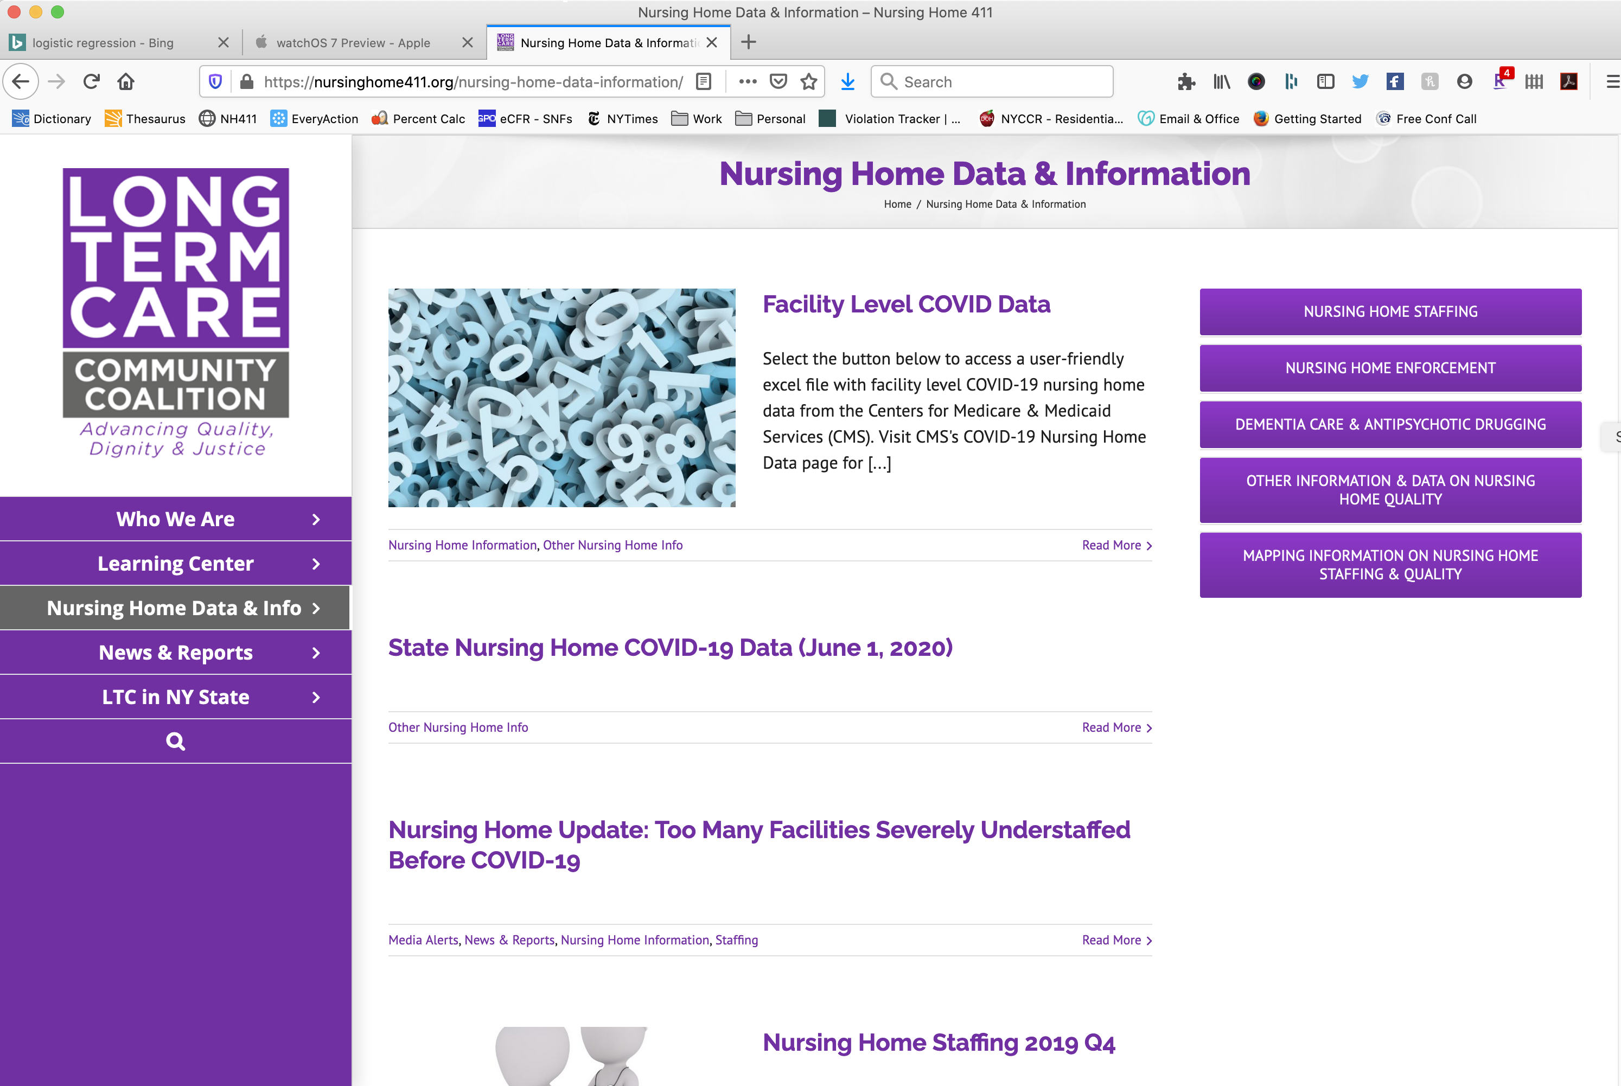
Resources @ www.nursinghome411.org

Slide 9
Comments on §483.80 (g)
COVID-19 Reporting
https://www.federalregister.gov/documents/2020/05/08/2020-09608/medicare-and-medicaid-programs-basic-health-program-and-exchanges-additional-policy-and-regulatory

Slide 10
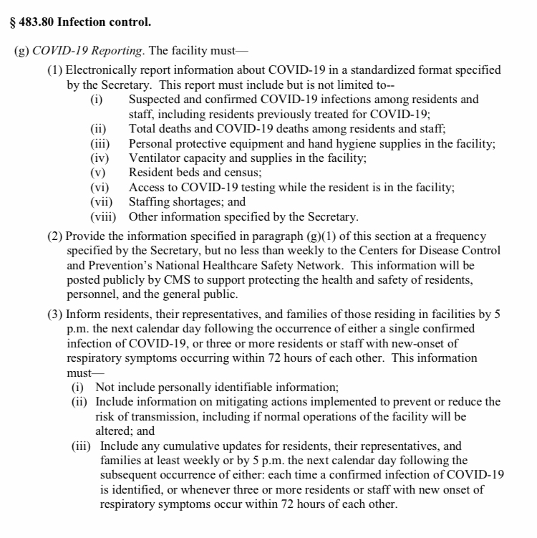

Slide 11
Key Recommendations
Collect additional information
Define and/or clarify certain information
Simplify some information

Slide 12
Key Recommendations
The same comprehensive information must be provided to everyone:
  CDC, CMS, state survey agency, State Long Term Care Ombudsman Program, Protection and Advocacy Agency
  AND
  Residents, their representatives, their families, and staff!
Information must be reported daily
Facilities must report on a standardized form
Information must be easy to obtain
Reporting must be retroactive to January 1, 2020
Reporting requirements should be expanded to other institutions and congregate settings

Slide 13

Advocacy Action YOU Can Take
Submit your own comments
Look for information from us to help you!

Slide 14
Reuniting Residents and Families
#ConnectionMatters

Slide 15
Ohio experience
Beverley Laubert, State LTC Ombudsman

Slide 16
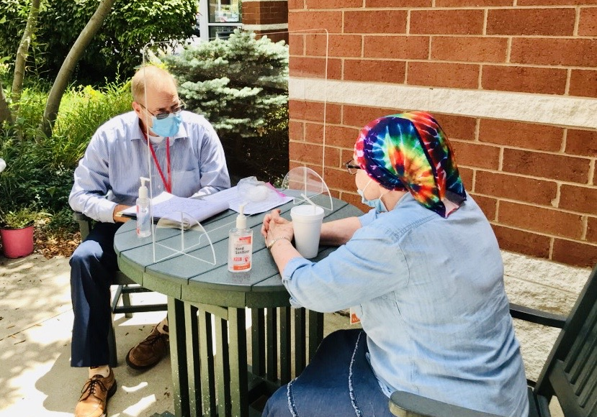

Slide 17
West Virginia experience
Suzanne Messenger, State LTC Ombudsman

Slide 18
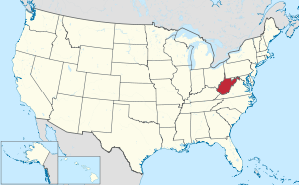
WEST VIRGINIA
Total Population – 1.792 million
Largest City (Charleston) – 47,215
123 Nursing Homes
  10,485 licensed beds (8,651 currently occupied)
Total COVID-19 Cases -2,712
  233 NH Residents
  167 NH Staff
Total COVID-19 Deaths - 92
  43 NH Residents
  0 Staff

Slide 19
Background
March 12 Governor Justice prohibited visitation at WV nursing homes.
March 13 CMS issued guidance on the restriction of nonessential medical staff and all visitors except in certain limited situations.
April 17 Governor Justice orders testing of all nursing home residents/staff.
May 6 Governor Justice orders testing of all assisted living residents/staff.
On May 18, 2020 CMS issued a recommendations memo to states QSO-20-30-NH outlining factors to be considered in making the decision to open nursing homes again.
June 11 Governor Justice announced that beginning on June 17, 2020, visitation at nursing homes may resume at facilities that have had no cases of COVID-19 for the fourteen consecutive day period immediately preceding June 17, 2020 (i.e., since June 3, 2020), using a general framework provided in Nursing Home COVID-19 Reopening Plan and Nursing Home & Assisted Living Reopening Plan FAQs

Slide 20
Phase Red Active COVID-19 positive residents or positive residents within the last 14 days.
Screening | Screen 100% of all persons entering the facility Screen 100% of residents at least daily
Visitation | Compassionate care only
Non-essential personnel | No non-essential personnel
Trips outside the facility | Only medically necessary trips outside of facility
Communal dining | No communal dining
Group activities | No group activities

Slide 21
Phase Yellow Facilities with no COVID-19 positives, and/or no substantial community spread for the immediately preceding 14 days, beginning no sooner than June 17, 2020.
Screening | Screen 100% of all persons entering the facility Screen 100% of residents at least daily
Limited Visitation | No more than two visitors allowed at the same time, by appointment only Visits must take place in a facility-designated location Time limitations may be imposed at facility’s reasonable discretion No visitors under 12 years old Visitors must wear face covering at a minimum, maintain 6 ft. social distancing, and use proper hand hygiene
Non-essential personnel | Non-essential healthcare and other personnel and contractors may be allowed as determined necessary by the facility Must maintain 6 ft. social distancing, use proper hand hygiene, and wear face covering
Trips outside the facility | Only medically necessary trips outside the facility

Slide 22
Phase Yellow Facilities with no COVID-19 positives, and/or no substantial community spread for the immediately preceding 14 days, beginning no sooner than June 17, 2020.
Communal dining | Communal dining allowed if 6 ft. social distancing can be maintained Proper hand hygiene must be used by residents Residents must wear face covering, as tolerated, to and from the dining area
Group activities and therapy | Group activities and therapy allowed if 6 ft. social distancing can be maintained No more than 10:1 ratio, resident to staff Group activities and therapy must take place in a facility-designated location Proper hand hygiene must be used by residents Residents must wear face covering, as tolerated, to and from the activity or therapy
Salon services | Beauticians and manicurists can provide services to residents if the safety guidelines required for hair salons, nail salons, and barber shops, as applicable, can be maintained.

Slide 23
Phase Green Facilities that have progressed 14 consecutive days under Phase Yellow with no COVID-19 positives and no substantial community spread.
Screening | Screen 100% of all persons entering the facility Screen 100% of residents at least daily
Visitation | Number and age of visitors allowed to be determined by facility Visitation by appointment only Visits must take place in a facility-designated location Time limitations may be imposed at facility’s discretion Visitors must wear face covering at minimum and use appropriate hand hygiene
Non-essential personnel | Non-essential personnel and contractors allowed in the facility Must maintain 6 ft. social distancing, use proper hand hygiene and wear face covering
Trips outside the facility | Only medically necessary trips outside the facility

Slide 24
Phase Green Facilities that have progressed 14 consecutive days under Phase Yellow with no COVID-19 positives and no substantial community spread.
Communal dining | Communal dining allowed if 6 ft. social distancing can be maintained Proper hand hygiene must be used by residents Residents must wear face covering, as tolerated, to and from the dining area
Group activities | Group activities allowed if 6 ft. social distancing can be maintained Proper hand hygiene must be used by residents Residents must wear face covering, as tolerated, to and from the activity or therapy
Salon services | Beauticians and manicurists can provide services to residents if the safety guidelines required by hair salons, nail salons, and barber shops, as applicable, can be maintained

Slide 25
Phase Blue At any time during Phase Yellow or Phase Green, if two or more residents test positive, or if it is determined that there is substantial community spread as defined by the Bureau for Public Health.
Screening | Screen 100% of all persons entering the facility Screen 100% of residents at least daily
Visitation | Compassionate care only
Non-essential personnel | Non-essential healthcare personnel, including medical providers, allowed in the facility Facilities may allow other non-essential personnel if they will not be entering any direct care areas
Trips outside the facility | Only medically necessary trips outside of facility

Slide 26
Phase Blue At any time during Phase Yellow or Phase Green, if two or more residents test positive, or if it is determined that there is substantial community spread as defined by the Bureau for Public Health.
Limited communal dining | Limited communal dining based on medical necessity 6 ft. social distancing must be maintained Proper hand hygiene must be used by residents Residents must wear face covering, as tolerated, to and from the dining area.
Limited group activities and therapy | Limited group activities and therapy allowed if 6 ft. social distancing can be maintained Group activities and therapy must take place in a facility-designated location Proper hand hygiene must be used by residents Residents must wear face covering, as tolerated, to and from the activity or therapy
Limited salon services | Beauticians and manicurists can provide services to residents on a limited basis if the safety guidelines required for hair salons, nail salons, and barber shops, as applicable, can be maintained.

Slide 27
CHALLENGES
Strict Interpretation of “compassionate care”
Process vs. impact of “reopening”
  What is a “visit”?
Life vs. safety

Slide 28

Suzanne
Messenger
State Long-term Care Ombudsman
Suzanne.e.messenger@wv.gov
304-816-3151

Slide 29
CMS Reopening-Visitation Guidance
QSO-20-30-NH (May 18, 2020) + FAQs
  3 Phases of “Reopening”
    Phase 1 – visitation restricted except for compassionate care
    Phase 2 – visitation restricted except for compassionate care
    Phase 3 – visitation allowed with screening and precautions
  Factors to Inform Reopening Decision-Making:
    Case status in community
    Case status in the nursing home
    Adequate staffing – no shortages, no contingency staffing plan
    Access to adequate testing – baseline and ongoing testing plan
    Universal source control – face coverings or masks, social distancing, handwashing/sanitizing
    Access to adequate Personal Protective Equipment (PPE)
    Local hospital capacity

Slide 30
New FAQs – June 23, 2020
Encourages “creative means” of connecting residents and families – such as outside visits
  With screening and precautions
  Items in visitation spaces routinely cleaned and disinfected
  Limit the number and size of visits, number of individuals visiting any one resident

Slide 31
FAQs - Communal Activities
 | Residents without COVID | Residents w COVID or symptoms
Eat in the same room w social distancing Limited people at tables 6 feet between tables | Yes | No
Group activities Social distancing among residents Hand hygiene Face coverings or facemasks Ex. Bingo, Book Club, Movies, Crafts | Yes | No

Slide 32
FAQs - Compassionate Care
Does not exclusively refer to end of life situations
CMS believes these visits should not be routine; should be limited
CMS encourages consultation with state leadership, families, ombudsman to help determine if a visit should be conducted for compassionate care
All screening and precautions should be taken
Nursing homes can create “safe spaces” within the facility
Consider setting appointment times
Limit the number of visitors allowed in the building at one time, and number visiting with any one resident

Slide 33
FAQs - Access to LTC Ombudsman
Residents have the right to access to the ombudsman
If in-person not available, facilities must facilitate resident communication with the ombudsman
FAQs - Discharge Waivers
Only apply to cohorting residents to prevent COVID-19 spread
“For all non-cohorting discharges, facilities must comply with all discharge requirements” – including notification and reasons in a manner and language they understand, and notice to the ombudsman

Slide 34
Social media campaign
Mike Dark, CANHR

Slide 35
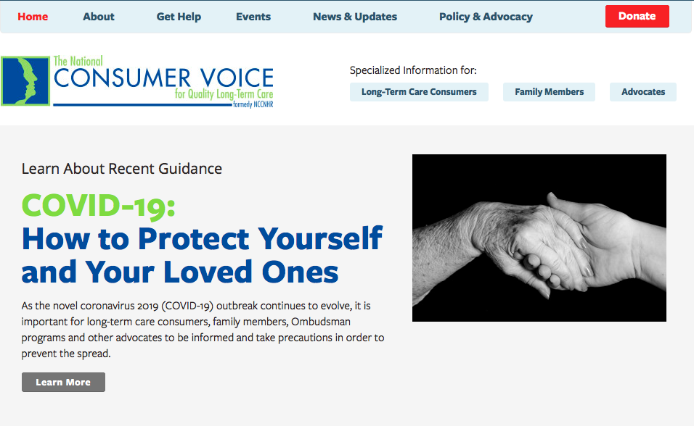
Resources https://theconsumervoice.org/issues/other-issues-and-resources/covid-19

Slide 36

www.theconsumervoice.org

Slide 37


Slide 38
Robyn Grant, rgrant@theconsumervoice.org
Jocelyn Bogdan, jbogdan@theconsumervoice.org
Sam Brooks, sbrooks@theconsumervoice.org www.theconsumervoice.org
Toby Edelman, tedelman@medicareadvocacy.org
www.medicareadvocacy.org
Eric Carlson, ecarlson@justiceinaging.org
www.justiceinaging.org
Richard Mollot, Richard@ltccc.org
www.nursinghome411.org

