Slide 1



COVID-19: advocating for nursing home residents, PARt I – National advocacy
April 17, 2020

Slide 2
Agenda
Introduction and housekeeping
Overview of the problem
Actions to expand coverage, reimbursement
Federal waivers of regulations
CMS Recommendations/Guidance
National level advocacy
Advocacy recommendations
Q&A

Slide 3
Presenters
Toby Edelman, Senior Policy Attorney, Center for Medicare Advocacy
Eric Carlson, Directing Attorney, Justice in Aging
Richard Mollot, Executive Director, Long Term Care Community Coalition
Robyn Grant, Director of Public Policy & Advocacy, National Consumer Voice for Quality Long-Term Care

Slide 4
Introduction
Toby S. Edelman
Senior Policy Attorney
Center for Medicare Advocacy
tedelman@MedicareAdvocacy.org
(202) 293-5760

Slide 5
The coronavirus pandemic
Nursing facilities have been at the center of the pandemic.
Less than two months ago, Life Care Center at Kirkland (WA) became the site where coronavirus was first seen.
  Residents, staff, visitors became ill.
  Death toll now 47.
.

Slide 6
nursing home residents
All people in congregate settings are at higher risk than others, but nursing home residents are at tremendous risk because
  Generally older
  Multiple health conditions, medically fragile
Some reports: one-quarter of all deaths are residents of nursing homes, assisted living, board and care, but likely undercounted. Some countries are not counting residents in death toll.

Slide 7
Problems exacerbated
Problems we’ve seen for years are exacerbated by the pandemic.
  Staffing shortages are worse, as sick staff are unable to work.
  Infection control and prevention remain an enormous problem.
    CMS: in infection control surveys week of Mar. 30, 36% of facilities with infection control surveys did not do proper handwashing; 25% did not use PPE correctly.

Slide 8
Lack of information
Federal government is not releasing, and probably does not have, information about which facilities have COVID-19 positive residents and staff, how many are sick, how many have died.
  No federal mandate on facilities to report; not all states are requiring facilities to report.
  National/state media compiling information.

Slide 9
Without information
States cannot target additional personal protective equipment (PPE) and staff to facilities in greatest need (American Health Care Association agreed, Apr. 13).
Residents and families more fearful, especially since visitors have been banned since mid-March.

Slide 10
Best practices
Some states are doing a better job at
  Collecting and publicly sharing facility-specific information about infections and deaths.
  Establishing COVID-19-only facilities in vacated facilities.
  Including residents/families in transfer/discharge decisions.

Slide 11
Going forward
Need to stay focused on what we can do now to make a terrible situation better for residents and families, to the extent possible.
Remember, when this immediate crisis is over, what we need to change in our health care system.

Slide 12
What we want to do today and at next week’s webinar
Share what we know about federal requirements and waivers
Talk about CMS’s recommendations and guidance.
Discuss advocacy at federal and state levels.
Hear from you.

Slide 13
Cms and congress
At the federal level,
  Expansion of coverage
  Increased reimbursement
  Waivers of longstanding Requirements of Participation (federal standards of care for facilities that choose to participate in Medicare or Medicaid, or both)

Slide 14
Expansion of coverage nursing home-specific
Changes to Medicare
  Waiver of requirement of 3-day inpatient hospital stay, as prerequisite to Medicare coverage in SNF.
  Extension of coverage beyond 100 days, but only if need for skilled care is result of COVID-19.

Slide 15
Expansion of coverage nursing home-specific
Increased use of telehealth (therapists, social workers, physicians)
Authorization of nurse practitioners,
physician assistants, clinical nurse specialists

Slide 16
Increased reimbursement
Proposed annual update to Medicare SNF reimbursement increases payments by 2.3% ($784 million) for FY 2021 (Apr. 10).
CMS approved more than $51 billion with accelerated/advance payment program for Medicare providers, including SNFs (Apr. 9).

Slide 17
Increased reimbursement
$30 billion of $100 billion in emergency COVID-19 stimulus fund
  CMS Administrator announced initial payout of $1.5 billion to SNFs (“There are no strings attached, so the health care providers that are receiving these dollars can essentially spend that in any way that they see fit.”), Skilled Nursing News (Apr. 8). https://skillednursingnews.com/2020/04/skilled-nursing-facilities-could-soon-see-1-5b-under-cmss-emergency-relief-plan-with-more-on-the-way/

Slide 18
Immunity from criminal and civil liability
NY State budget bill provides immunity from civil and criminal liability to health care facilities and health care professionals for harm or damages related to COVID-19.
USA Today reports Florida nursing home trade association seeking immunity.

Slide 19
Our concerns
Facility staff, including health care professionals and paraprofessionals, are putting their lives on the line every day to take care of residents.
But, for the unscrupulous, combination of more money, fewer rules, less oversight, and possible immunity is dangerous.

Slide 20
Waivers of resident protections
Most of our discussion today focuses on what is waived in federal nursing home law, what remains, issues we have identified so far of greatest concern for residents.
Federal government has also granted §1135 Medicaid waivers to states.

Slide 21
For further information, or to receive the
Center’s free weekly electronic newsletter, CMA Alert,
update emails and webinar announcements, contact:
Communications@MedicareAdvocacy.org
Or visit
www.MedicareAdvocacy.org

Slide 22
CMS Waives Various Nursing Facility Regulations
Eric Carlson, Directing Attorney
April 17, 2020

Slide 23
Waivers Relating to Transfers

Slide 24
Transfer Within Facility
For sole purpose of separating COVID+ and COVID- residents, CMS has waived regulatory rights to:
  Share a room by consent of both persons.
  Receive notice before transfer within facility.
  Refuse certain transfers within facility.

Slide 25
Facility-to-Facility Transfers
CMS waives some portions of transfer/discharge regulations, but only in 3 situations:
  Transferring residents with COVID-19 or respiratory infection symptoms to facility dedicated to care of such residents;
  Transferring residents without diagnosis or symptoms to facility dedicated to care of such residents; or
  Transferring residents without symptoms of a respiratory infection to another facility for 14-day observation.

Slide 26
Process for “Cohort” Transfers
“New” facility must agree to accept resident.
Advance notice is not required.
  CMS is “only waiving the requirement … for the written notice of transfer or discharge to be provided before the transfer or discharge. This notice must be provided as soon as practicable.”

Slide 27
Notice AFTER Transfer?
Consider: Notice “as soon as practicable” is of little use if transfer already has taken place.

Slide 28
Waive Physical Plant Standards
“To allow for a non-SNF building to be temporarily certified and available for use by a SNF in the event there are needs for isolation processes for COVID-19 positive residents.”

Slide 29
Waive Standards to Allow for Repurposing of Rooms
“Rooms that may be used for this purpose include activity rooms, meeting/conference rooms, dining rooms, or other rooms, as long as residents can be kept safe, comfortable, and other applicable requirements for participation are met.”

Slide 30
Weaknesses in Waivers
What’s missing?
  Quality of care standards for facilities caring for COVID-positive residents.
  Collaboration and discharge planning; communication with residents and their representatives.

Slide 31
Care Provider Standards

Slide 32
Nurse Aide Training
Waiver of nurse aide training requirements, except for “competency.”
Ordinarily,
  Within 4 months of employment, must complete 75 hours of training and pass competency examination.
  Must participate in training program during first 4 months.

Slide 33
Access to “Outside” Professionals
Waiver to allow physician visits to be performed remotely via telehealth.
MD can delegate any tasks to physician assistant, nurse practitioner, or clinical nurse specialist.
  Tasks must be under the physician’s “supervision.”

Slide 34
Social Distancing in Nursing Facilities

Slide 35
Distancing Internally
CMS issues guidance & waives regulations to
  Eliminate communal meals and other communal activities, including resident councils.

Slide 36
Severely Limiting Visitation
Prohibit visitation except for “compassionate situations.”
    “Compassionate situations” including but not limited to end of life visitation.

Slide 37
Few “Essential” Persons
Visitation restrictions include:
  Family and friends.
  Ombudsman program representatives.
  Non-essential health care providers.
    “Essential” read narrowly.
Also, no access for ANYONE with symptom of respiratory infection.

Slide 38
When Visits Do Take Place
Limited to resident’s room or other designated room, e.g., “clean” room.
Must wear Personal Protective Equipment, e.g., face masks.
“Hand hygiene.”
“Suggest refraining from physical contact.”

Slide 39
Alternatives to In-Person Visiting
Phone calls, video calls, standing outside window, etc.
Suggestions/recommendations from CMS, rather than mandate.
Limitations: facility buy-in and possible lack of technology.
  One response – New Mexico authorizes state funds to purchase tablets for use in facilities.

Slide 40
Facilitating Contact with Ombudsman, etc.
“If in-person access is not available …, facilities need to facilitate resident communication (by phone or other format) with”
  Ombudsman program;
  Resident’s representative;
  Resident’s physician; or
  Representative of protection and advocacy agency.

Slide 41
Other Waivers

Slide 42
Assessments and Reporting
Deadlines waived for Minimum Data Set (MDS) assessment and transmission.
Waiving Pre-Admission Screening and Annual Resident Review (PASARR).
Waiver of requirement to submit staffing data through Payment Based Journal system.

Slide 43
Thinking About Waivers
Most regulations are still effective.
  E.g., Except in three limited situations, transfer/discharge protections are still in place.

Slide 44
Federal Requirements & Recommendations
Richard Mollot, Executive Director
Long Term Care Community Coalition
www.nursinghome411.org

Slide 45
Federal Requirements & Recommendations: Background
The Centers for Medicare and Medicaid Services (CMS): the federal agency which oversees nursing homes, hospitals, and other health care providers who receive Medicare and/or Medicaid funds.
State Survey Agencies: Responsible for making sure that federal requirements are achieved by providers in their states and that consumers are protected.
Federal Requirements & Guidance: Mandatory expectations for providers and state inspectors.
Federal Recommendations: What the government considers to be a good idea but entirely optional.

Slide 46
CMS Recommendations for Nursing Homes
Nursing Homes should immediately ensure that they are complying with all CMS and CDC guidance related to infection control.
  Facilities should focus on adherence to appropriate hand hygiene as set forth by CDC.
  CMS issued extensive infection control guidance, including a self-assessment checklist that long-term care facilities can use to determine their compliance with these crucial infection control actions.
  Facilities should also refer to CDC’s guidance to long-term care facilities on COVID-19 and also use guidance on conservation of personal protective equipment (PPE).
State and local health departments should work together with long-term care facilities in their communities to determine and help address long-term care facility needs for PPE and/or COVID-19 tests.
Long-term care facilities should immediately implement symptom screening for all.

Slide 47
CMS Recommendations for Nursing Homes
Long-term care facilities should ensure all staff are using appropriate PPE when they are interacting with patients and residents, to the extent PPE is available and per CDC guidance on conservation of PPE.
  For the duration of the state of emergency all long-term care facility personnel should wear a facemask while they are in the facility.
  Full PPE should be worn for the care of any resident with known or suspected COVID-19 per CDC guidance on conservation of PPE.
  If COVID-19 transmission occurs in the facility, healthcare personnel should wear full PPE for the care of all residents irrespective of COVID-19 diagnosis or symptoms.
  Patients and residents who must regularly leave the facility for care (e.g., hemodialysis patients) should wear facemasks when outside of their rooms.
  When possible, all long-term care facility residents, whether they have COVID-19 symptoms or not, should cover their noses and mouths when staff are in their room. Residents can use tissues for this. They could also use cloth, non-medical masks when those are available.
To avoid transmission within long-term care facilities, facilities should use separate staffing teams for COVID-19-positive residents to the best of their ability, and work with State and local leaders to designate separate facilities or units within a facility to separate COVID-19 negative residents from COVID-19 positive residents and individuals with unknown COVID-19 status.

Slide 48
CMS Requirements for State Surveys (Inspections)
Normally: States must survey all nursing homes on an annual basis, with a permissible timespan between inspections of 9-15 months.
Temporary Federal Requirements: CMS issued a memo on March 23 “authorizing modification of timetables and deadlines for the performance of certain required activities, delaying revisit surveys, and generally exercising enforcement discretion for three weeks.
  During this three-week timeframe, only the following types of surveys will be prioritized and conducted:
  Complaint/facility-reported incident surveys identified as immediate jeopardy.
  Targeted Infection Control Surveys: Federal CMS and State surveyors will conduct targeted Infection Control surveys of providers identified through collaboration with the Centers for Disease Control and Prevention (CDC) and the HHS Assistant Secretary for Preparedness and Response (ASPR).
As of April 17, CMS has continued this policy, indicating on a phone call this week that it will continue until they communicate otherwise.

Slide 49
CMS Requirements for Resident Transfer and Discharge
Normally: With very limited exceptions, facilities must provide 30 days notice for a facility-initiated discharge. Residents have the right to initiate an appeal within that timeframe.
In response to COVID-19 pandemic: CMS is waiving requirements (with some exceptions) to allow a long term care (LTC) facility to transfer or discharge residents to another LTC facility solely for the following cohorting purposes:
  Transferring residents with symptoms of a respiratory infection or confirmed diagnosis of COVID-19 to another facility that agrees to accept each specific resident, and is dedicated to the care of such residents;
  Transferring residents without symptoms of a respiratory infection or confirmed to not have COVID-19 to another facility that agrees to accept each specific resident, and is dedicated to the care of such residents to prevent them from acquiring COVID-19; or
  Transferring residents without symptoms of a respiratory infection to another facility that agrees to accept each specific resident to observe for any signs or symptoms of a respiratory infection over 14 days.
Resident discharge protections waived under very limited circumstances related to COVID.

Slide 50
Federal Requirements: No Discrimination on Basis of Age or Disability
In a March 28, 2020 bulletin, the U.S. HHS stated that
“[P]ersons with disabilities should not be denied medical care on the basis of stereotypes, assessments of quality of life, or judgments about a person’s relative “worth” based on the presence or absence of disabilities or age.
Decisions by [health care providers] concerning whether an individual is a candidate for treatment should be based on an individualized assessment of the patient based on the best available objective medical evidence.

Slide 51
Visit our home page www.nursinghome411.org
for
Coronavirus resources & updates;
Fact sheets on nursing home resident rights;
Data on staffing, infection control violations, and ratings for all U.S. nursing homes;
Forms & tools for resident-centered advocacy;
Dementia Care Advocacy Toolkit;
And more!
Sign up for alerts @ https://nursinghome411.org/join/.
Listen to our new Nursing Home 411 podcast on Spotify & Apple Podcasts.
www.nursinghome411.org
www.twitter.com/LTCconsumer
www.facebook.com/ltccc
feedback@ltccc.org

Slide 52
National Advocacy
Centers for Medicare and Medicaid Services (CMS)
  Ongoing communication with Director of Nursing Homes Division
      Frequent emails
      Meetings
      Memos

Slide 53

CMS
Two glimmers of hope
1 - Reporting of COVID cases
2 - Communication between residents and families

Slide 54

CMS
Letter to Seema Verma, CMS Administrator

Slide 55
Problems communicated to CMS
Lack of knowledge and reporting
  Number of cases, fatalities, staffing levels, amount of PPE, availability of testing kits in each facility
Very little knowledge of what is happening in facilities
Isolation of nursing home residents and extreme anxiety of family members
Various aspects of COVID-only facilities
  Lack of any criteria for designating such facilities
  Moving residents out of one facility to another in order to create COVID only facilities
  Lack of advance notice for these transfers between/within facilities
Continued involuntary discharges of residents to unsafe locations

Slide 56
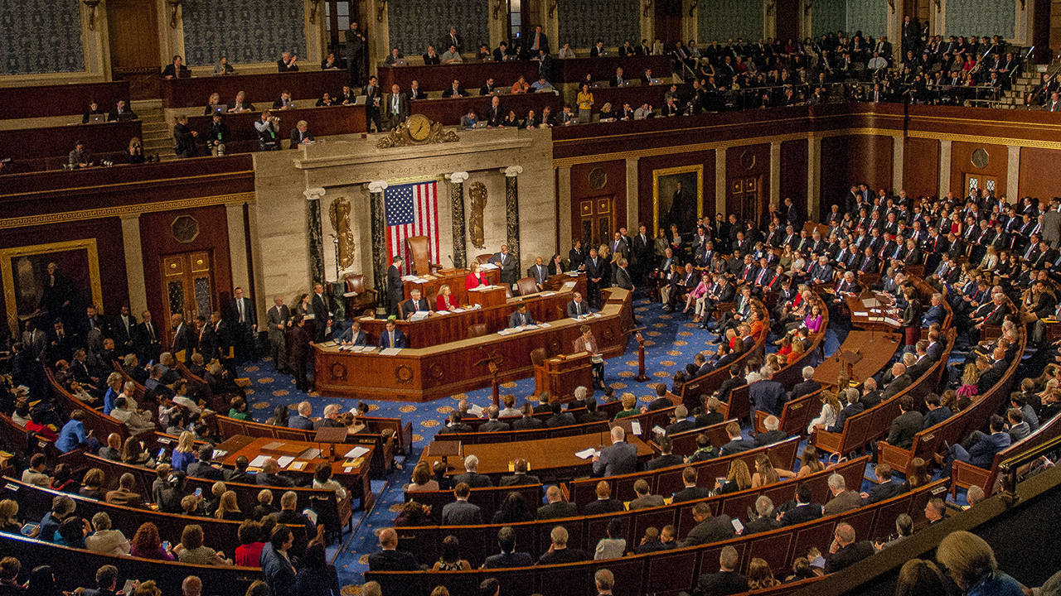
National Advocacy
Congress
In addition to many issues
already discussed:
Full-time infection preventionist with a specified level of training and experience
Per day civil money penalties for infection control violations
At least two weeks of paid sick leave for nursing home employees

Slide 57

ACCESS ACT
Advancing Connectivity during the Coronavirus to Ensure Support for Seniors Act has been introduced in the Senate and House

Slide 58

Advocacy Recommendations

Slide 59
Recommendation #1: Establish a State Level Team
Responsibilities
Gather information: daily reports about cases, fatalities, staffing levels, available supply of PPE/testing kits
Coordinate with appropriate entities to ensure PPE, testing kits, other needed supplies are obtained; determine where they are most needed; distribute to those facilities
Monitor onsite in facilities with COVID cases
Assess if a facility is showing signs of distress; send in a strike team
  Strike team to help with infection control, hands-on care, staff training and/or assistance with other needs

Slide 60
Recommendation #2: Establish Distinct COVID-19 Only Facilities or Units
There must be specific criteria for designation as a facility
Suggested criteria:
  A direct care staffing level (nurses and nurse aides) of at least 4.1 hours per resident day
  A 24 hr registered nurse
  A full-time infection preventionist
  Adequate PPE
  Private rooms

Slide 61
Recommendation #3: Transparency of Information
COVID information
Number of COVID cases, COVID related deaths, total deaths all causes
Reported to residents, families, staff, the public, local health department, state survey agency
  State survey agency reports to CMS and CDC
Staffing information
Posting inside facility and at facility entrance at beginning of each shift
COVID and Staffing information
State survey agency to post online on daily basis

Slide 62
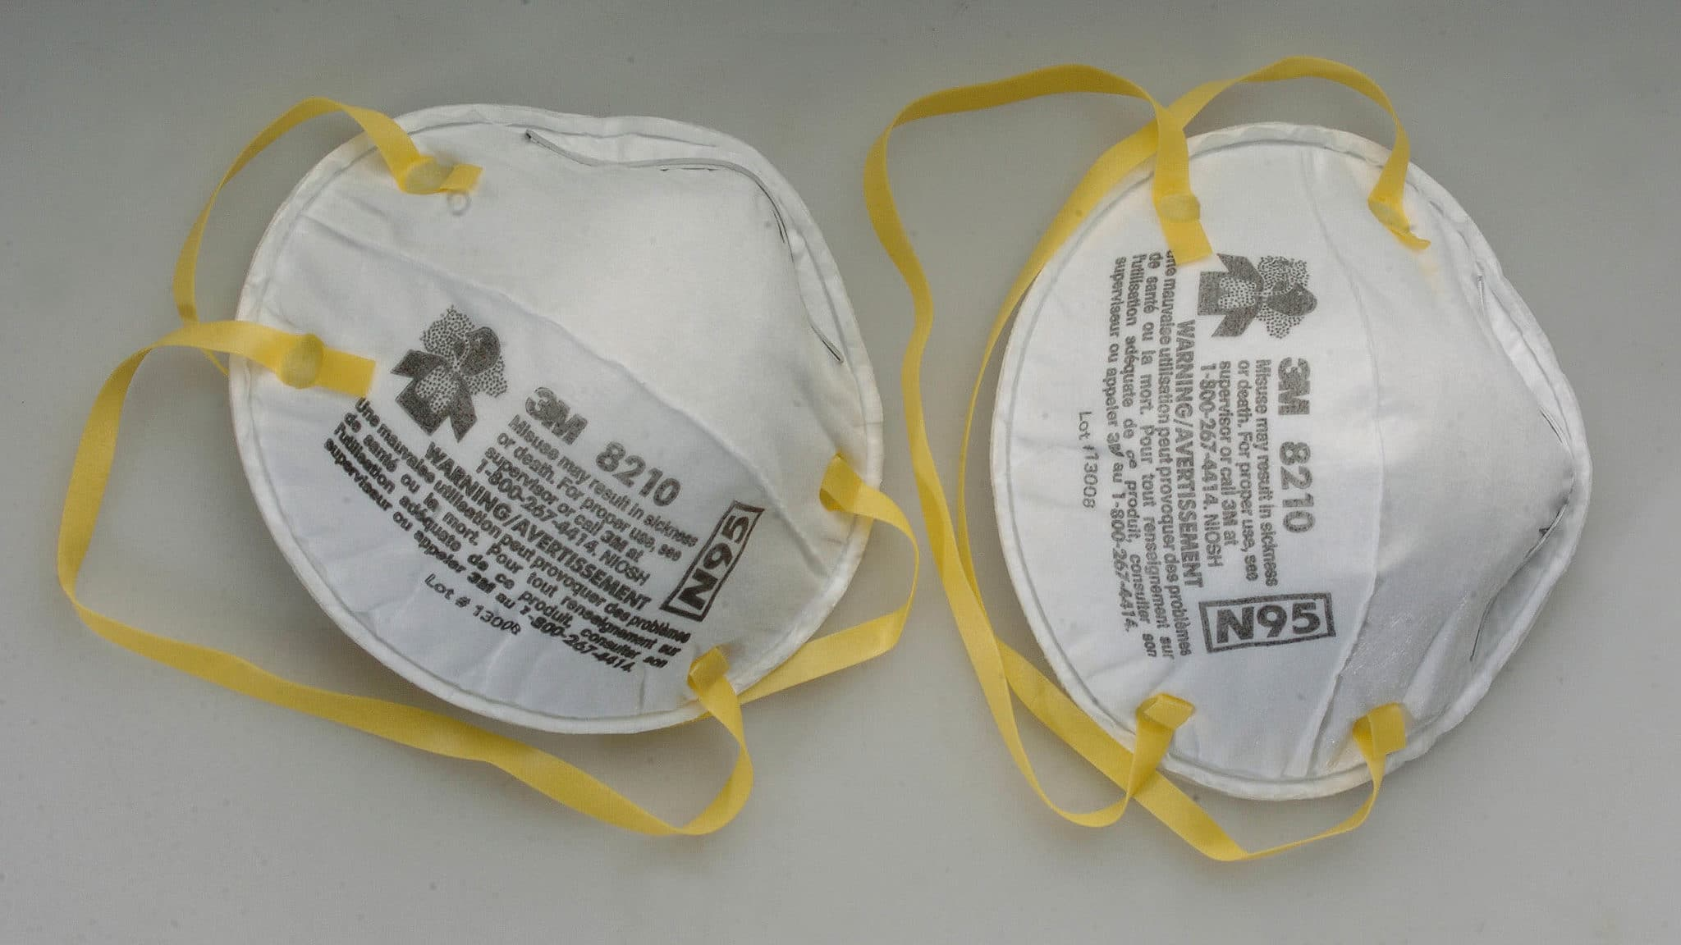

Recommendation #4: Adequate PPE and Testing
Essential for protecting residents
and staff!

Slide 63
Recommendation #5: Support and Protect Residents During Admission, Transfer, Discharge
Transfer/Discharge
Advance discussion of options/plans regarding proposed transfer
Facility notification of resident, family/representative
Facility notification of ombudsman and provision of names of residents/contact information for residents and their families
Suspension of all non-COVID related involuntary transfers or discharges

Slide 64
Recommendation #5: Support and Protect Residents During Admission, Transfer, Discharge
Admissions
Do not force facilities to admit any individual being discharged from a hospital regardless of their COVID status
Do not permit facilities with no known or suspected COVID-19 outbreaks to admit or readmit anyone without testing negative for COVID-19 or having been isolated for 14 days with no signs or symptoms

Slide 65

A CALL TO ACTION!
Notes:
My sense is that this is a pretty sophisticated group of advocates and there isn’t much about advocacy action that I can tell you that you don’t already know.

Slide 66
Join us next Friday, April 24, 2:00pm ET
COVID-19: Advocating for Nursing Home Residents, Part II – State Advocacy Activities
Friday, April 24, 2:00pm ET

Slide 67
Robyn Grant, rgrant@theconsumervoice.org www.theconsumervoice.org
Toby Edelman, tedelman@medicareadvocacy.org
www.medicareadvocacy.org
Eric Carlson, ecarlson@justiceinaging.org
www.justiceinaging.org
Richard Mollot, Richard@ltccc.org
www.nursinghome411.org

