Slide 1

Sexual Abuse in Nursing Homes
What You Need To Know
Wednesday, September 5, 2018

Slide 2
The Consumer Voice
The National Consumer Voice for Quality Long-Term Care (Consumer Voice) is a national, non-profit organization in Washington, D.C. that advocates for people receiving care and services at home, in assisted living, or in a nursing home.
Clearinghouse of information and resources for empowering consumers, families, caregivers, advocates and ombudsmen in seeking quality care, no matter where.
Provide technical assistance and support for state advocacy regarding long-term care services and supports and have a national action network.

Slide 3
Presenters
Julie Schoen, J.D., Deputy Director, National Center on Elder Abuse, Keck School of Medicine (USC)
Dr. Pamela Teaster, Director, Center for Gerontology (Virginia Tech)
Alisha Lineswala, J.D., Public Policy & Program Specialist, National Consumer Voice for Quality Long-Term Care
Amity Overall-Laib, Director, National Ombudsman Resource Center
Vicki Elting, Assistant State Long-Term Care Ombudsman, Washington State Long-Term Care Ombudsman Program
Lori Smetanka, J.D., Executive Director, National Consumer Voice for Quality Long-Term Care

Slide 4


THE NATIONAL CENTER ON ELDER ABUSE
Funded by a grant from the Administration on Community Living and Administration on Aging (ACL/AoA), serving as one of 27 National Resource Centers. The NCEA is a provider of up-to-date, pertinent and valuable resources, education, and information on elder abuse and neglect.
As a leader in the elder justice movement, we:
Create valuable educational resources
Provide training curricula tailored to a variety of audiences
Deliver up-to-date research
Build partnerships and make connections
Explore innovative models
Listen to what the field needs
Take advantage of opportunities to advance the field
Communicate our efforts
Envision our goals for tomorrow

Slide 5

Sexual Abuse in
Long-Term Care Settings:
Research Findings and
Practical Implications
Pamela B. Teaster, Ph.D.
Professor & Director
Center for Gerontology, Virginia Tech
National Consumer Voice for Quality Long-Term Care/
National Center on Elder Abuse
Webinar, September 5, 2018

Slide 6
CDC Elder Sexual Abuse
Forced or unwanted sexual interaction (touching & non-touching) of any kind with adult 60+. May include, not limited to, forced or unwanted completed or attempted contact between…forced or unwanted intentional touching, either directly or through the clothing...
These acts also qualify as sexual abuse if they are committed against an incapacitated person who is not competent to give informed approval.
Centers for Disease Control and Prevention. (2018). Elder Abuse: Definitions https://www.cdc.gov/violenceprevention/elderabuse/definitions.html

Slide 7
Literature Review
Prevalence and Correlates of Emotional, Physical, Sexual, and Financial Abuse and Potential Neglect in the United States: The National Elder Mistreatment Study
Ron AciernoPhD, Melba A. HernandezMS, Ananda B. AmstadterPhD, Heidi S. ResnickPhD, Kenneth SteveMS, Wendy MuzzyBS, and Dean G. KilpatrickPhDAuthor affiliations, information, and correspondence details
Accepted: May 15, 2009 . Published Online: American Journal of Public Health. September 20, 2011
Sexual Abuse of Older Women Living in Nursing Homes
Pamela B. Teaster PhD &Karen A. Roberto PhD. Pages 105-119 | Published online Journal of Gerontological Social Work: 11 Oct 2008. https://doi.org/10.1300/J083v40n04_08
From Behind the Shadows: A Profile of the Sexual Abuse of Older Men Residing in Nursing Homes
Pamela B. Teaster PhD,Holly Ramsey-Klawsnik PhD,Marta S. Mendiondo PhD,Erin Abner MPH,Kara Cecil BS &Mary Tooms BS
Pages 29-45 | Published online Journal of Elder Abuse and Neglect: 08 Sep 2008

Slide 8
Acknowledgements
Holly Ramsey-Klawsnik, Ph.D. Director of Research, National Association of Adult Protective Services
Erin Abner, Ph.D. Associate Professor, University of Kentucky
Adult Protective Services: Oregon, New Hampshire, Tennessee, Texas, Wisconsin
Texas Department of Aging and Disability Services, Wisconsin Elder Abuse, Wisconsin Bureau of Quality Assurance

Slide 9
Objectives
To investigate patterns of the sexual abuse of vulnerable older and younger adults living in long-term care institutions;
To test a web-based system for obtaining sensitive and confidential information on the sexual abuse of vulnerable adults; and
To refine an emergent theory of the mistreatment of vulnerable adults.

Slide 10
Specific Questions
  Who are the victims?
  Who are the offenders?
  Where are the cases occurring?
  What factors correlate with sexual abuse in care facilities?
  How often do these cases reach state attention?
  How are they investigated?
  Do professionals have adequate resources to respond effectively?
  What is our response to victims?
  How are perpetrators handled?
  Can we create a suggested protocol for responding to alleged cases?

Slide 11
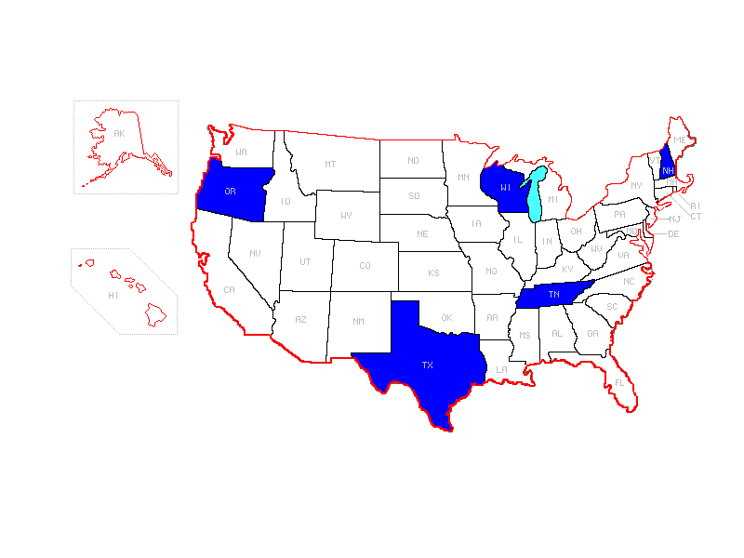
Participating States
New Hampshire APS
Oregon APS
Tennessee APS
Texas APS
Texas Department of Aging and Disability Services
Wisconsin APS/Elder Abuse
Wisconsin Bureau of Quality Assurance

Slide 12
Data Analysis
Goal: to identify factors independently associated with substantiation of sexual abuse allegations
Method: unadjusted analysis, adjusted analysis (logistic regression)

Slide 13
Unadjusted Results - Victim
On average, victims in substantiated cases were:
  about 10 years older
  more likely to be female
  more likely to have dementia
  more likely to have impaired ADLs
  less likely to be oriented to person at least some of the time
  less likely to reside in care facilities with high level supervision
See Table 2. Abner et al. Victim, allegation, and investigation characteristics associated with substantiated reports of sexual abuse of adults in residential care settings. J Interpersonal Violence 2016; DOI:10.1177/0886260516672051

Slide 15
Unadjusted Results - Victim
On average, we did not see differences with regard to:
  Orientation to place or time
  Ability to communicate

Slide 16
Unadjusted Results - Allegation
On average, sexual abuse allegations were more likely to be substantiated if:
  there was also an allegation of neglect
  the sexual abuse was of a “hands-on” type
    rape, attempted rape, molestation, harmful genital practices, oral-genital contact, prostitution of victim, sadistic sexual activity, or sexualized kissing
  the accused perpetrator was another resident

Slide 17
Unadjusted Results - Investigation
On average, substantiated sexual abuse was more likely if:
  the victim disclosed abuse
  the investigative agency had regulatory authority
  the time between “incident” and report was less than 4 days
On average, we did not see differences with regard to:
  Witnesses making the allegation
  Victims providing a written statement

Slide 18
Our Adjusted Model
We included these predictors:
  Victim
    Age, sex, psychiatric illness, dementia, ADL impairments, ambulation, orientation, ability to communicate, care facility level of supervision
  Allegation
    Other abuse allegations, perpetrator relationship to victim, hands-on offense
  Investigation
    Victim disclosed abuse, victim written statement, victim injury, agency type
    Subset analysis: time from incident to report

Slide 21
Conclusions/Determining Risks
Based on this analysis, key factors in predicting substantiation of sexual abuse cases in the five states were:
  Care facility level of supervision
  Perpetrator relationship to victim
  Victim injury
  Victim disclosure
  Time from incident to report

Slide 22
Caveats
Results may not be generalizable in other states
Other unmeasured factors likely to be important, e.g.:
  Past experience of the investigator
  Victim cognitive status

Slide 23
To Consider…
18% of facility sexual abuse investigations substantiated vs. 46% of all allegations (Teaster et. al., 2006)
How much of this difference is due to facility cases?
How much is due to sexual abuse allegations?
Practice question: Are sexual abuse allegations harder to investigate? Harder to substantiate?

Slide 24
Not Surprising
More female than male victims in substantiated cases
Alleged physical contact substantiated more frequently than no physical contact
Questions:
  How do we consider non-touching forms of sexual abuse?
  Do state and regulation definitions include non-touching sexual offenses?

Slide 25
Significant Finding
Over ½ of alleged perpetrators were facility employees, ¼ were residents
Yet 63% of substantiated cases involved resident alleged perpetrators
Staff alleged perpetrator sub rate = 19.4%
Resident alleged perpetrator substantiation rate vs staff alleged perpetrators= 62.5% (2.5 x)

Slide 26
Profound Finding
Substantiation was more likely when the abuse report was received within 3 days of the alleged incident
4-fold greater odds of substantiation
Implications…
  On mandatory reporting & time limits
  On investigation commencement time

Slide 27
Victim Disclosure
If the alleged victim disclosed abuse, substantiation was more likely – 3-fold greater
However, among older women, over ¼ who disclosed sexual abuse did not have case substantiated (Teaster, Ramsey-Klawsnik, Abner & Kim, 2015)
Implications - those disclosing but not believed
Implications for non-verbal victims
High need for special communication remedies

Slide 28
Injuries
Substantiated cases included more visible injuries
In fact, 5-fold greater odds of substantiation
However, very few victims received forensic exams

Slide 29
Signs and Indicators of Sexual Abuse
Sustaining a pelvic injury
Having problems walking or sitting
Developing a sexually transmitted disease or STD
Torn, bloody, or stained underwear
Bruises of the genitals or inner thigh
Bleeding from the anus or genitals
Traxler, C. (2018). Sexual abuse of the elderly. https://www.nursinghomeabusecenter.com/elder-abuse/types/sexual-abuse/

Slide 30
Signs and Indicators of Sexual Abuse (continued)
Panic attacks
Signs of Post-Traumatic Stress Disorder (PTSD)
Symptoms of agitation
Social or emotional withdrawal from others
Engaging in inappropriate, unusual or aggressive sexual activities
Suicide attempts
Engaging in unusual or inappropriate actions that appear to be from a sex role relationship between the perpetrator of elder sexual abuse and the victim
Traxler, C. (2018). Sexual abuse of the elderly. https://www.nursinghomeabusecenter.com/elder-abuse/types/sexual-abuse/

Slide 31
Response to Victim
LISTEN TO THE VICTIM
Act quickly, conduct forensic examination, look for injuries
Maintain a high index of suspicion
Intervention that protects, not punishes the victim
Consider a spectrum of sexual abuse AND polyvictimization
Response to the perpetrator(s), the family, and the affected organization

Slide 32

Thank you very much!

Slide 33
Federal regulations

Slide 34
Freedom from Abuse
§483.12 Freedom from Abuse, Neglect, and Exploitation
  The resident has the right to be free from abuse….as defined in this subpart.
  §483.12(a) The facility must—
    (1) Not use verbal, mental, sexual, or physical abuse, corporal punishment, or involuntary seclusion;
  Guidelines: Each resident has the right to be free from abuse, neglect and corporal punishment of any type by anyone.
    Staff (permanent and temporary)
    Visitors (including family, friends, and strangers)
    Even other residents

Slide 35
Employment & Reporting
§483.12(a) The facility must—
  §483.12(a)(3) Not employ or otherwise engage individuals who—
    Have been found guilty of abuse, neglect, exploitation, misappropriation of property, or mistreatment by a court of law;
    Have had a finding entered into the State nurse aide registry concerning abuse, neglect, exploitation, mistreatment of residents or misappropriation of their property; or
    Have a disciplinary action in effect against his or her professional license by a state licensure body as a result of a finding of abuse, neglect, exploitation, mistreatment of residents or misappropriation of resident property.
  §483.12(a)(4) Report to the State nurse aide registry or licensing authorities any knowledge it has of actions by a court of law against an employee, which would indicate unfitness for service as a nurse aide or other facility staff

Slide 36
Written Policies & Procedures: Prohibition and Prevention of Abuse
§ 483.12(b) The facility must develop and implement written policies and procedures that:
  (1) Prohibit and prevent abuse, neglect, and exploitation of residents and misappropriation of resident property,
  (3) Include training as required at paragraph §483.95,

Slide 37
Written Policies & Procedures: Investigations of Allegations
§483.12(b) The facility must develop and implement written policies and procedures that:
  (2) Establish policies and procedures to investigate any such allegations [of abuse]

Slide 38
Written Policies & Procedures: Reporting
§483.12(b) The facility must develop and implement written policies and procedures that:
  (5) Ensure reporting of crimes occurring in federally-funded long-term care facilities in accordance with section 1150B of the Act. The policies and procedures must include but are not limited to the following elements.
    (i) Annually notifying covered individuals, as defined at section 1150B(a)(3) of the Act, of that individual’s obligation to comply with the following reporting requirements.
    (ii) Posting a conspicuous notice of employee rights, as defined at section 1150B(d)(3) of the Act.
    (iii) Prohibiting and preventing retaliation, as defined at section 1150B(d)(1) and (2) of the Act.

Slide 39
Facility Response to Alleged Violations
§483.12(c) In response to allegations of abuse, neglect, exploitation, or mistreatment, the facility must:
  (1) Ensure that all alleged violations involving abuse….are reported immediately, but not later than 2 hours after the allegation is made.

Slide 40
Investigation
483.12(c) In response to allegations of abuse, neglect, exploitation, or mistreatment, the facility must:
  (2) Have evidence that all alleged violations are thoroughly investigated.
  (3) Prevent further potential abuse, neglect, exploitation, or mistreatment while the investigation is in progress.
  (4) Report the results of all investigations to the administrator or his or her designated representative and to other officials in accordance with State law, including to the State Survey Agency, within 5 working days of the incident, and if the alleged violation is verified appropriate corrective action must be taken.

Slide 41

Role and responsibilities of the ombudsman program in investigating complaints involving abuse

Slide 42
What is NORC?
Funded by the Administration on Aging/Administration for Community Living grant
Operated by the National Consumer Voice for Quality Long-Term Care (Consumer Voice) in cooperation with the National Association of States United for Aging and Disabilities (NASUAD)
Provides support, technical assistance, and training for state long-term care ombudsman programs and their program representatives:
  Information, consultation, and referral for Ombudsman programs
  Training and resources for state ombudsman programs and program representatives
  Promotes awareness of the role of the Ombudsman program
  Works to improve ombudsman skills, knowledge, and effectiveness in both program management and advocacy

Slide 43
What is the Long-Term Care Ombudsman Program (LTCOP)?
LTCOP representatives are resident-directed advocates.
LTCOPs advocate for quality of care and quality of life of residents in long-term care (nursing homes, board and care/assisted living, other similar adult care facilities).
Per the Older Americans Act (OAA) and LTCOP Rule the program:
  Investigates and resolves complaints.
  Provides information to residents, families, staff (e.g., residents’ rights).
  Advocates for systemic changes to improve residents’ care and quality of life.
  Provides technical support for the development of resident and family councils.
  Represents resident interests before governmental agencies.
  Advocates for changes to improve residents’ quality of life and care.
  Seeks legal, administrative, and other remedies to protect residents.
  Ensures residents have regular and timely access to the LTCOP.

Slide 44






LTCOP Activity Highlights (2016)
Visited 27,822 long-term care facilities at least quarterly
Attended 22,205 Resident Council Meetings and 1,974 Family Council Meetings
10,690 community education sessions
4,702 trainings for LTC facility staff
115,708 consultations to LTC facility staff
378,526 information and consultation to individuals (residents, family members, others)

Slide 45
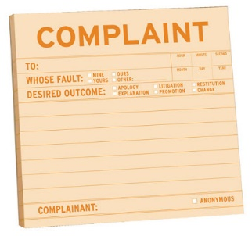
National Ombudsman Reporting System (NORS) Data
2016
199,493 complaints in 2016
11,225 nursing home complaints involving abuse, gross neglect, or exploitation
  819 complaints involving sexual harassment, sexual coercion, or sexual assault by facility staff, management, or an unknown/outside individual that gained access to a resident due to facility negligence.
  2,764 complaints involving willful physical or sexual abuse by a resident against one or more other residents.
This Photo by Unknown Author is licensed under CC BY-SA-NC

Slide 46
LTCOP Complaint Investigations
Ombudsman program representatives:
  Investigate individual complaints and address concerns that impact several or all residents in a facility.
  Can address general concerns they personally observe during a visit (e.g. odors, concerns about the environment, staff not knocking on resident doors before entering).
  Cannot share information without resident consent.
  Investigate to gather the facts, but the main goal is to resolve the issue to the residents’ satisfaction.
  Call upon others to fulfill their responsibilities to residents.
  Represent resident needs by working for legislative and regulatory changes (e.g., coordinated systems advocacy lead by the State Ombudsman).

Slide 47
Resident-Directed Advocacy
As resident advocates:
  The resident guides LTCOP action.
  The LTCOP needs resident consent prior to taking any action on a complaint or sharing resident information.*
  The LTCOP seeks to resolve complaints to the residents’ satisfaction.
  The LTCOP represents residents’ interests, both individually and systemically.
  The LTCOP empowers residents and promotes self-advocacy.
*If the resident cannot provide consent, the LTCO will work with the resident’s legal representative or follow their state procedure if the resident doesn’t have a legal representative.

Slide 48
Person-Centered Complaint Processing
Ombudsman Program Final Rule 45 CFR 1324.19(b)
Person-centered complaint processing approach--the Ombudsman or representative of the Office shall:
Support and maximize resident participation;
Offer privacy;
Discuss the complaint with the resident (and/or resident’s representative) in order to:
    Determine the perspective of the resident;
    Request informed consent in order to investigate the complaint;
    Determine the wishes of the resident with respect to resolution of the complaint, including:
      whether the allegations are to be reported
      disclosure of information to the facility and/or appropriate agencies.
  Advise the resident of his/her rights;
  Work with the resident to develop a plan of action for resolution of the complaint;
  Investigate to determine whether the complaint can be verified; and
  Determine whether the complaint is resolved to the resident’s satisfaction.

Slide 49

Why is resident-directed advocacy important?
By providing confidential, conflict free, resident-directed advocacy:
  Trusted, person-centered problem solver
  Build rapport
  Enhanced trust
  Credible source of information
From the resident’s perspective, “if I have a complaint, do I trust the Ombudsman program to investigate and resolve my complaint?”

Slide 50
Key Distinctions between the Ombudsman Program and Adult Protective Services
 | LTC Ombudsman | Adult Protective Services
Mission | Resolve complaints to satisfaction of the resident Improve the quality of care and quality of life of residents | Stop abuse, neglect and exploitation; Protect the victim
Role of individual self-determination | Resident-directed advocate; represents resident interests | Stress victim self-determination, but protects victim even if not consistent with individual wishes
Abuse, neglect, exploitation | Respond to any resident-related complaint (ACL provides 119 complaint types) 8% abuse/neglect/exploitation, 2016 | Respond to reports of abuse, neglect, exploitation (and self-neglect in some states)
Purpose of “investigation” | RESOLVE: Not the official finder of fact; do not “substantiate” abuse “Verify” to determine whether sufficient information to continue toward resolution Gather information in order to resolve the problem, not for any legal proceeding | DETERMINE: Official finder of fact Determine whether reported allegation occurred Many states use the term “substantiate” If determined, case often referred to law enforcement for prosecution
Systems level advocacy | Required by the Older Americans Act and LTCOP Rule. | Not a responsibility (may be prohibited by state law)

Slide 51
To recap…the Ombudsman program
Cannot be mandatory reporters
Provides resident-directed advocacy to resolve issues to the resident’s satisfaction
Investigates complaints involving abuse, but is not the official “fact finder” to substantiate abuse or determine whether a law or regulation has been violated.

Slide 52
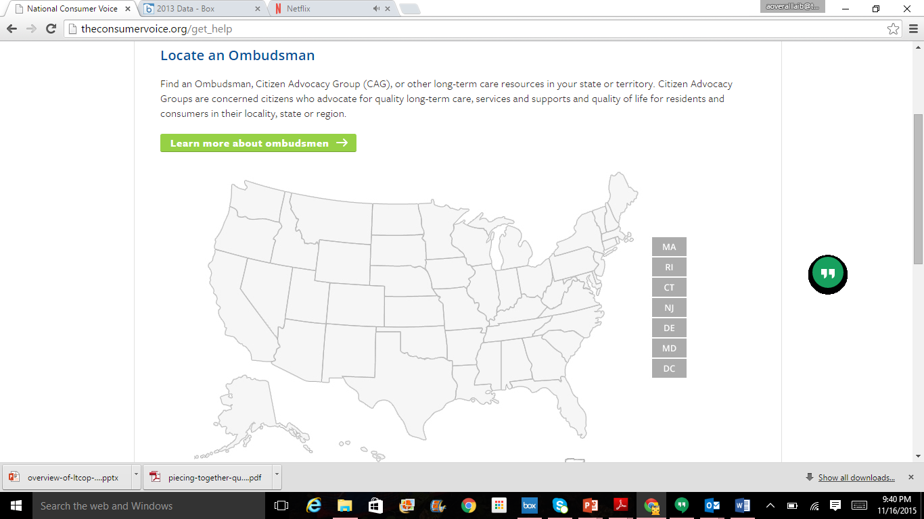
How to Contact the LTCOP
Nursing homes are required to post contact information for the LTCOP and some states require assisted living facilities/board and care facilities to post information about the LTCOP.
Visit the NORC website to locate your local or state LTCO: http://www.ltcombudsman.org/

Slide 53
State examples

Slide 54
The Prevention and Detection of Sexual Assault of
Nursing Home Residents
Developed by the Nursing Home Ombudsman Agency of the Bluegrass and the Bluegrass Rape Crisis Center.
This manual and training resource is intended for use by ombudsmen in collaboration with local rape crisis programs.
My Body, My Rights brochure
http://ltcombudsman.org/omb_support/training/materials-created-by-ombudsman-programs#abuse

Slide 55
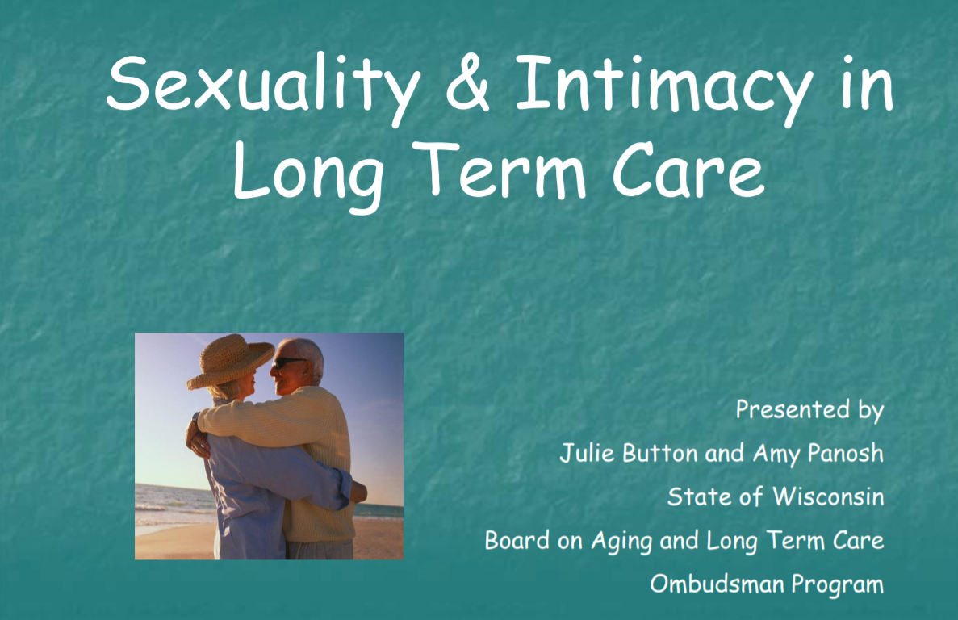

Sexuality and Intimacy in Long-Term Care Facilities
Examples of facility policies and procedures
Consumer education
Training for facility-staff by Ombudsman programs
http://ltcombudsman.org/issues/sexuality-and-intimacy-in-long-term-care-facilities

Slide 56
resources

Slide 57
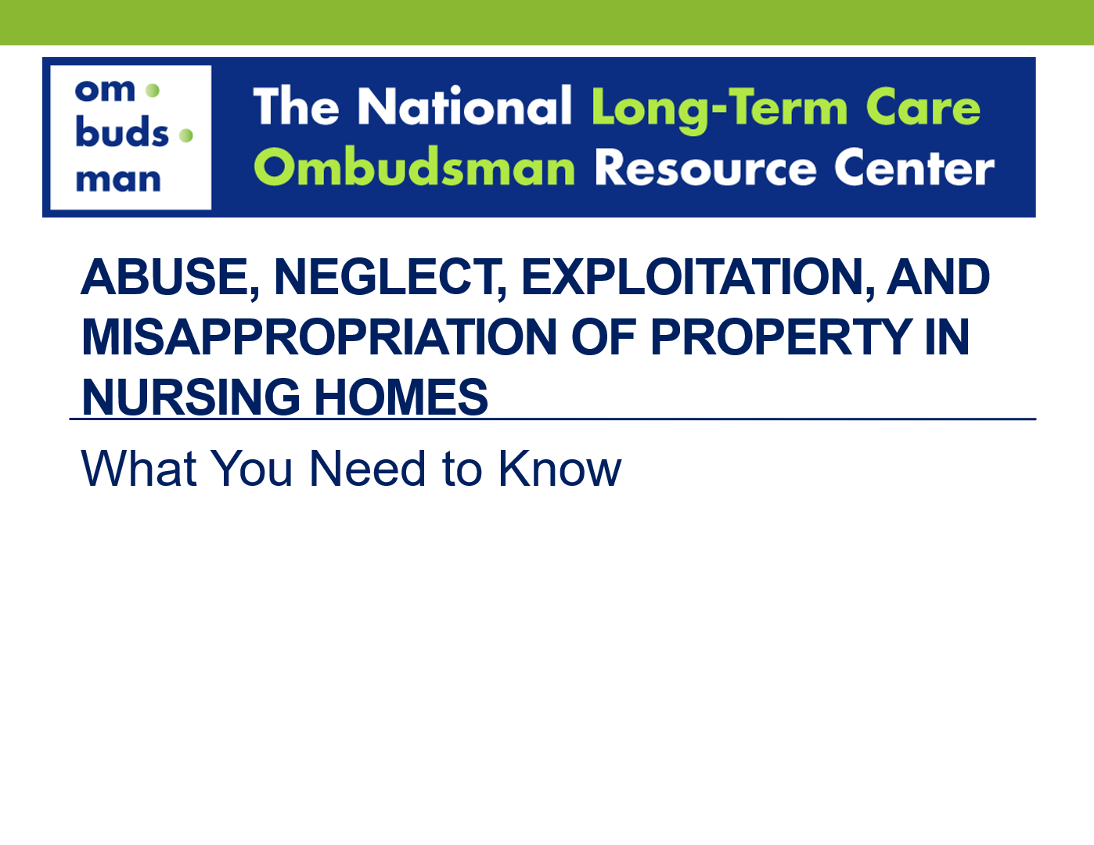
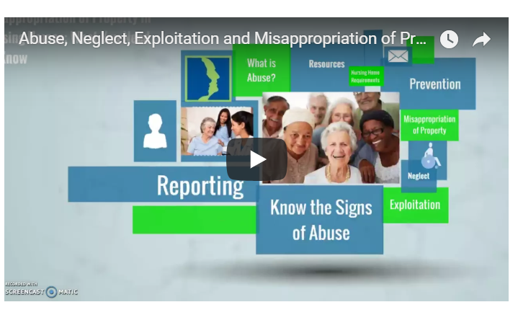
Abuse, Neglect, Exploitation, and Misappropriation of Property
Based on revised nursing home regulations
On-Demand Training Course
PowerPoint
Fact Sheet
http://ltcombudsman.org/issues/abuse-neglect-and-exploitation-in-long-term-care-facilities#info-for-consumers

Slide 58
LTCOP Reference Guide
Responding to Allegations of Abuse: Role and Responsibilities of the Ombudsman Program
Overview
Key Points
AoA Statements
What Can An Ombudsman Do?
LTCO Advocacy Strategies
Resources
http://ltcombudsman.org/uploads/files/issues/ane-no-consent-ref-guide-july_2018.pdf

Slide 59
Balancing Privacy & Protection Surveillance Cameras in Nursing Home Residents’ Rooms
http://ltcombudsman.org/uploads/files/issues/cv-ncea-surveillance-factsheet-web.pdf

Slide 60
Resident-to-Resident Mistreatment
Consumer Fact Sheet
LTCOP Advocacy
http://ltcombudsman.org/issues/abuse-neglect-and-exploitation-in-long-term-care-facilities#resident-to-resident

Slide 61
Additional Information
Nursing Home Regulations
http://ltcombudsman.org/library/fed_laws/federal-nursing-home-regulations
Abuse, Neglect, Exploitation Issue Page
http://ltcombudsman.org/issues/abuse-neglect-and-exploitation-in-long-term-care-facilities
Ombudsman Program Final Rule
http://ltcombudsman.org/library/fed_laws/ltcop-final-rule

Slide 62
ACL’s Frequently Asked Questions (FAQs)
Question: Does the Rule prohibit an Ombudsman or representatives of the Office from being mandated reporters under state abuse reporting laws?
Answer: Yes. Both the Older Americans Act and the Rule prohibit reporting of resident-identifying information without the resident’s consent. By logical extension, this precludes mandated reporting of suspected abuse which discloses such information. Through the strict disclosure limitations within the Act, Congress has indicated its intent for the Ombudsman program to be a safe, person-centered place for residents to bring their concerns. Residents can be assured that their information will not be disclosed without their consent, the consent of the resident representative, or court order. (OAA Section 712(d)(2)(B)). Despite numerous Congressional reauthorizations of the Act, Congress has never provided an exception for abuse reporting in the Act.

Slide 63
ACL’s FAQs
Question: Does the Rule prohibit Ombudsman programs from investigating abuse complaints?
Answer: No. Both the Older Americans Act and the Rule require the Ombudsman program to “identify, investigate, and resolve complaints that … relate to action, inaction or decisions that may adversely affect the health, safety, welfare, or rights of the residents.” Abuse, neglect and exploitation of residents are among the complaints that fall within this purview. However, Ombudsman programs are not the official entity to substantiate (or, finder of fact) for abuse complaints on behalf of the state or other governmental entity. Ombudsman programs represent the interests of residents, rather than the interests of the state or other governmental entity. (See OAA Section 712(a)(3)(E), (a)(5)(B)(iv); 45 CFR 1324.13(a)(5), 1324.19(a)(4)).
Notes:
For more information see ACL’s FAQ’s

Slide 64
The National Long-Term Care
Ombudsman Resource Center (NORC)
www.ltcombudsman.org
This project was supported, in part, by grant number 90OMRC0001-01-00, from the U.S. Administration for Community Living, Department of Health and Human Services, Washington, D.C. 20201. Grantees undertaking projects under government sponsorship are encouraged to express freely their findings and conclusions. Points of view or opinions do not, therefore, necessarily represent official Administration for Community Living policy.

Slide 65

A single bracelet does not jingle.
  -Congolese proverb

Slide 66



The Alliance to End Sexual Violence in Long Term Care

Slide 67
Who we are
Statewide partnership to provide technical assistance and build capacity and effectiveness together for the advocacy of long term care residents who have experienced sexual violence today, tomorrow, or in the past.
Who you are
Disability advocates, sexual assault advocates, long-term care ombudsmen, and any individual or organization that cares for or about the lives of residents of long term care.

Slide 68

Who Is Affected By Sexual Violence?
Sexual Violence knows no boundaries - it can affect every age, race, class, culture, gender, ability, sexual orientation, gender identity, and sex, but in the end, we are all affected.
Residents of long term care facilities are highly vulnerable to sexual violence because of their isolation and dependence on others for their care.
Residents are largely silent about sexual violence.
Key idea

Slide 69
Retaliation is a reality
May be for any complaint or problem: residents are encouraged to not cause or “be a problem”.
May be for forming relationships with other residents
May be because one is perceived as difficult
Can include:
longer waits for assistance, not allowing one to leave the facility, restricting visitors, outings, access to resources, events, and activities, restricting relationships, showers, over or under medicating, cold food or food one can’t eat, and the most frightening: the threat of discharge.
Advocacy barriers

Slide 70
We must be Resident/Survivor driven
Take time, be with the person
Role may just be to listen and be present, without resolution
Advocate is not the fixer: role is to support and empower
Assure confidentiality
Question and mirror survivor experience for support
Recognize with trauma, things may not be in chronological order
Take time, be with the person
Be trauma-informed
Advocate role

Slide 71

Vision
To bring the silence
surrounding sexual violence
in long term care facilities
out of the shadows and into
the community for support
and healing.
Thank you

Slide 72
This project is supported by Grant No. 2012-FW-AX-K003 awarded by the Office on Violence Against Women, U.S. Department of Justice. The opinions, findings, conclusions, and recommendations expressed in this publication/program/exhibition are those of the author(s) and do not necessarily reflect the views of the Department of Justice, Office on Violence Against Women.

Slide 73
Questions?

Slide 74
Getting help
If You Suspect Sexual Abuse

Slide 75
Getting Help
Facility’s administrator, director of nursing, social worker, or other trusted staff-person
Law Enforcement
Long-Term Care Ombudsman Program
State Survey Agency that licenses the facility
Protection and Advocacy or Adult Protective Services
Citizen Advocacy Group

Slide 76
How to Contact the LTCOP
Nursing homes are required to post contact information for the LTCOP and some states require assisted living facilities/board and care facilities to post information about the LTCOP.
Visit the National Consumer Voice website to locate your local or state LTCO: http://theconsumervoice.org/get_help

Slide 77
resources

Slide 78
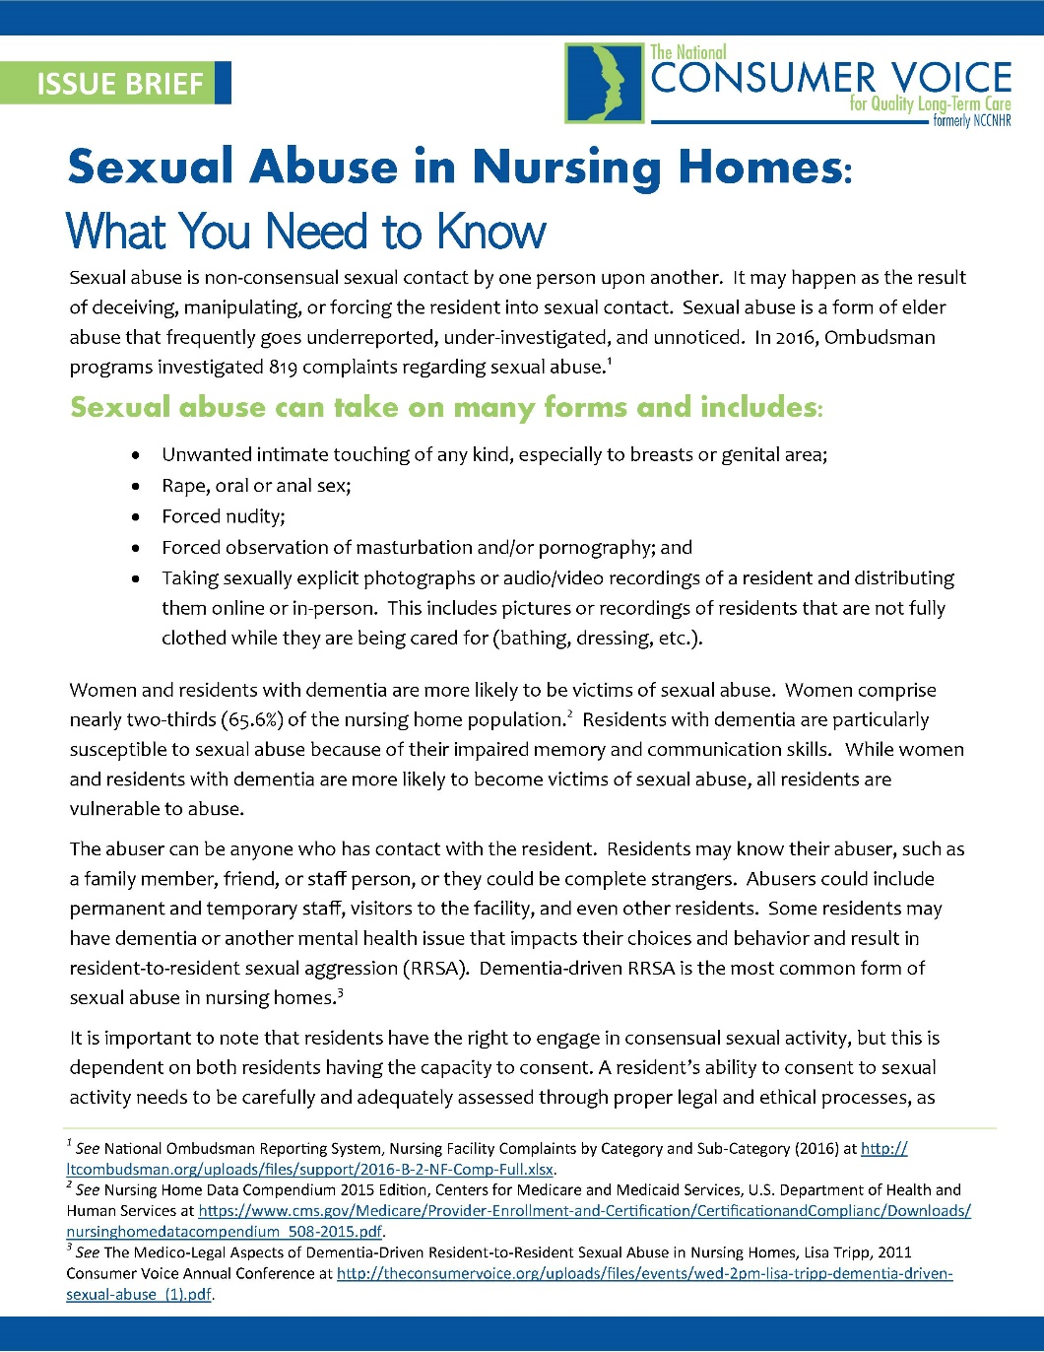
Fact Sheet

Slide 79
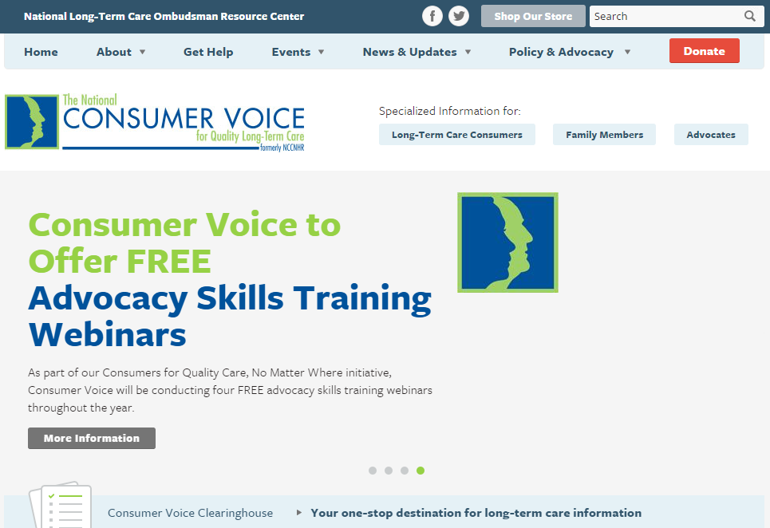
www.theconsumervoice.org

Slide 80

Fact Sheets
  Assessment and Care Planning
  Basics of Individualized Care
  Residents’ Rights
  Guide to Choosing a Nursing Home
  Abuse and Neglect
  Emergency Preparedness
  Restraint Free Care
Resident and Family Council information
Guides
  Piecing Together Quality Long-Term Care: A Consumer’s Guide to Choices and Advocacy
  Nursing Homes: Getting Good Care There

Slide 81




The National Center on Elder Abuse
The goal of the NCEA is to improve the national response to elder abuse, neglect, and exploitation by gathering, housing, disseminating, and stimulating innovative, validated methods of practice, education, research and policy.
Find the NCEA Online!
ncea.aoa.gov
gero.usc.edu/cda_blog/
NationalCenteronElderAbuse
@NCEAatUSC

Slide 82


Connect with us online!
www.theconsumervoice.org
National Consumer Voice for Quality Long-Term Care
@ConsumerVoices

