Slide 1
When nursing homes close: HEAR FROM PILOT STATES
Part 3
April 18, 2018
Dr. Cynthia Rudder, Founder and Former Executive Director, Long Term Care Community Coalition
Lori Smetanka, Executive Director, Consumer Voice
State Presenters: Salli Pung (MI SLTCO), Stephen Gobbo, Esq. (LARA), Laurie Ehrhardt (MDHHS), Jamie O’Neal (TennCare), Lauren Meeker (TN SLTCO), and Dennis Temple (TDMHSAS)
This project is funded by the Retirement Research Foundation.

Slide 2
Agenda
Introduction & Project Overview
Lori Smetanka, Executive Director, Consumer Voice
Dr. Cynthia Rudder, Project Researcher and Trainer
State #1: Michigan
Salli Pung, Michigan State Long-Term Care Ombudsman
Stephen Gobbo, Esq., Deputy Director, Bureau of Community & Health Systems, Michigan Department of Licensing and Regulatory Affairs
Laurie Ehrhardt, Nursing Home Quality Analyst, Medical Services Administration, Michigan Department of Health and Human Services
State #2: Tennessee
Jamie O’Neal, Director of MLTSS and Dual Eligible Initiatives and Operations, Division of TennCare, Long Term Services and Supports
Lauren Meeker, Tennessee State Long-Term Care Ombudsman, Tennessee Commission on Aging and Disability
Dennis Temple, Director of PASSR, Older Adult Services, and Disaster Mental Health Services; Tennessee Department of Mental Health and Substance Abuse Services
Q&A / Closing
All panelists

Slide 3
NEGATIVE IMPACTS OF NURSING HOME CLOSURE
Transfer trauma (also referred to as "relocation stress syndrome")
Self-care deficits - Impaired ability to perform or complete activities of daily living for oneself, such as feeding, dressing, bathing, toileting.

Slide 4
Depression, sometimes manifesting as agitation
Increase in withdrawn behavior

Slide 5
Falls
Weight loss

Slide 6
2015-2016 NATIONAL STUDY: FUNDED BY THE RETIREMENT RESEARCH FOUNDATION
Using online surveys and one-on-one interviews:
OBJECTIVES:
Identify obstacles
Identify policies and procedures for overcoming the obstacles
Identify best practices
Make recommendations
Click here to view the full report.

Slide 7
CONCLUSIONS: OBSTACLES TO A SUCCESSFUL CLOSING
Lack Of Appropriate And Nearby Placements
Poor Discharge Planning
Lack Of Communication
Poor Notice/Not Enough Time
Staffing Issues
Transfer Trauma
Notes:
Do These Seem Like The Obstacles In Your State?
Are There Any Other Obstacles You Have Seen?

Slide 8
STATE BEST PRACTICE CASE STUDIES
OHIO
WISCONSIN
CONNECTICUT
Other states with best practices:
Iowa
South Carolina
Washington, DC
Rhode Island
Notes:
Also, discuss state case studies in the tool kit. The state case studies reinforce the data collected in the on-line surveys and the one-on-one interviews. Many of the obstacles to a successful transition for nursing home residents have the potential to be overcome by the processes in the best practice states. The state case studies reinforce the data collected in the on-line surveys and the one-on-one interviews, as they show that several of the obstacles to a successful transition for nursing home residents have the potential to be overcome by the implementation of specific processes and requirements at the state level, and from quick and concerted action by the appropriate State Agencies and the Long-Term Care Ombudsman Program. Developing processes for timely communication with residents and families, delineating roles and responsibilities for all state agencies, creation of state-developed closure manuals that outline the processes to be followed by the closing facility, as well as the state agencies and programs overseeing the closure, are all strategies being employed by states to assure that a nursing home closure occurs with the least amount of negative impact on residents as possible.
Through the data collection and analysis, and interviews with state program representatives, we were able to identify a range of recommendations for CMS, for State Agencies, and for State Long-Term Care Ombudsman Programs that would enhance protections for residents facing relocation, and help better prepare them for the moving experience.

Slide 9
2017-2018 Project*
During the last 10 months, we have worked with two states as they examined and worked to enhance their nursing home closure process to improve the closure experience for residents: Michigan and Tennessee.
Michigan’s State Ombudsman Office is independent of the other state agencies.
Tennessee is part of the state structure of agencies.
* This project was also funded by the Retirement Research Foundation.

Slide 10
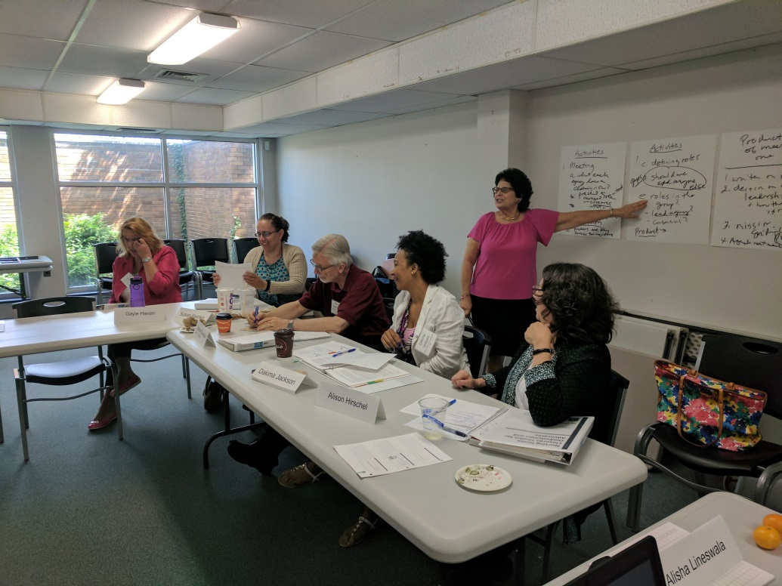
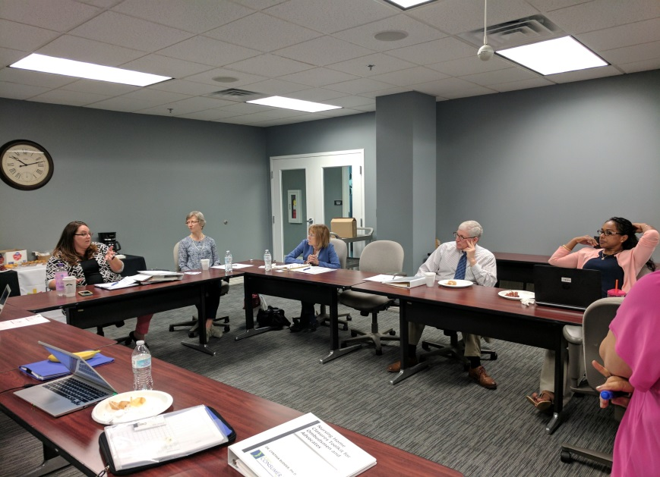
Project Activities
We gave each state a one and a half day training summarizing our earlier project with the recommendations for ombudsmen and other state agencies.

Slide 11
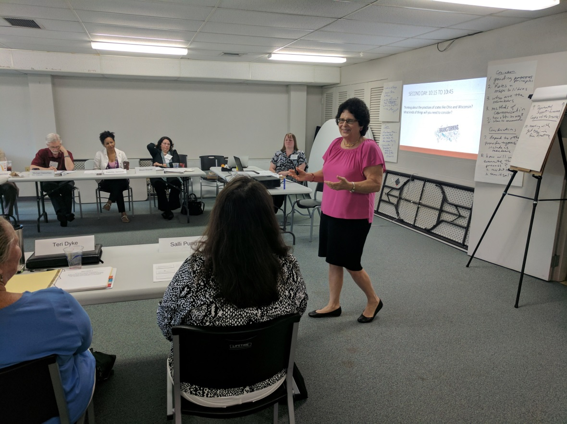
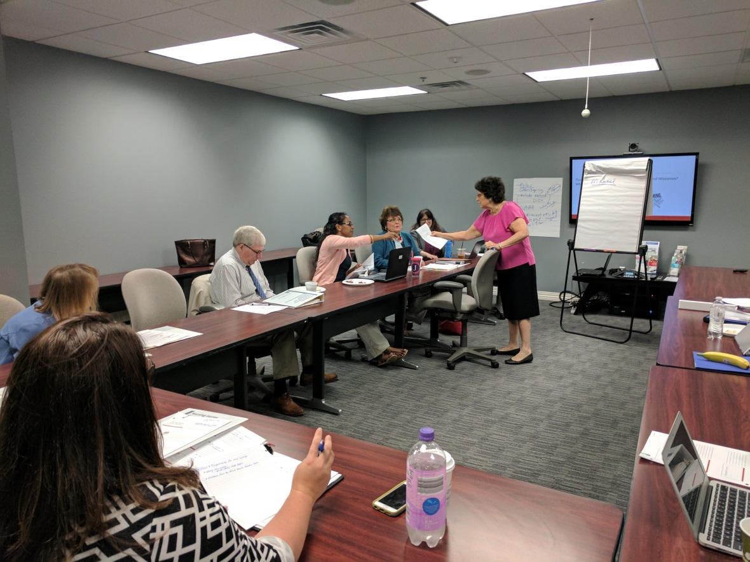
We asked each state to choose two recommendations to work on and facilitated a discussion as each state developed these goals and created a 12 month workplan.

Slide 12
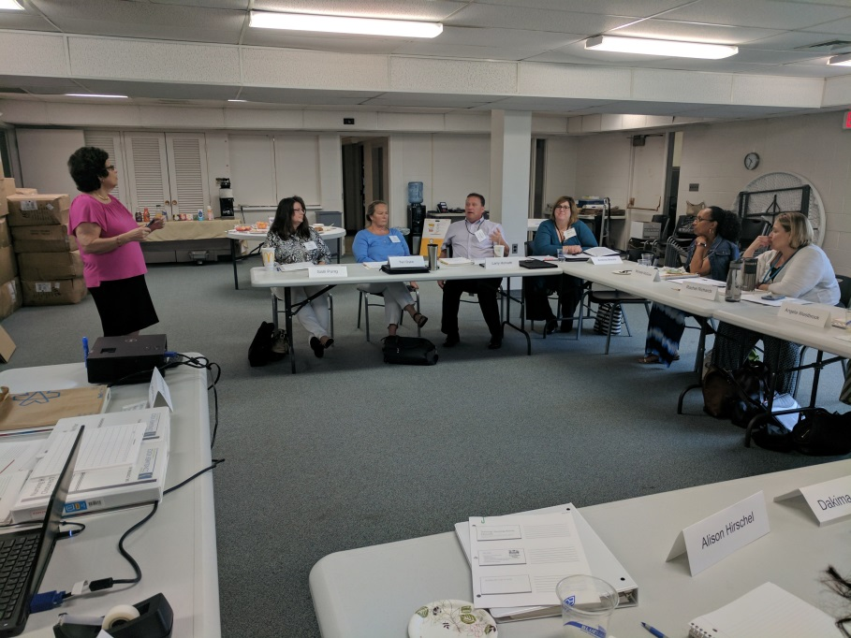
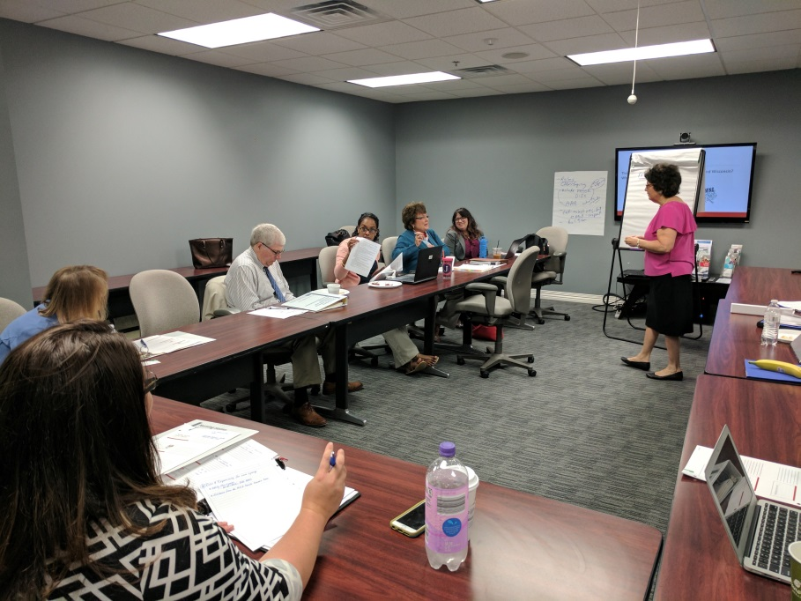
We spent time on a strategy for meeting each goal.
Project staff held monthly or bimonthly conference calls with the full relocation teams of each state, which included state agencies new to the team.

Slide 13
Goals of the Pilot States
The full report lists many different recommendations for CMS, States and for Ombudsmen. Please see report for a full list of recommendations.
The two states we worked with chose to:
Improve/enhance their closure team
Include the State Ombudsman in the closure plan review
Develop a tool to follow up with transferred residents to prevent deterioration and transfer trauma

Slide 14
State #1: Michigan
Salli Pung (SLTCO)
Stephen Gobbo, Esq. (LARA)
Laurie Ehrhardt (MDHHS)

Slide 15
Michigan Presenters
Salli Pung, Michigan State Long-Term Care Ombudsman, Michigan Elder Justice Initiative
Stephen Gobbo, Esq., Deputy Director, Bureau of Community & Health Systems, Michigan Department of Licensing and Regulatory Affairs
Laurie Ehrhardt, Nursing Home Quality Analyst, Medical Services Administration, Michigan Department of Health and Human Services

Slide 16
Benefits
Identify Needed Participants
Understand Agency Resources
Develop A Shared Vision
Revisit Roles and Responsibilities
Produce Work Products

Slide 17
Obstacles
Expectations Beyond Regulations
Assumed “Take Over”
Limited History or Experience
Confusion for Providers

Slide 18
Application
Utilization of New LARA Checklist
Evolution of the Closure Experience

Slide 19
State #2: Tennessee
Jamie O’Neal (TennCare)
Lauren Meeker (SLTCO)
Dennis Temple (TDMHSAS)

Slide 20
Tennessee Presenters
Jamie O’Neal, Director of MLTSS (Managed Long Term Services and Supports) and Dual Eligible Initiatives and Operations, Division of TennCare, Long Term Services and Supports
Lauren Meeker, Tennessee State Long-Term Care Ombudsman, Tennessee Commission on Aging and Disability
Dennis Temple, Director of PASSR, Older Adult Services, and Disaster Mental Health Services; Tennessee Department of Mental Health and Substance Abuse Services

Slide 21
When Nursing Homes CLOSE in TennESsee:
Working Together to Improve the Transition of Residents
April 18, 2018

Slide 22
Tennessee Overview
TennCare – State Medicaid Agency (SMA) and Medicaid program
TennCare managed care demonstration began in 1994
Entire Medicaid population (1.4 million) in managed care since 1994 (including individuals with I/DD)
Three health plans (Managed Care Organizations or MCOs) operating statewide
Physical/behavioral health integrated in 2007
Managed LTSS began with the CHOICES program in 2010
Includes all Medicaid Nursing Facility Services and HCBS for older adults and adults with physical disabilities
Each NF resident has an assigned health plan Care Coordinator

Slide 23
TN Nursing Facility Closure Process
TN has long had an established process for NF closures
Implementation of CHOICES MLTSS program in 2010 added significant capacity to facilitate this process
Includes partnership with State Survey Agency (Health Care Facilities), CMS, TennCare-contracted health plans (MCOs), Area Agencies on Aging and Disability (intake agency for HCBS) and the LTC Ombudsman Office
Early notification to MCOs to engage Care Coordinators in transition process (“boots on the ground”)
Assessment of capacity in area facilities by SMA or SSA
Detailed written notice to facility residents and family members, including rights and the opportunity to explore HCBS as well as transition to other facilities
Onsite meeting jointly hosted by SMA and SSA to provide information and answer questions
All partners in attendance to provide assistance as needed

Slide 24
TN Nursing Facility Closure Process
Daily status update call with facility, SMA, SSA, CMS and HCF to review status of all resident transitions (including planned, completed, pending, etc.) hospital admissions, address questions/concerns, etc.
Daily roster (7 days/week) submitted by facility with any updates and changes throughout closure process
Review and discussion with the closing facility regarding Residents’ funds and personal belongings to confirm these items are inventoried and transferred with each Resident
Ongoing daily communication with MCOs, including updated MCO rosters and transition status for their members a minimum of 3 times per week
Allows for reconciliation with facility roster
Ongoing engagement/facilitation of transitions by Care Coordinators/team
Opportunities to explore HCBS as well as transition to another facility
Arrangement of transportation to accommodate transition
Internal processes for escalating applications or document submissions to assist in expediting eligibility determinations, transition to HCBS, etc.

Slide 25
Opportunities for Improvement
Expanding the team
TN Department of Mental Health and Substance Abuse Services is now a part of the NF closure team
Documenting the process
TN will have a manual that details the process we use for NF closures
This manual will be available as a reference and for new staff for the future
Opportunities to strengthen and enhance engagement of the LTC Ombudsman in the closure and transition process

Slide 26
Tennessee Long Term Care Ombudsman
What Positives have come from working together on this project?
Improved Relationships
Improving Communications
Nursing Home Closure Manual for Closure Team

Slide 27
Tennessee Long Term Care Ombudsman
Follow Along
Baseline Assessment
Follow Along Assessment
Areas for growth and improvement

Slide 28
Nursing Facility Relocation Process – Office of PASRR
Collaborating with the Nursing Facility Closure Team and nursing facility staff, the State PASRR office is better able to quickly identify “at risk” residents due to their clinical status, to determine if:
a Change of Status has been submitted
if not, if a Change of Status is needed, in light of clinical risk factors
and/or a Change of Status is now needed because additional specialized services are required to effect a healthy transfer
Dennis Temple, Director of PASRR Older Adult Programs & Disaster Mental Health Services

Slide 29
Nursing Facility Closure Process – Office of PASRR
The Office of PASRR is on daily calls with the closure team and has incorporated questions into the Ombudsman’s Resident Baseline Assessment tool to ensure transferred residents receive any specialized services needed
The PASSR Office will also help facilitate access to mental health services for those individuals leaving the nursing facility system
If an individual indicates they want to leave the nursing facility system, the PASRR office works with the closure team to ensure they are aware of all mental health care alternatives available to them upon their departure
Dennis Temple, Director of PASRR Older Adult Programs & Disaster Mental Health Services

Slide 30
Question and Answer

Slide 31
Contact Information
Cynthia Rudder
crnhcc@aol.com
Lori Smetanka
lsmetanka@theconsumervoice.org
Michigan Presenters
Salli Pung
spung@meji.org
Stephen Gobbo, Esq.
gobbos@michigan.gov
Laurie Ehrhardt
ehrhardtl@michigan.gov
Tennessee Presenters
Jamie O’Neal
jamie.o’neal@tn.gov
Lauren Meeker
lauren.meeker@tn.gov
Dennis Temple
dennis.temple@tn.gov

