Slide 1
BRIEFING
The Need for Federal Staffing Standards in Nursing Homes
December 9, 2021

Slide 2
About the Consumer Voice
The leading national voice representing consumers in issues related to long-term care.
Advocate for public policies that support quality of care and quality of life responsive to consumers’ needs in all long-term care settings
Empower and educate consumers and families with the knowledge and tools they need to advocate for themselves
Train and support individuals and groups that empower and advocate for consumers of long-term care
Promote the critical role of direct-care workers and best practices in quality-care delivery

Slide 3
Welcome and Reminders
The program is being recorded
Use the Q&A feature for questions for the speakers
Use the chat feature to make comments or respond to questions from speakers or other attendees
Links to the PowerPoint and resources – in the chat box

Slide 4
House version:
Build Back Better Reconciliation Bill
Creates a process for establishing minimum staffing requirements
Requires nursing homes to have a Registered Nurse on duty 24 hours per day
Provides necessary funds to improve the survey and oversight process
Improves the accuracy and reliability of certain skilled nursing facility data
Requires auditing of Medicare cost reports
Also:
Provides $4 billion for workforce recruitment, retention, and training

Slide 5
Speakers
Charlene Harrington Professor Emerita, School of Nursing, UCSF
Richard Mollot
Executive Director
Long Term Care Community Coalition
Robyn Grant
Director of Public Policy & Advocacy
Consumer Voice

Slide 6
Nursing Home Staffing – Congressional Briefing
Charlene Harrington, Ph.D., RN
Professor Emerita
University of California San Francisco

Slide 7
Residents in US nursing homes are highly vulnerable
Generally older with multiple chronic conditions (90% are 65+, 34% are 85+)
60%+ have dementia
60% are frail and need extensive help
Take 9+ different medications daily

Slide 8
Basic nursing care is labor intensive 24 hours per day
Basic care – bathing, dressing, toileting, transferring, eating, walking/mobility by certified nursing assistants (CNAs)
Morning and evening care
General assistance 24 hours a day
Assistance by 1-2 CNAs
Licensed practical nurse care - medications, treatments, coordination, communications – 24 hours a day

Slide 9
Nursing care is highly complex requiring RNs 24 hours a day 7 days a week
RNs are specifically trained in:
infection control planning and management
resident assessment & care planning
identification and treatment of infections, chronic, and acute care conditions
surveillance of residents and resident care
coordination and communication with medical, dietary, therapy, social services, pharmacy, laboratory, and other
required for supervision of LPNs and CNAs

Slide 10
Nurse staffing, especially RNs, are associated with higher quality of care
improved process and outcome measures
better functional improvement
reduced incontinence
fewer urinary tract infections and catherization
less pain
fewer pressure ulcers
less weight loss and dehydration
lower use of antipsychotics
less restraint use
fewer infections
fewer falls with injuries
less rehospitalization and emergency department use
less missed care
fewer adverse outcomes
lower mortality rates
fewer deficiencies

Slide 11
Most nursing homes did not meet recommended staffing before the pandemic
75% of homes almost never met CMS expected RN staffing levels based on resident acuity in 2017-18 ^{Geng et al 2019}
54% homes did not meet the federal requirement of 1 licensed nurse on duty every shift for up to 30 days in 2018 ^{OiG 2020}
Staffing levels are 15% lower on weekends and holidays
Annual turnover rate of resident care was 100% for all nurses and 141% for RNs in 2017-18 ^{Gandhi et al 2021}
Nursing turnover is related to heavy workloads and low wages

Slide 12
COVID-19 had devasting impact on nursing homes
CA nursing homes were 2x more likely to have COVID-19 resident infections if RN staffing less than .75 hours per resident day ^{Harrington et al 2020}
In CT, every 20 minute increase in RN staffing had 22% fewer COVID-19 infections and 26% fewer COVID-19 deaths ^{Li et al. 2020}
Higher nurse aides and total nursing had lower COVID-19 outbreaks & fewer deaths ^{Gorges & Konetzka 2020}
US nursing homes with higher RN staffing and quality ratings fewer COVID deaths and fewer staffing shortages Williams et al 2021; McGarry et al 2020

Slide 13
Minimum staffing recommend- ations by researchers & experts
Minimum staffing for lowest resident acuity
1 RN: 28 residents day shift; 1:30 evenings; and 1:40 nights) (45 minutes/resident day)
1 LPN: 38 residents day shift; 1:40 evenings; 1:56 nights (33 minutes/resident day)
1 CNA: 7 residents on days/evenings & 1 CNA:15 nights (2.8 hours/resident day)
Total nurse staffing 4.1 hours/ resident day CMS 2001; ANA 2014; Schnelle 2014
Higher staffing levels are needed and required by CMS for higher acuity

Slide 14
Conclusions
Residents deserve to have adequate staffing especially RN staffing 24 hours a day every day
Residents deserve to be protected from infections and to have high quality care
Nursing staff deserve to have reasonable workloads, a living wage, and a comfortable and safe working environment

Slide 15
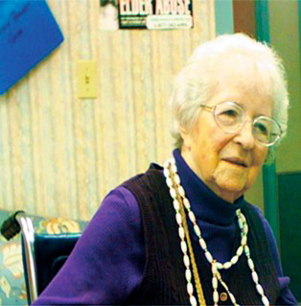
Federal Nursing Home Staffing Standards:
Necessary, Affordable, and Achievable
Richard Mollot, Long Term Care Community Coalition
www.nursinghome411.org

Slide 16
The Long Term Care Community Coalition
LTCCC is a nonprofit, nonpartisan organization dedicated to improving care & quality of life for the elderly & adult disabled in long term care (LTC).
What we do:
Policy research & analysis;
Systems advocacy;
Public education;
Home to two local LTC Ombudsman Programs.
Richard Mollot: Executive director since 2005.
www.nursinghome411.org

Slide 17
What are the Data?
Nursing Home Staffing Data
Past. In the past, nursing homes provided self-reported information on their nurse staffing based on the two-week period prior to their annual survey.
Current. In the face of persistent concerns about both staffing levels and accuracy of the reported information, the 2010 Affordable Care Act required nursing homes to report nursing and other key staff…
on a daily basis,
for every day of the year,
based on payroll records,
in auditable files.
Why is this important? We now have excellent information on the extent to which facilities employ sufficient staffing to provide the care and services they promise to residents, families, and tax-payers.

Slide 18
What do the Data Show?
Nursing Home Staffing Data
Less than a third (31.2%) U.S. nursing homes met the total care staff threshold (4.10 HPRD) as determined by the 2001 federal study.
Average total nurse staffing HPRD were 3.75 in Q2 2021. Average RN staffing was 0.66 HPRD. The typical resident needs at least .75 RN HPRD.
Average total resident census climbed 29,000 (1.1 million) from the previous quarter despite a slight decrease in total number of facilities reporting PBJ data (14,812, down from 14,857). This indicates that nursing homes are taking in new residents despite insufficient staffing.
Contract staff accounted for 5.75% of all nurse staff hours in Q2 2021 after accounting for 5.02% of nurse hours in the previous quarter.
The failure to ensure adequate staffing destabilized the industry and puts residents at risk.
The industry’s own data indicate that most facilities are clearly understaffed

Slide 19
Are Baseline Staffing Standards Achievable?
It is Possible!
One-third of nursing home already meet minimum staffing needs of 4.1 nursing HPRD.
Over 75% of facilities already have enough RNs for 24-hour coverage.
However, in the absence of a federally defined minimum, doing so is voluntary.
With nursing homes increasingly owned by sophisticated corporations, we cannot count on the diminishing number of owners who take their commitment to residents seriously.
It is Affordable!
The average cost to shift to 24-hour RN staffing is $61.82 per facility per day.
The cost range to achieve 24-hours RN staffing per day ranges from 3¢ to $141.15 per day.
The actual costs of achieving 24-hour RN staffing nationwide is $75.1 million per year.
National nursing home expenditures were $173 billion in 2019. The above cost is less that one-tenth of 1% of total US NH expenditures.
Aren’t nursing home residents worth it?
The industry’s own data indicate that decent staffing standards are affordable and achievable

Slide 20
Resources

Slide 21
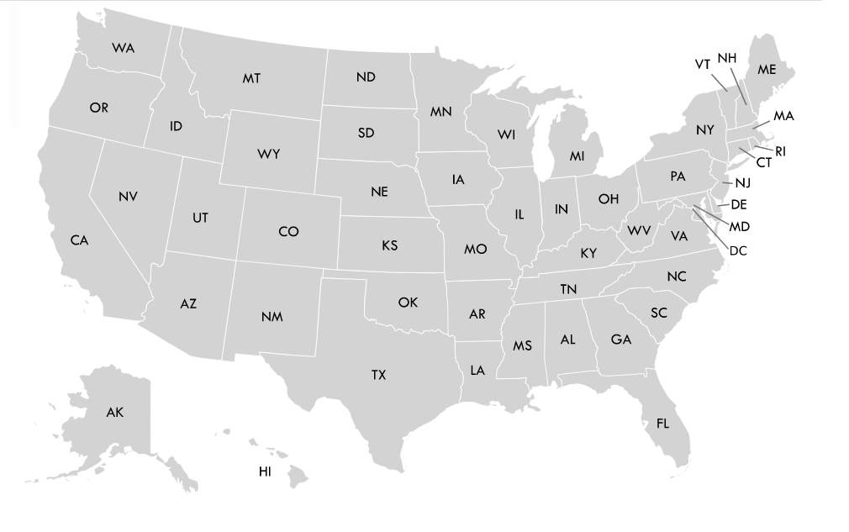
LTCCC’s state pages
Use clickable map to find your state
State pages contain state-specific
Staffing
Ratings
Ombudsman resources
And more…
nursinghome411.org/states

Slide 22
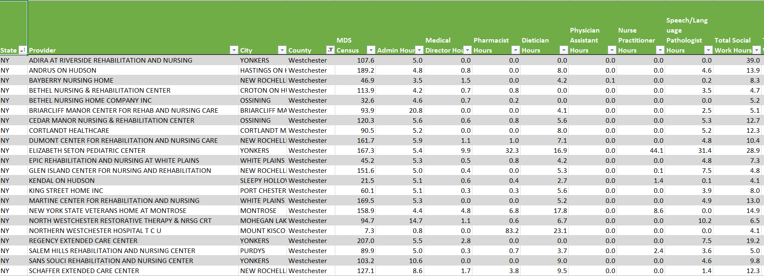
Example: Find your facility’s or region’s staffing data
Facility Nursing Staff (Use Provider filter)
County Non-Nursing Staff (Use County filter)

Slide 23
Nursing Home Oversight & Enforcement: Expectation vs. Reality
Register for our 12/21 webinar:
https://nursinghome 411.org/event/data-oversight-program/
for
the story behind the data.
nursinghome411.org/news-reports/reports/survey-enforcement/

Slide 24
State Nursing Home Staffing StandardS
Robyn Grant
Director of Public Policy & Advocacy

Slide 25
Federal statute and regulation
Registered nurse on-site eight hours a day, seven days a week. 42 C.F.R. § 483.35(b)(1).
Licensed nurse—either a registered or licensed practical/vocational nurse—serving as a Charge Nurse on-site twenty-four hours daily. 42 C.F.R. § 483.35(a)(2).
Sufficient nursing staff to meet residents’ needs. 42 C.F.R. § 483.35(a)(1).

Slide 26
State Requirements for Total Nursing Staff Time Recommended Staffing Standard: 4.1
Total hprd | # of States | States
4.10+ | 1 | DC
3.50 – 4.09 | 6 | CA, FL, IL, MA, NY, RI
3.00 – 3.49 | 6 | AR, CT, DE, MD, VT, WA
2.50 – 2.99 | 8 | ME, MS, NJ, NM, OH, OK, PA, WI
2.00 – 2.49 | 13 | CO, GA, IA, ID, KS, LA, MI, MN, OR, SC, TN, WV, WY
1.50 – 1.99 | 1 | MT
1.00 – 1.49 | 0
<1.00 | 1 | AZ

Slide 27
Twenty-four Hour Registered Nurse
Only 6 states require an RN 24/7
CO, CT, DC, DE, MD, RI

Slide 29
Public Dollars for Nursing Homes
Medicare > $25 billion annually
Medicaid > $50 billion annually
COVID Support & Relief Funds
$21 billion from CARES Act
Paycheck Protection Program loans to keep workers
Temporary suspension of Medicare sequestration
State funding from the Federal Medical Assistance Percentage Program
Medicare accelerated and advance payment program
Deferral of employer payroll taxes
Higher Medicaid reimbursement rates in some states
Higher Medicare payment rates in 2020
Higher Medicaid and Medicare revenues related to higher resident acuity
Economic injury disaster loans (not limited to nursing homes)
Other non-monetary support (e.g. PPE, tests, training, national guard, strike teams)
https://medicareadvocacy.org/report-snf-financial-support-during-covid/#_edn15

Slide 30
We can support minimum staffing standards
Increase Transparency and Accountability for Public Funds
Require funds to be spent on resident care
Audited consolidated cost reports
Target any new dollars toward resident care and staff support
Support Caregivers by improving jobs
Living wages and benefits
Invest in training
Address turnover, retention, advancement opportunities
Address racial and gender equity and disparities

Slide 32
QUESTIONS?

Slide 33
The National Consumer Voice for Quality Long-Term Care
www.theconsumervoice.org
Connect with us:
National Consumer Voice for Quality Long-Term Care
@ConsumerVoices

