Slide 1
Family Advocacy for Residents During COVID

Slide 2
How would you describe your primary role:
Family member of a nursing home resident/assisted living facility resident/individual receiving services at home
Resident of a nursing home/assisted living facility/ individual receiving services at home
Long-term care ombudsman
Individual citizen advocate
Member of a citizen advocacy group
Other

Slide 3
Agenda
How to advocate on behalf of a loved one and other residents
Individually
Through a Family Council
Long-Term Care Ombudsman Program
Common Situations
Visitation
Transfers/discharges
Going outside/leaving the facility
Transparency
Testing
Advocating Together
Q&A/discussion

Slide 4
Residents’ Rights
Despite the pandemic, residents still have the right to:
Receive care and services to obtain highest level of well-being
Participate in the development and implementation of a person-centered plan of care, including the right to make decisions about care now and in the future
Be free from abuse, neglect, exploitation, and misappropriation of property
Voice grievances without discrimination or retaliation and prompt efforts by the facility to solve their grievances

Slide 5
INDIVIDUAL ADVOCACY
What can you do to help your family member?

Slide 6
Individual Advocacy
Work with your facility!
Speak regularly with administration and staff
Ask what they are doing to keep residents safe
Insist on regular updates to all families
Care planning conference
File a grievance with the facility

Slide 7
Individual Advocacy
Ombudsmen
Contact the ombudsman program in your state to assist you https://theconsumervoice.org/get_help
State Survey Agency
Limited BUT still file complaints
Elected Officials
They need to know what’s happening in their district/state
https://www.house.gov/representatives/find-your-representative
Media
Write letters to the editor, reach out to local media, use social media

Slide 8
Individual Advocacy
Share Your Story:
https://theconsumervoice.org/issues/other-issues-and-resources/covid-19/residents-families/share-your-story

Slide 9
Advocating Through a Family Council

Slide 10
What a Family Council Is
A self-led self-determining group of families and friends of nursing home residents that:
Works to improve the quality of care and quality of life of the facility’s residents; and
Provides families with a voice in decision-making that affects them and their loved ones.

Slide 11
What Family Councils Do
Act on concerns and complaints affecting nursing home residents
Advocate for positive change within the facility and the long-term care system
Communicate with the nursing home administrator and staff
Serve as a sounding board and advisory body on new ideas and improvements
Educate and inform families about issues relating to residents, the nursing home, and the long-term care system
Provide support to family members

Slide 12
Family Council Rights
A resident’s family has the right to meet in the facility with the families of other residents in the facility.
The facility must provide a family group, if one exists, with private space.
Staff or visitors may attend meetings only at the group’s invitation.
The facility must provide a designated staff person responsible for providing assistance and responding to written requests that result from group meetings.
Staff person must be approved by the family group and the facility
When a family group exists, the facility must listen to the views and act upon the grievances and recommendations of residents and families concerning proposed policy and operational decisions affecting resident care and life in the facility.
The facility must be able to demonstrate their response and rationale for such response.
This does not mean the facility must implement as recommended every request of the family group.

Slide 13
Starting a Family Council
Find out if there is a family council in your loved one’s facility
If not, start one!
Develop a flyer announcing the formation of a family council; put your name and contact information on it
Ask the administrator to send your flyer to family members
Contact the Long-Term Care Ombudsman Program for assistance
Create a Facebook group to attract family members; communicate directly with them about forming a family council
Be creative and innovative:
One family member handed out flyers at the facility’s laundry pick up/drop off area.

Slide 14
Build Your Family Council: Resources
Long-Term Care Ombudsman Program
Consumer Voice Family Council Center

Slide 15
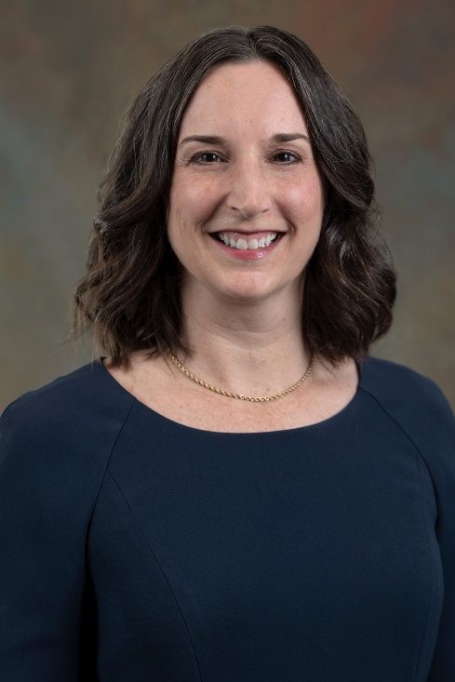
What is the State LTC Ombudsman Program?
Patty Ducayet, Texas State LTC Ombudsman
LTC Ombudsmen represent the interests of residents
Receive complaints from anyone on behalf of a resident

Slide 16
Advocating With an LTC Ombudsman
Individual problems
Facility and corporate management
Coordinating with other agencies
Systemic problems
Media
Lawmakers
State survey agency
National organizations

Slide 17
CoMmon situations:
WHAT YOU NEED TO KNOW!

Slide 18
Visitation
CMS Guidance, March 13, 2020
https://www.cms.gov/files/document/qso-20-14-nh-revised.pdf
Facilities should restrict visitation of all visitors and non-essential health care personnel, except for certain compassionate care situations, such as an end-of-life situation.
Decisions about visitation during an end of life situation should be made on a case by case basis, …

Slide 19
CMS Frequently Asked Questions, April 24, 2020
https://www.cms.gov/files/document/qso-20-28-nh.pdf
4. Q: The CMS memorandum (QSO-20-14-NH (Revised)) states that visitation should be allowed in “certain compassionate care situations, such as an end-of-life situation.” What is an example of a “compassionate care situation”?
A: The memorandum intends to provide general guidance on how to limit visitation as much as possible, while also acknowledging that there are times when visits should be allowed. We encourage frequent communication among patients, residents, families, facilities, and other health care providers when appropriate (e.g., hospice providers), so they can work together to identify when a visit for compassionate care is needed, and can be safely conducted. One example of such a situation is one in which a resident is receiving hospice care and their health status is sharply declining, or when a resident is not enrolled in hospice, but their health status has sharply declined.

Slide 20
Visitation: Advocacy Strategies
Individually: Make the case that your loved one’s situation fits the criteria for a compassionate care situation
Family Council:
Urge the facility to expand its definition of a compassionate care situation
Try to work with administration to develop a plan for a phased-in approach to allowing visitation
Individually and with Family Council:
Determine where your state is with developing reopening guidance
Provide input, help shape the guidance

Slide 21
Transfers/Discharges
Federal nursing home regulations provide protections:
Advance written notice, generally 30 days prior to date of proposed transfer/discharge
Right to appeal hearing in front of administrative law judge

Slide 22
Waiver of These Regulations in Only 3 Situations:
Resident with COVID-19 transferred to COVID-dedicated facility
Resident without COVID-19 transferred to Non-COVID facility
Transfer for 14-day observation

Slide 23
What Does This Mean?
“[W]e are only waiving the requirement … for the written notice of transfer or discharge to be provided before the transfer or discharge. This notice must be provided as soon as practicable.”
CMS, COVID-19 Emergency Declaration Blanket Waivers for Health Care Providers.

Slide 24
Residents Still Have Rights
Right to:
Choice of where to be transferred/discharged
Sufficient preparation and orientation to ensure a safe and orderly transfer

Slide 25
Transfers/Discharges: Advocacy Strategies
Individually: Request the transfer be stopped for the moment; ask for a meeting to discuss options
Individually and with Family Council: Advocate at both the facility and state level for:
Advance notice (at least 72 hours)
Advance conversation to explore options/make plans

Slide 26
Leaving a Facility during COVID-19
Going to a shared courtyard
Going for a walk or out for lunch
Going home with a family member for the duration

Slide 27
My mother wants to go outside to the courtyard!
If the facility has no active cases of COVID-19, there is no CMS guidance that says she can’t!
FAQ QSO-20-28-NH https://www.cms.gov/files/document/qso-20-28-nh.pdf
Can a resident leave a nursing home for an appointment or outside activity?
“With regard to outside activities, the CMS memorandum (QSO-20-14-NH (Revised)) states that facilities should cancel “all group activities such as internal and external group activities.” This means there should be no group activities occurring outside or inside of the building, due to the risk of transmission.”

Slide 28
Yes, going outside on facility grounds should be permitted!
There are facilities in some states that are starting to have “outdoor visitation.”
There are facilities that are allowing smokers to go outside.
As long as residents practice social distancing when outdoors they should be permitted to enjoy outdoor spaces.
Outdoor recreation is encouraged during this time, it shouldn’t be different for residents of long term care facilities.

Slide 29
What can you do?
Talk to the facility
Bring this up at a care planning meeting
Get your ombudsman involved

Slide 30
My mother wants to go for a walk away from the facility or to lunch at a nearby restaurant. Can she?
QSO-20-28-NH https://www.cms.gov/files/document/qso-20-28-nh.pdf
What if a resident wants to leave the nursing home against medical advice?
“It is unlawful for a facility to detain and stop a resident from leaving the facility if the resident wishes to leave…. If a resident insists on leaving against medical advice, the facility must allow them to leave, should encourage them to wear a facemask while out in the community, discuss the importance of handwashing, offer hand sanitizer if available, and document in the resident’s medical record how the facility discouraged leaving and explained the risks of leaving to the resident and/or resident representative.
For a resident who leaves and intends to return, the facility should monitor the resident upon return for fever and signs and symptoms of respiratory infection for 14 days (preferably in a space dedicated for observation of asymptomatic residents), and implement the necessary Transmission-Based Precautions if the resident develops fever or signs and symptoms of respiratory infection.”

Slide 31
So what does this mean?
Your loved one CAN leave their facility!
BUT…
They may be quarantined and monitored for 14 days upon return.
They may be asked/required to take tests to determine their COVID-19 status.
The facility may push back and not want to let them back in!

Slide 32
What can you do?
Discuss the decision with the facility BEFORE your loved one leaves. Understand their policies. Accept that monitoring and quarantine may be done for the safety of everyone within the facility. Once someone leaves the facility grounds, it’s impossible to control where they go or whether they practice social distancing.
If you are uncomfortable with what the facility is requiring – contact your ombudsman!

Slide 33
Can I take my mother home for the duration of the pandemic?
Yes! But, there are many things to consider.
Does your loved one want to leave?
Residents have the right to leave the facility and reside somewhere else!
Talk to the facility about whether your mother can return – and get it in writing!!!
If her care is covered by Medicaid, what are your rights for holding her bed and her return in the future?
Is your home equipped for mother’s needs? Consider:
A special bed or other equipment – shower chair, wheelchair, elevated toilet seat
Stairs and her ability to maneuver around the house
Bathing, toileting, eating
Lifting and Transferring in and out of bed or chairs – will a second person be needed?

Slide 34
Is someone available to provide 24/7 care if needed?
If you need outside help, how will you pay for it?
Is there a risk of exposure to COVID-19
Is everyone in your household practicing social distancing?
What if someone gets infected while she’s with you?
Who will oversee her medical care and medications?
In the nursing home residents often rely on a medical director, will you be able to find a doctor in your community?
What if your mother becomes more ill in your home or needs more care than you can provide?
Will you be able to bring in additional help?
Will she need to return to a long-term care facility and if so, can she return to the facility where she currently lives?
See our checklist: http://eldermistreatment.usc.edu/wp-content/uploads/2020/06/CV_TakingAResidentHome.pdf

Slide 35
Transparency DURING COVID-19
What does the facility have to report?
What should I be asking? Where else can I find information?

Slide 36
What does the facility have to report?
FEDERAL REQUIREMENTS
Required to report to families, residents, and resident representatives: (by 5pm the next calendar day, following the occurrence of or weekly)
Single confirmed infection OR
Three or more residents or staff with new onset respiratory symptoms occurring within 72 hours of each other
Actions they are taking to mitigate the spread of the virus
Required to report to CMS: (at least weekly)
Suspected and confirmed COVID-19 cases among residents and staff
Total deaths and total deaths from COVID-10
Personal Protective Equipment and hand hygiene supplies
Ventilator capacity and supplies
Resident beds and census
Access to testing in facility
Staffing shortages
https://www.govinfo.gov/content/pkg/FR-2020-05-08/pdf/2020-09608.pdf

Slide 37
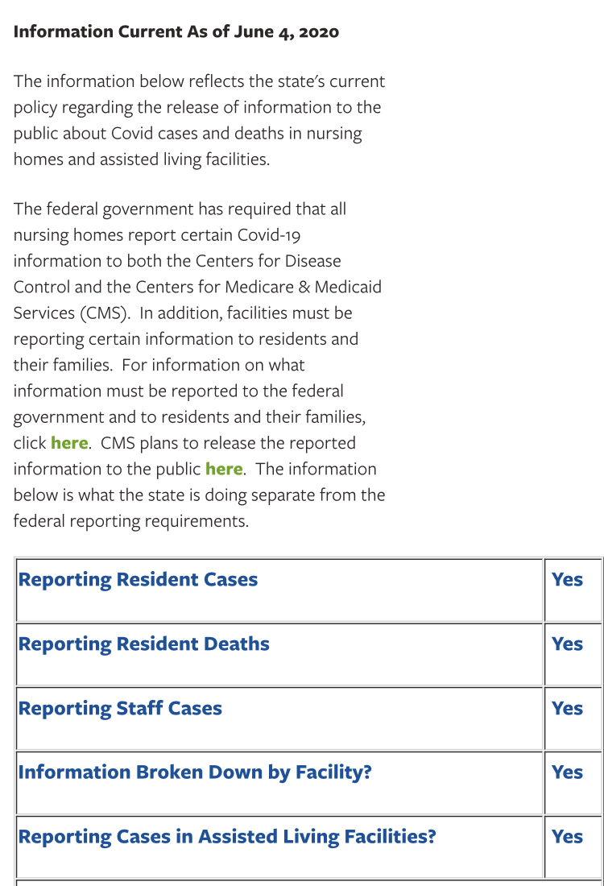
What does the facility have to report?
STATE REQUIREMENTS:
Many states have their own individual requirements
State COVID-19 Nursing Home Policies:
https://theconsumervoice.org/state-information

Slide 38
So what should I be asking?
Make sure that the facility is giving you the information they are required to share!
Ask them for more! Ask for regular updates! There is no reason that families are not receiving public information.
Individual advocacy
Work with your family council

Slide 39
Where else can I find information?
Federal information:
CMS made State and facility level information available to the public in early June 2020.
https://data.cms.gov/stories/s/COVID-19-Nursing-Home-Data/bkwz-xpvg
State information:
State COVID-19 Nursing Home Policies:
https://theconsumervoice.org/state-information

Slide 40
Covid-19 Testing Hypothetical
Mrs. Smith suffers from advanced dementia. She tends to become distressed when the facility performs invasive procedures, such as blood tests.
The facility contacts her daughter, who is her designated representative, and tells her that the facility will be testing all residents for Covid-19 using a nasal swab.
Daughter/representative is gravely concerned that her mother will not tolerate the intrusive procedure and it will cause her distress.
Can daughter/representative refuse testing on Mrs. Smith’s behalf?

Slide 41
Testing Continued
Mrs. Smith has a right to designate a representative who can exercise her rights. 42 C.F.R. § 483.10(b)(3).
The facility must treat the decisions of the representative as the decision of Mrs. Smith. 42 C.F.R. § 483.10(b)(4).
Mrs. Smith, and therefore, her representative, has the right to refuse treatment. 42 C.F.R. § 483.10(c)(6).

Slide 42
Testing Continued
Request alternative form of testing.
Could be quarantined for 14 days.
Could be threatened by facility with discharge.
Contact local ombudsman
Contact state licensing agency

Slide 43
Join With Others
State advocacy groups
Citizen advocacy groups https://theconsumervoice.org/get_help
AARP state chapters
Other groups?
Long-Term Care Ombudsman Program https://theconsumervoice.org/get_help
Consumer Voice
Join Action Network https://act.theconsumervoice.org/join-action-network

Slide 44
RESOURCES
Consumer Voice: COVID-19 in Long-term Care Facilities:
https://theconsumervoice.org/issues/other-issues-and-resources/covid-19
Keeping Families Together Checklist:
http://eldermistreatment.usc.edu/wp-content/uploads/2020/06/NCEA_KeepingFamilysTogether.pdf
Should I Take My Loved One Home During the COVID-19 Crisis: http://eldermistreatment.usc.edu/wp-content/uploads/2020/06/CV_TakingAResidentHome.pdf

Slide 46
The National Consumer Voice for Quality Long-Term Care
www.theconsumervoice.org
Robyn Grant: rgrant@theconsumervoice.org
Jocelyn Bogdan: jbogdan@theconsumervoice.org
Sam Brooks: sbrooks@theconsumervoice.org
Patty Ducayet: patricia.ducayet@hhsc.state.tx.us

