Slide 1

Balancing privacy & protection
Surveillance Cameras in Nursing Home Residents’ Rooms
Tuesday, September 12, 2017
Notes:
Good afternoon and thank you for joining us for today’s webinar, “Balancing Privacy & Protection: Surveillance Cameras in Nursing Home Residents’ Rooms.”
This is Lori Smetanka, Executive Director of Consumer Voice and we are hosting this webinar in collaboration with the National Center on Elder Abuse (NCEA).

Slide 2
Agenda
Julie Schoen, Deputy Director, National Center on Elder Abuse (NCEA)
  NCEA
Lori Smetanka, Executive Director, Consumer Voice
  Considerations for surveillance
Bill Whited, State LTC Ombudsman, Oklahoma
  Oklahoma’s statute governing use of cameras in residents’ rooms
Notes:
The purpose of today’s webinar is to…
After a quick overview of webinar logistics and introduction to Consumer Voice we will hear from Julie Schoen, Deputy Director, NCEA, then I will ..
All lines will be muted during the presentations, but we will have time for questions after all of the presentations. If you have a question, please post your question using the chat feature on the right-side of your screen. We will keep track of incoming questions and do our best to respond during the open discussion portion of the webinar. You also have the option of raising your hand to ask a question and we will unmute your line.
This webinar is being recorded and will be available on our website with the resources mentioned during this training in the near future.

Slide 3
The Consumer Voice
The National Consumer Voice for Quality Long-Term Care (Consumer Voice) is a national, non-profit organization in Washington, D.C. that advocates for people receiving care and services at home, in assisted living, or in a nursing home.
Clearinghouse of information and resources for empowering consumers, families, caregivers, advocates and ombudsmen in seeking quality care, no matter where.
Provide technical assistance and support for state advocacy regarding long-term care services and supports and have a national action network.
Notes:
For those of you not familiar with our organization we are a national, non-profit organization that advocates for people receiving long-term care services and supports in all settings- in their own home, assisted living, or NH. We have a clearinghouse of information and resources to empower consumers, families, LTCO, and others in advocating for quality care, no matter where. We also provide technical assistance and support for state advocacy regarding LTCSS and have a national action network.
Before I move into discussing quality care, I want to welcome Julie Schoen, Deputy Director of the National Center on Elder Abuse on to say a few words.

Slide 4


THE NATIONAL CENTER ON ELDER ABUSE
Funded by a grant from the Administration on Community Living and Administration on Aging (ACL/AoA), serving as one of 27 National Resource Centers. The NCEA is a provider of up-to-date, pertinent and valuable resources, education, and information on elder abuse and neglect.
As a leader in the elder justice movement, we:
Create valuable educational resources
Provide training curricula tailored to a variety of audiences
Deliver up-to-date research
Build partnerships and make connections
Explore innovative models
Listen to what the field needs
Take advantage of opportunities to advance the field
Communicate our efforts
Envision our goals for tomorrow

Slide 5
Why electronic monitoring?

Slide 6


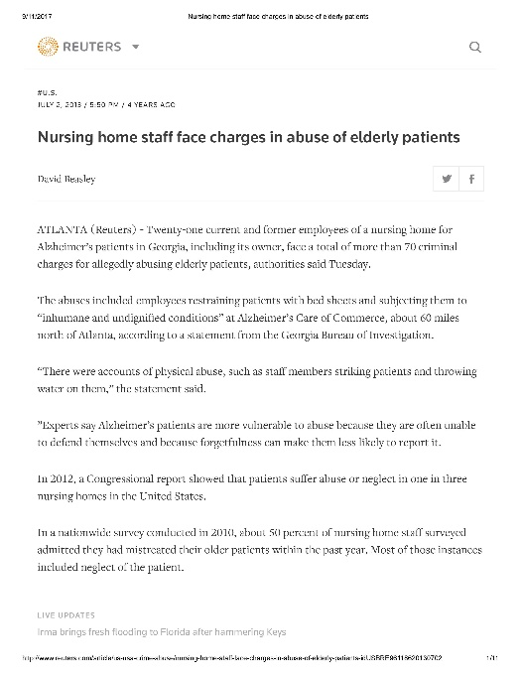
Why Electronic Monitoring?
Concerns of poor care
Unexplained bruises, injuries
Resident inability to verbally communicate
Changes in resident behavior
Lack of response to expressed concerns

Slide 7
Video & Audio Recordings
Electronic monitoring can include video recordings, audio recordings or both
Cameras or recording devices placed in a resident’s room – or part of a room – to capture what takes place

Slide 8
Capturing the good, the bad, and the ugly
What we’d like to see
Kindness,
Tenderness, &
Good care practices
What else it can show
Rough handling
Bullying
Neglect
Abuse

Slide 9
Residents Rights
Dignity, Respect, Privacy

Slide 10
Right to Quality Care
Quality Care
  Is individualized to meet the care needs and preferences of each resident.
  Promotes resident dignity, choice, and self-determination in all aspects of life and care.
  Improves, or maintains, the highest practicable well-being of each resident.
Notes:
Regardless of where an individual receives long-term care services and supports they are entitled to receive quality, individualized care.
What does quality care mean?
Quality care promotes resident dignity, choice, and self-determination in all aspects of life and care.
Providing quality care means that each resident’s care is individualized in order to meet their needs and preferences. In order to determine care needs and preferences staff must work with the resident and their family members and/or representatives in order to gain a comprehensive understanding of what is important to them in their daily life and how they can best meet their care needs. Residents may have limited capacity due to dementia or mental illness, but they should be involved in their daily care and life decisions as much as possible.

Slide 11
Rights, Law, and Regulations
All residents have:
  the same rights as those in the larger community plus additional protection in federal and/or state law and regulation.
  the right to be protected from mistreatment, including abuse, neglect, and exploitation and are entitled quality, individualized care.
Notes:
Individuals living in nursing homes and assisted living facilities maintain the same rights as individuals in the larger community and have additional rights and protections in federal and/or state law.
All residents, regardless of the type of facility, have the right to be protected from mistreatment, including abuse, neglect, and exploitation.
Nursing homes must meet federal requirements in order to participate in Medicare and Medicaid. Those requirements include residents’ rights and require that residents receive services and activities that “attain or maintain the highest practicable physical, mental, and psychosocial well-being of each resident in accordance with a written plan of care” and that facilities “care for its residents in such a manner and in such an environment as will promote maintenance or enhancement of the quality of life of each resident.”
There are no federal regulations for assisted living facilities (also known as board and care or personal care homes) so requirements are different in each state.
Despite these regulatory differences among nursing homes and assisted living the indicators of quality care and advocacy steps we will discuss today are applicable in all long-term care facilities.

Slide 12
Dignity & Respect
Interactions with staff, residents, visitors
  Spoken to kindly
  Treated respectfully
  No verbal harassment, yelling, bullying
  No compromising or undignified photos or recordings
While receiving care
  No rough handling
  No compromising or undignified photos or recordings
  Follow appropriate care guidelines

Slide 13
Privacy
In rooms
During personal care
In communications

Slide 14
State actions
Laws, Guidelines, and Other Activities

Slide 15
Does Your State Have a Law or Guideline?
Illinois
New Mexico
Texas
Washington
Maryland
Laws
Guidelines

Slide 16
Laws & Guidelines Address:
Consent
Notice requirements
Assumption of costs
Penalties for obstruction or tampering
Access to the recordings
Use of the records

Slide 17
Other State Practices
New Jersey
Ohio
Office of Attorney General loans camera equipment to families
Office of Attorney General will place cameras in certain circumstances

Slide 18
Electronic Monitoring in Oklahoma Nursing Homes
Effective November 1, 2013
William “Bill” Whited, State Long-Term Care Ombudsman
Notes:
Mature Person Design Slide, perfect for any presentation that highlights mature persons, senior living, maturity, wellness, or retirement. Modern template that's perfect for an psychology, healthcare, exercise, retirement (or financial retirement products) presentation. Can be used for business or home use. 8 x 11, landscape orientation. Graphic features smiling young adults; a diverse group. You can modify the graphic and add one of the thousands available from Microsoft Office. Sample chart and table slides included. Additional super easy templates, visit www.supereasytemplates.com. Download more slides for .99 cents each! We’d love to hear from you. Tell us what you think of our presentation design slides, email us at support@supereasytemplates.com. We’d like to know what you like and what you don’t like! We’re always trying to grow and improve, so we look forward to hearing from you.

Slide 19
Oklahoma Nursing Home Care Act
§63-1-1953.1
"Authorized electronic monitoring" means the placement of electronic monitoring devices in the common areas or room of a resident of a nursing facility and the tapes or recordings from such devices pursuant to the provisions of this act;
"Authorized electronic monitoring devices" means:
a. video surveillance cameras installed in the common areas or resident's room under the provisions of this act, or
b. audio devices installed in the room of a resident under the provisions of this act that are designed to acquire communications or other sounds occurring in the room;

Slide 20
Protections in Electronic Monitoring statute
§63-1-1953.2, 1953.3, and 1953.4
Written notice from the facility;
Cannot refuse admittance or discharge because of the use of said device;
Facility shall post notice near its main entrances;
Tamper with or hampering is a crime;
Cannot intercept communications or images without express consent of the facility (common area) or resident.
Recordings can be admitted into evidence in both civil and criminal proceedings

Slide 21
What Powers or Limitations are there for Resident/Representative?
§63-1-1953.5 and 1953.6
Must obtain written consent from roommate/representative before placing the monitoring device
  Limitations can be required by roommate
  Roommate May deny (facility must allow a change of room if they do)
  Specific form must be used
Must provide written notice to the facility of the use of electronic monitoring;
All associated cost are theirs;
May post notice of monitoring at entrance of the room;

Slide 22
What’s the Outcome of the Electronically Monitoring Law?
Deterrence;
Irrefutable evidence of abuse or neglect;
A sense of safety/empowerment;
Privacy concerns;
Exacerbated paranoia;
Competing interests of the resident(s), their representative(s) and the facility;
Overt obstruction;
Statistically the numbers of substantiated abuse and neglect remain relatively unchanged.

Slide 23
Links to Oklahoma Statute and Forms
NURSING HOME CARE ACT and LONG-TERM CARE SECURITY ACT -TITLE 63 OF THE OKLAHOMA STATUTES
  https://www.ok.gov/health2/documents/HRDS%20675%20NHCA%201113.pdf
Consent by Roommate Form
  https://www.ok.gov/health2/documents/LTC%20Consent%20By%20Roommate%20For%20Authorized%20Electronic%20Monitoring.pdf
Notice to Facility Form
  https://www.ok.gov/health2/documents/LTC%20Consent%20Form%20Notice%20to%20Facility%20for%20Authorized%20Electronic%20Monitoring.pdf

Slide 24
Questions and Discussion
Contact Information
William “Bill” Whited
Oklahoma State Long-Term Care Ombudsman
William.Whited@OKDHS.org
405-521-6734

Slide 25
considerations
Before Placing Electronic Recording Devices

Slide 26
Get Legal Advice
Prior to installing a surveillance camera or other recording device, we recommend that residents and families consult an attorney to discuss their rights and options.

Slide 27
State Laws or Guidelines
Read and understand your state’s laws or guidelines
Failure to comply has consequences
  Specific forms that must be used?
  Specific notification requirements?
  Obtaining consent from roommates or legal representatives (if applicable)
If no law or guideline –
  GET LEGAL ADVICE
  Consider the elements of laws passed

Slide 28
What type of recording?
Video, audio, or both?
  Video is generally focused on a single resident
  Audio has a broader scope – other parts of the room, hallways, in-room bathrooms
Are there different considerations for consent and notification?
  Wiretapping laws

Slide 29
Facility policies
Be aware of any facility policies around electronic monitoring
Be sure to follow any state law or guideline
Get legal advice to understand your rights and responsibilities
Our position: A resident should have the right to install a surveillance camera or other monitoring device

Slide 30
Consent
Resident and Roommate
Capacity issues – consent from legal representative
How to document consent?

Slide 31
Notification of the Device
What information needs to be shared?
Who needs to be notified?
  Facility administration?
  Staff?
  Other residents?
  Visitors?
How is the notification provided?
  Signs in the facility – where do they need to be placed?

Slide 32
When and How the Device Will Be Used
Will the camera or recording device be on all the time?
Are there times when you (the resident) would like it turned off, such as while you are receiving personal care? Or when you have visitors?
Who will turn the device on/off? How will this be communicated to that person?

Slide 33
Installation, Maintenance, Upkeep
Who will be responsible for installing and maintaining the recording device?
Who will be responsible for any costs associated with it?

Slide 34
Access to the Recordings
Who will be able to access the camera/recording device?
Viewing the recordings?
How will they be used?

Slide 35
Relationship With Staff
Recognize that use of a recording device may impact the relationship with facility staff
For some – distrust, paranoia

Slide 36
Cameras are No Substitute
For Personal Involvement

Slide 37
Cameras are a tool
Cameras, recording devices are no substitute for
  personal involvement,
  regular and vigilant monitoring of care,
  sufficient, well-trained staff
A tool that provides information

Slide 38
Getting help
If You Suspect Poor Care, Abuse, Neglect

Slide 39
Getting Help
Facility’s administrator, director of nursing, social worker, or other trusted staff-person
Long-Term Care Ombudsman Program
State Survey Agency that licenses the facility
Protection and Advocacy or Adult Protective Services
Citizen Advocacy Group
Law Enforcement

Slide 40
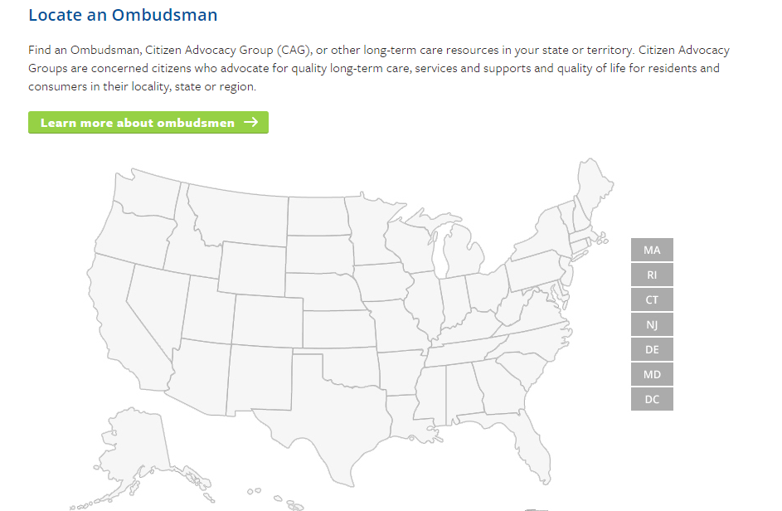
How to Contact the LTCOP
Nursing homes are required to post contact information for the LTCOP and some states require assisted living facilities/board and care facilities to post information about the LTCOP.
Visit the National Long-Term Care Ombudsman Resource Center website to locate your local or state LTCO: http://www.ltcombudsman.org/
Notes:
As you can see LTCO handle a variety of concerns and are resident advocates in all aspects of their work. To get more information about the LTCOP or find out how to contact your state or local program, visit our website. Using the map you can search for your state and local LTCOPs, state survey agency, APS, Medicaid agency, and other state entities.

Slide 41
Questions?

Slide 42
resources

Slide 43
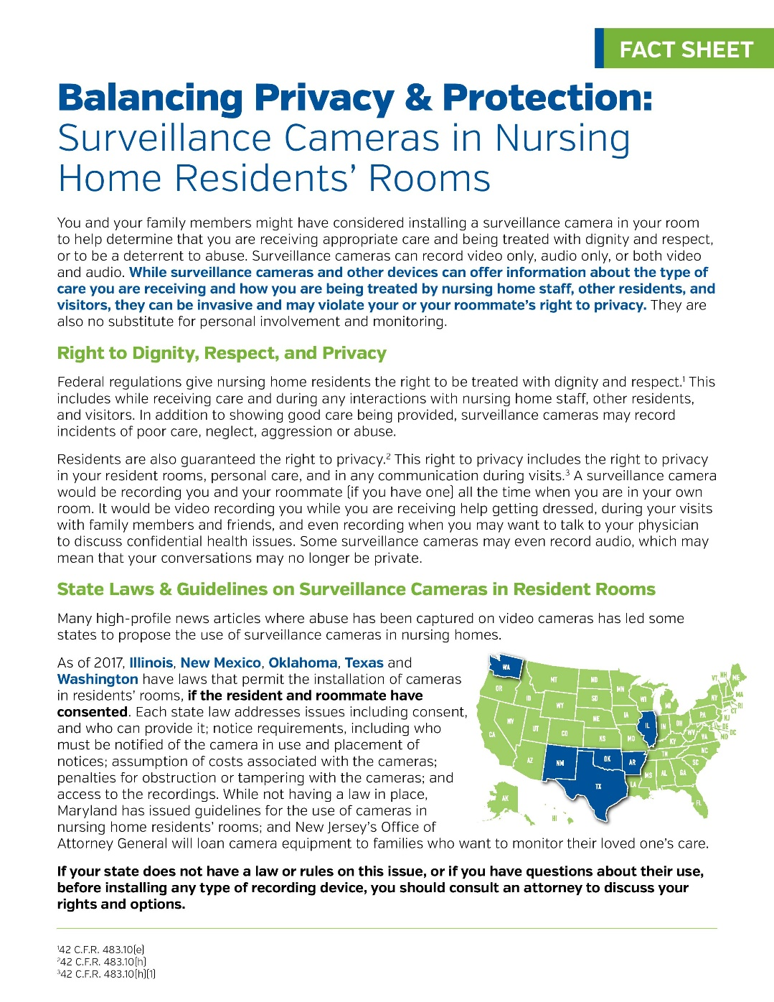
Fact Sheet

Slide 44
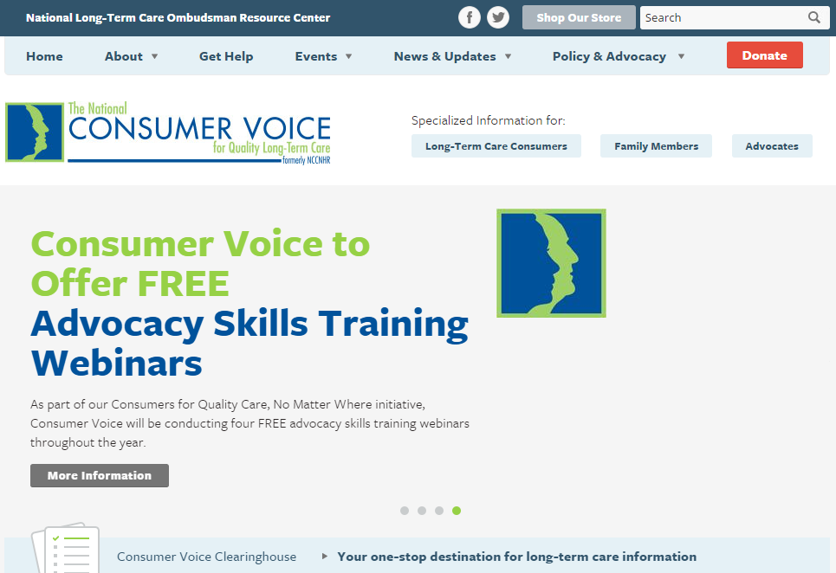
www.theconsumervoice.org
Notes:
Our organization is the leading advocacy for consumers receiving long-term care services and supports and we have a wealth of information available to support consumers, family members, and other in advocating for quality care.
As you can see in the red circle we have specific information for long-term care consumers, family members, and advocates, once you click on those tabs you will be directed to a variety of materials. We have information available for residents in nursing homes, assisted living, and those receiving home and community based services.

Slide 45

Fact Sheets
  Assessment and Care Planning
  Basics of Individualized Care
  Residents’ Rights
  Guide to Choosing a Nursing Home
  Abuse and Neglect
  Emergency Preparedness
  Restraint Free Care
Resident and Family Council information
Guides
  Piecing Together Quality Long-Term Care: A Consumer’s Guide to Choices and Advocacy
  Nursing Homes: Getting Good Care There
Notes:
Here are just a few examples of the types of resources we have available for consumers, family members, and advocates.

Slide 46




The National Center on Elder Abuse
The goal of the NCEA is to improve the national response to elder abuse, neglect, and exploitation by gathering, housing, disseminating, and stimulating innovative, validated methods of practice, education, research and policy.
Find the NCEA Online!
ncea.aoa.gov
gero.usc.edu/cda_blog/
NationalCenteronElderAbuse
@NCEAatUSC
Notes:
As we shared earlier this webinar and new fact sheet were products developed in collaboration with the NCEA and you can find the NCEA online at their main website, blog, Facebook page and twitter.

Slide 47


Connect with us online!
www.theconsumervoice.org
National Consumer Voice for Quality Long-Term Care
@ConsumerVoices
Notes:
In closing, I would like to thank NCEA for their support and collaboration on this webinar and specifically Julie Schoen for her presentation earlier, Bill Whited for his review of Oklahoma requirements and it’s applications, and thank YOU for joining us today.
The webinar recording and all materials will be posted on our website soon.
For additional resources and visit our website and connect with us on Facebook and Twitter. If you are looking for something specific or have any questions/comments, please let us know how we can help you.
Also, once the webinar ends you will be directed to a quick evaluation and we encourage you to complete the evaluation as your feedback is important to us.

